Slide 1

STOCK TRADING SIMULATION SYSTEM
CAPSTONE PROJECT

Slide 2
Team members

Slide 3


Contents
Introduction
Project Management
Requirement Specification
System design
Testing
Summary
Demo

Slide 4
Introduction
1
Problem abstract
2
Existing systems
3
Idea
4
Proposal

Slide 5
Introduction
1
Problem abstract

Slide 6

Introduction
1
Problem abstract

Slide 7
Introduction
2
Existing systems
 | FUNCTION | hoclamgiau.vn | estock.com.vn | scue.vn
1 | IPO |  |  | x
2 | Periodic and continuous matching engine | x | x | x
3 | Stock price calculating |  |  | x
4 | Order and account checking SMS |  | x
5 | Trading history management | x |  | x
6 | Stock management | x | x | x
7 | Notification

Slide 8
Introduction
3
Idea
Provides stocks information
Basic functions of HOSE real stock exchange
No need money
To learn and practice stock trading

Slide 9
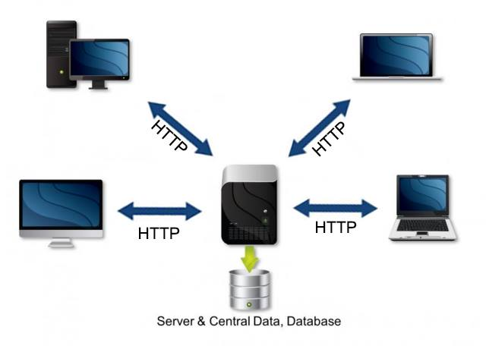


Introduction
4
Proposal
IPO
Periodic and continuous matching engine
Stock price calculating
Trading history management
Stock management
Notification

Slide 10
Project Management
1
Project organization
2
Process model
3
Project planning
4
Risk management plan
5
Team communication

Slide 11
Project Management
1
Project organization
Supervisor (Mr.TrungNT)
Project Manager (VietTQ)
SRS Team
VietTQ
QuangHD
Design Team
TuanPG
HuyPM
Coding Team
QuangHD
VietTQ
TuNN
TuanPG
HuyPM
Testing Team
TuNN
VietTQ
TuanPG

Slide 12
Project Management
2
Process model
Your text in here
Requirement
Design
Implementation
Verification
Maintenance

Slide 13
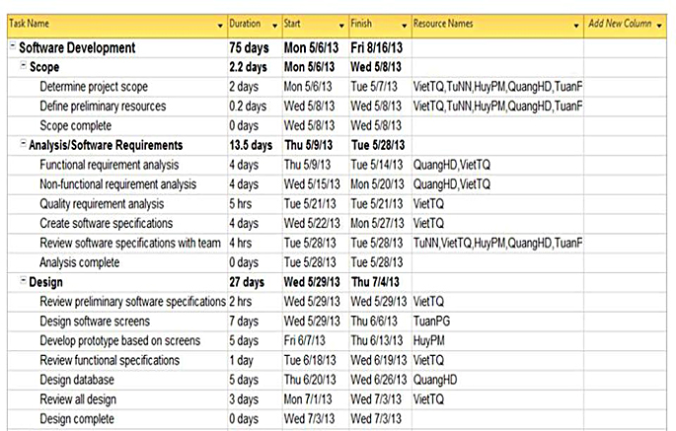
Project Management
3
Project planning

Slide 14
Project Management
4
Risk management plan

Slide 15
Project Management
No. | Risk | Avoidance Plan | Contingency Plan | Status
1 | Member is absent at critical times | Organize team so that there is more overlap of work and people | Assign different people to take responsibility | Closed
2 | Schedule slip | - Member: Send Daily Report to PM, raise issue when having trouble that they cannot solve on their own. - PM: Control members tasks base on project plan | Find the cause that make project behind schedule and work overtime to resolve this problem | Closed
3 | Requirements not clear | Technical Leader contact with customer 1 time a week and study from other website early in project | Raise to higher manager or customer | Closed
4 | Bug not fully detected | Test Leader must create scenario to run throughout the system and write test case to cover critical point that can cause bug | Raise to PM to assign member to fix bug immediately | Closed
5 | Software got problem during development progress | Check and use stable version of software. Often make backup version of project | Use other software that has similar functions with current software and use backup project version | Closed

Slide 16

Project Management
5
Team communication
Phone
Email
Trello, Assembla
Meeting face to face
Facebook

Slide 17
Project Management
Source control & Bug tracking
Assembla.com
Trello.com

Slide 18
Software Requirement
1
Functional Requirement
2
Non-functional Requirement

Slide 19

Software Requirement
Features
IPO
Periodic and continuous matching engine
Stock price calculating
Trading history management
Stock management
Notification

Slide 20
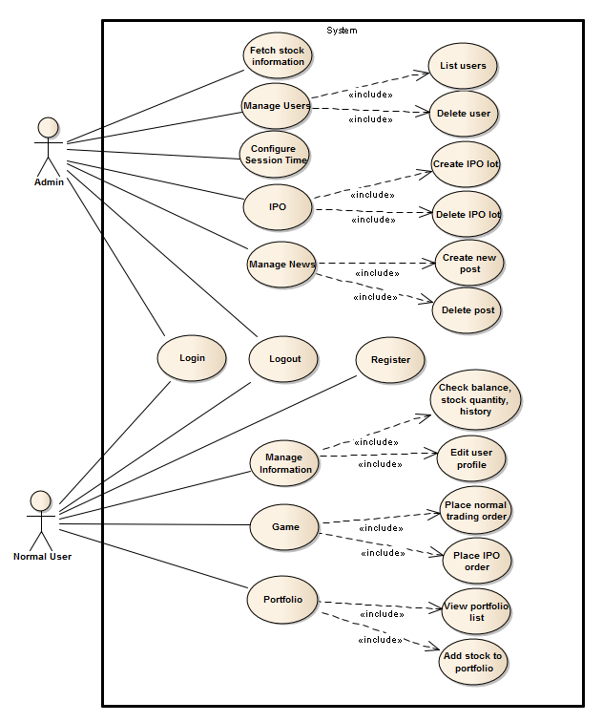
Software Requirement
Use case diagram

Slide 21
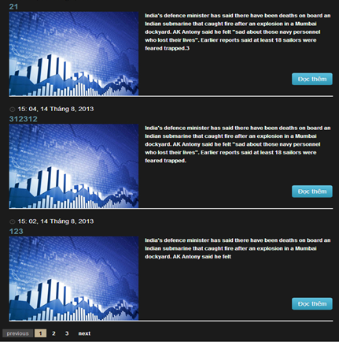
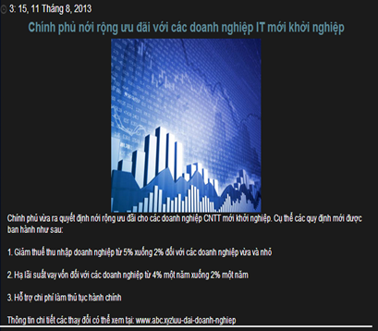
Software Requirement
List news
News detail

Slide 22
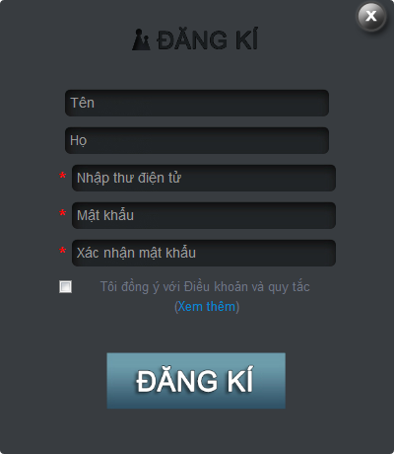
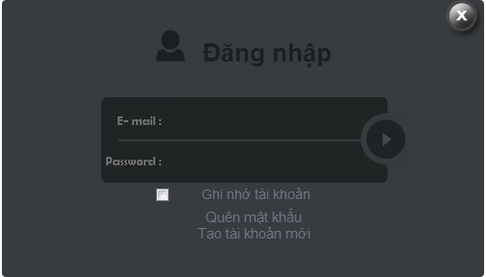
Software Requirement
Login
Register

Slide 23

Software Requirement
Admin
Normal User
Login

Slide 24
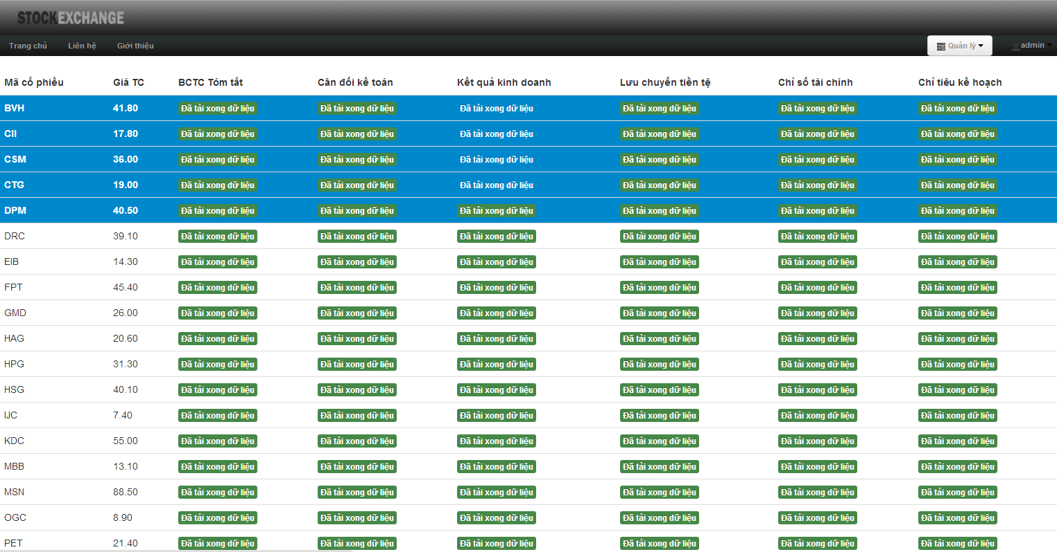
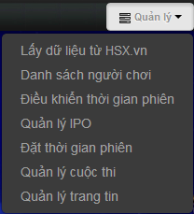
Software Requirement
Fetch data from HSX.vn

Slide 25
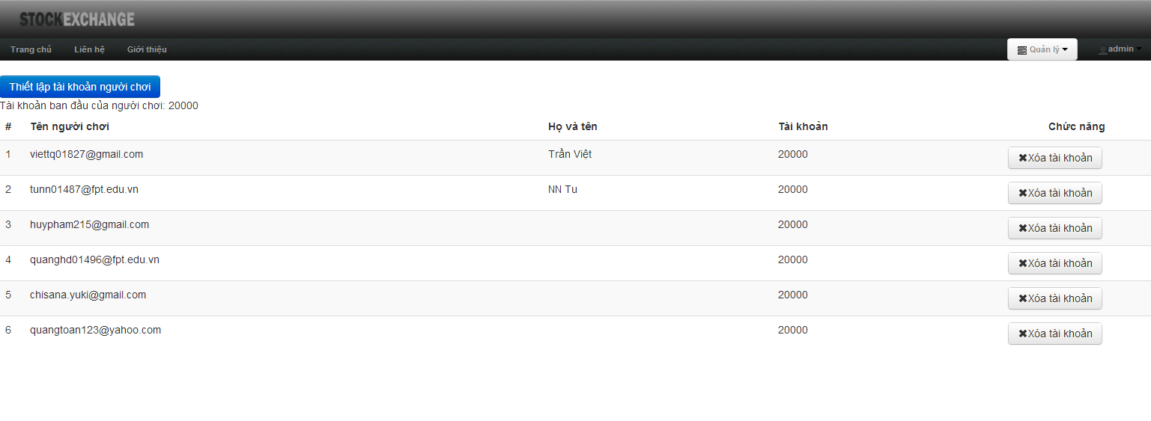
Software Requirement
Manage user

Slide 26
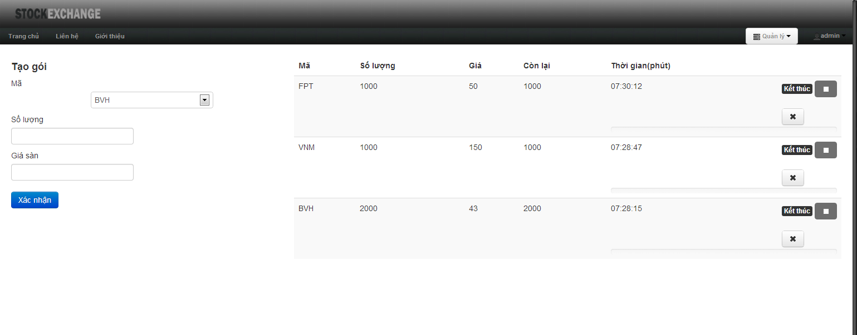

Software Requirement
Manage IPO

Slide 27
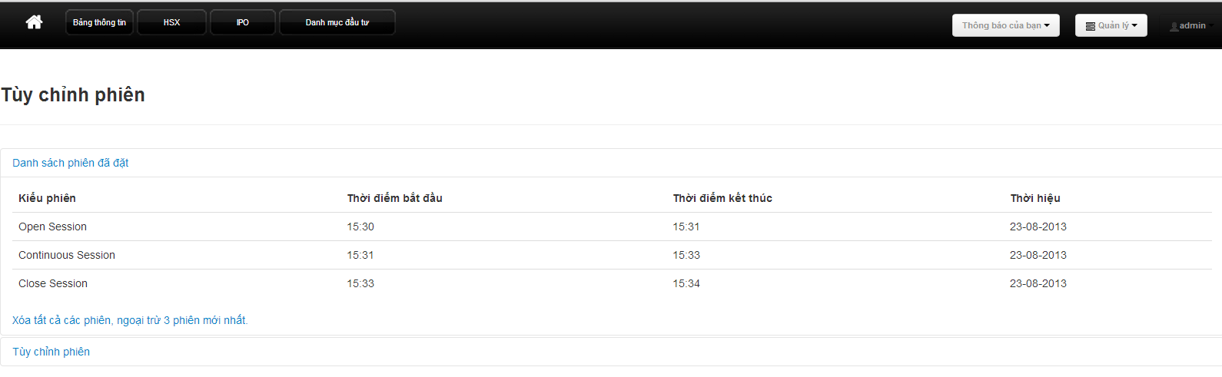
Software Requirement
Set time sessions

Slide 28
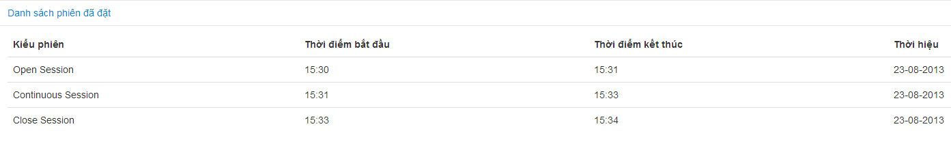

Software Requirement
List sessions
Delete sessions

Slide 29
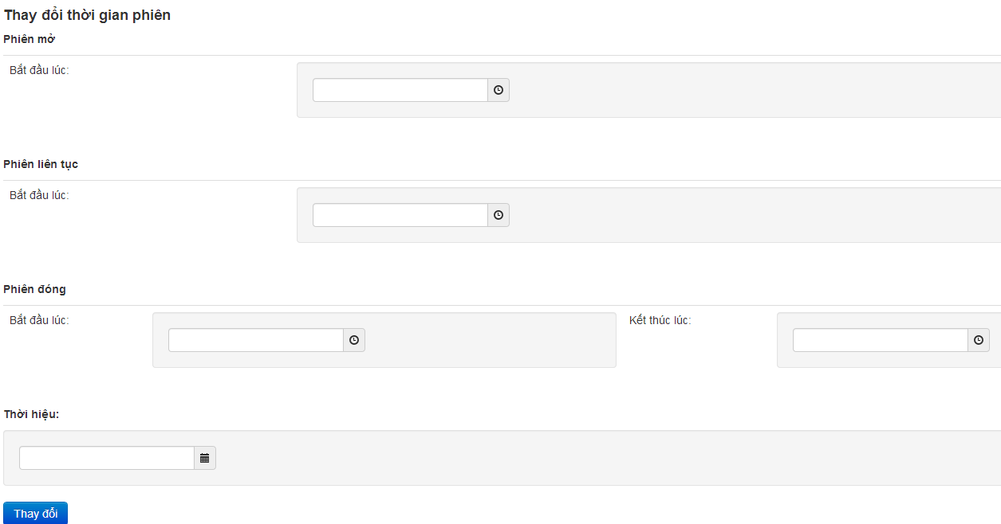
Software Requirement
Edit time sessions

Slide 30
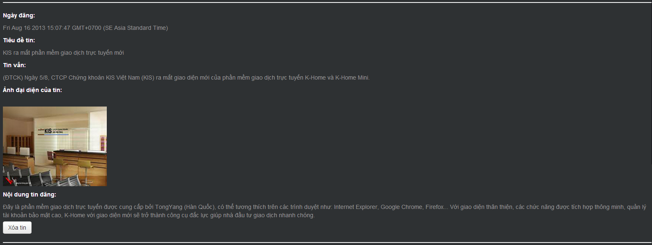
Software Requirement
Manage IPO
Manage news

Slide 31
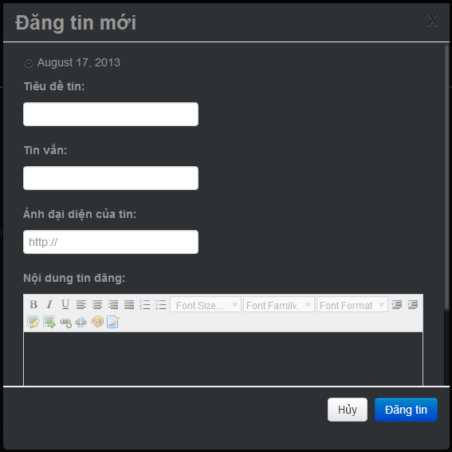
Software Requirement
Write news

Slide 32
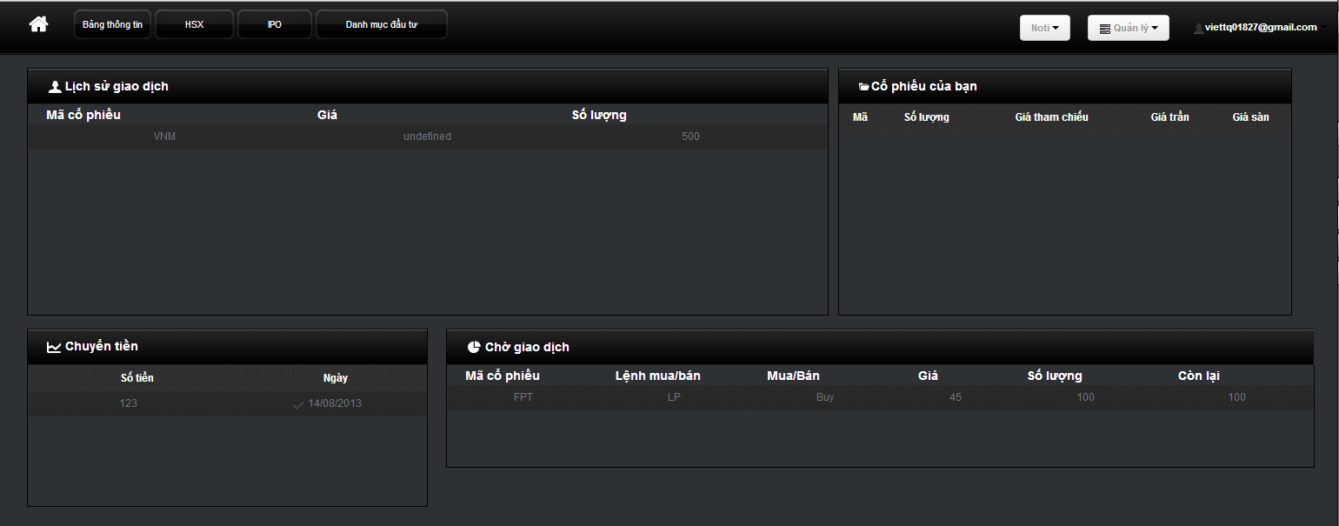


Software Requirement
Dashboard

Slide 33
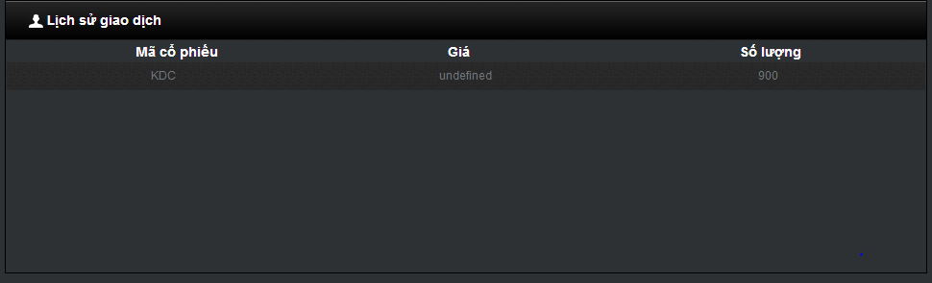
Software Requirement
History

Slide 34
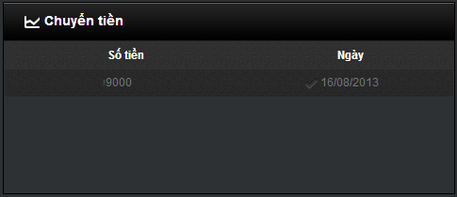
Software Requirement
Money transaction

Slide 35
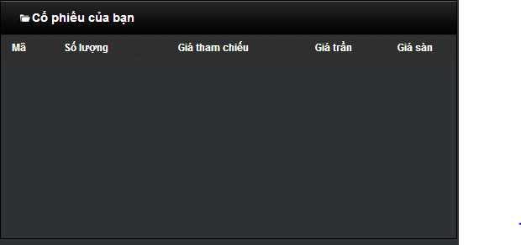
Software Requirement
Own stocks

Slide 36
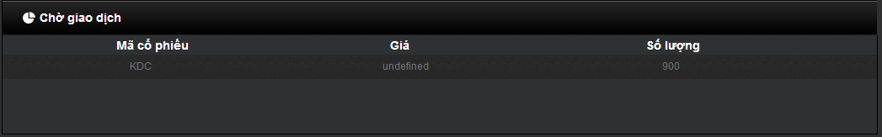
Software Requirement
Pending

Slide 37
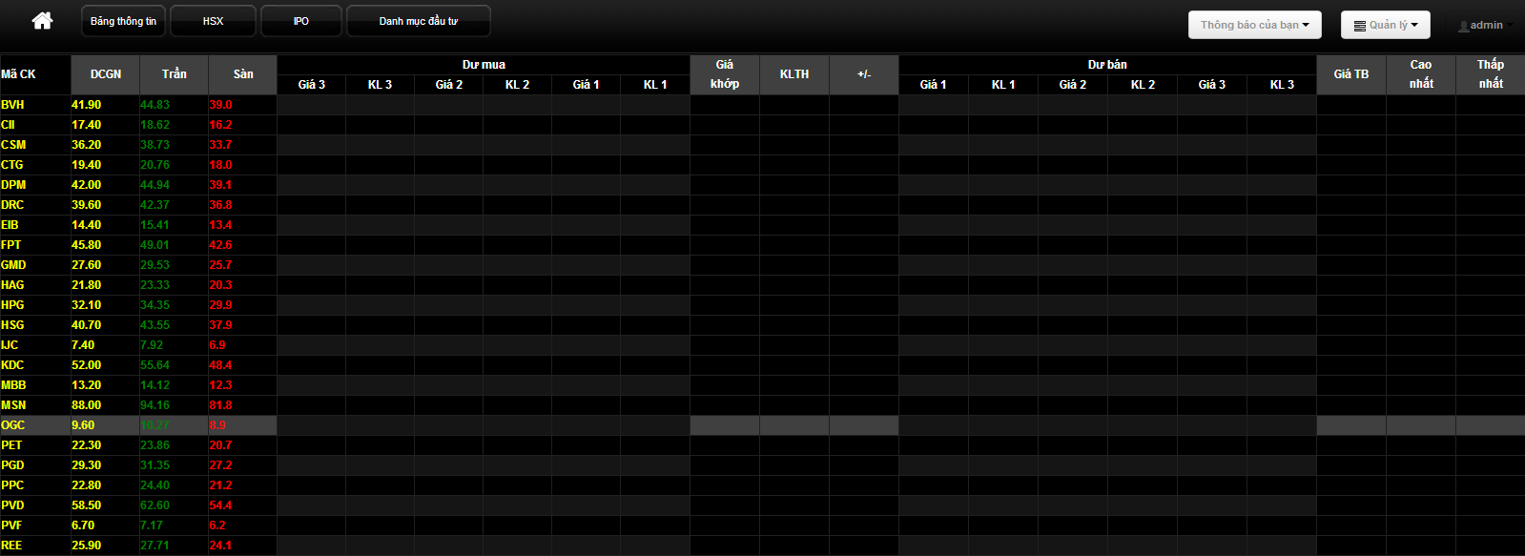
Software requirement
HSX

Slide 38
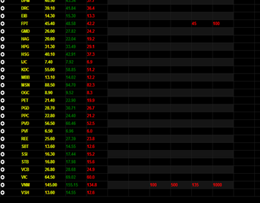
Software requirement
HSX in sessions

Slide 39
Software requirement
HSX in sessions

Slide 40
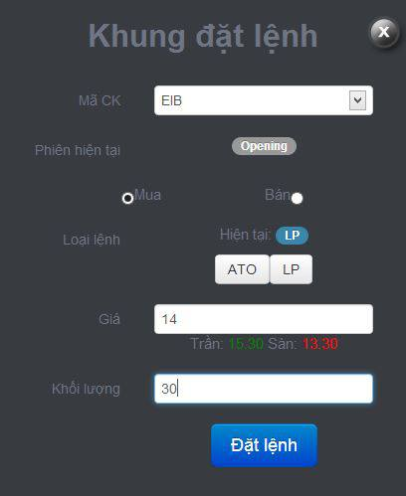
Software Requirement
Place orders

Slide 41
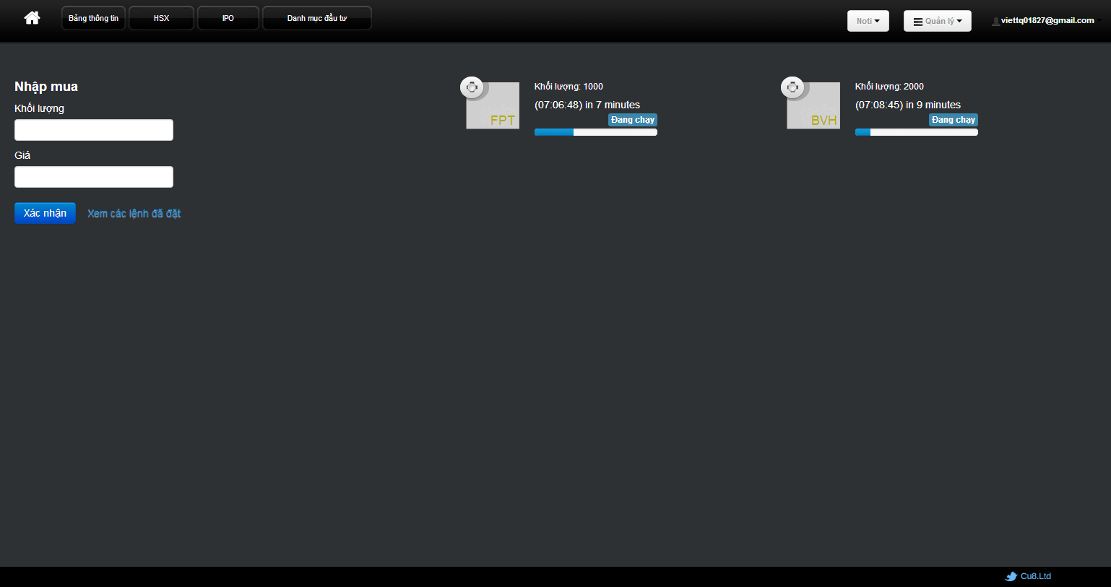
Software Requirement
IPO

Slide 42
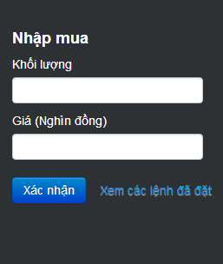
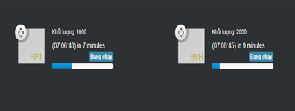
Software Requirement
IPO lots
Place IPO orders

Slide 43
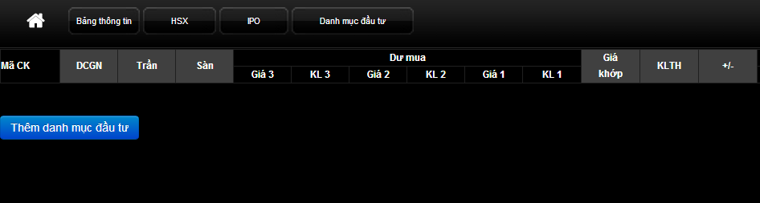
Software Requirement
Portfolio

Slide 44
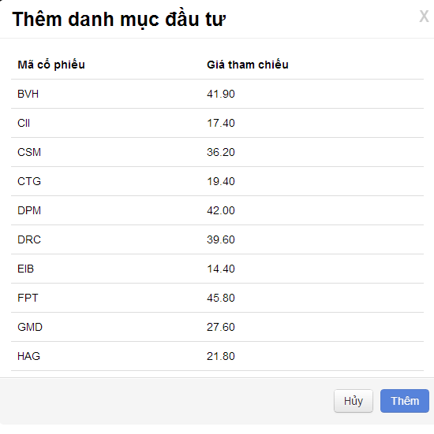
Software Requirement
Add Portfolio

Slide 45
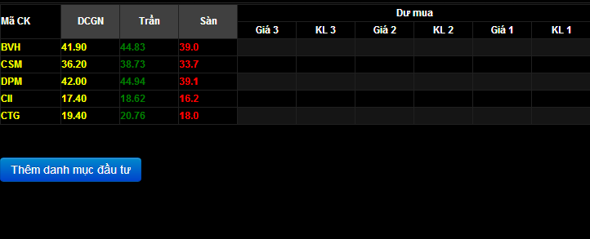
Software Requirement
Added Portfolio

Slide 46
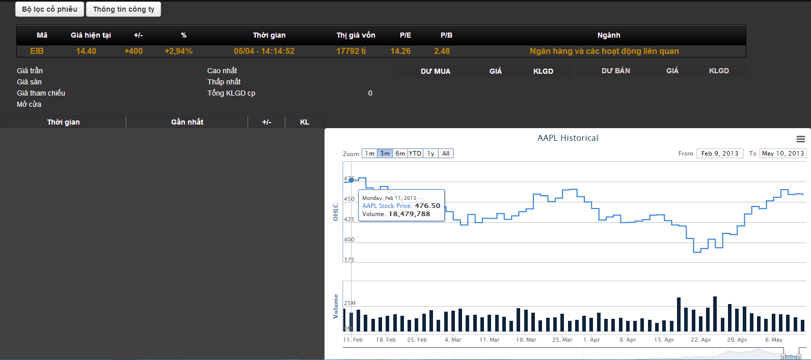
Software Requirement
Stock detail

Slide 47
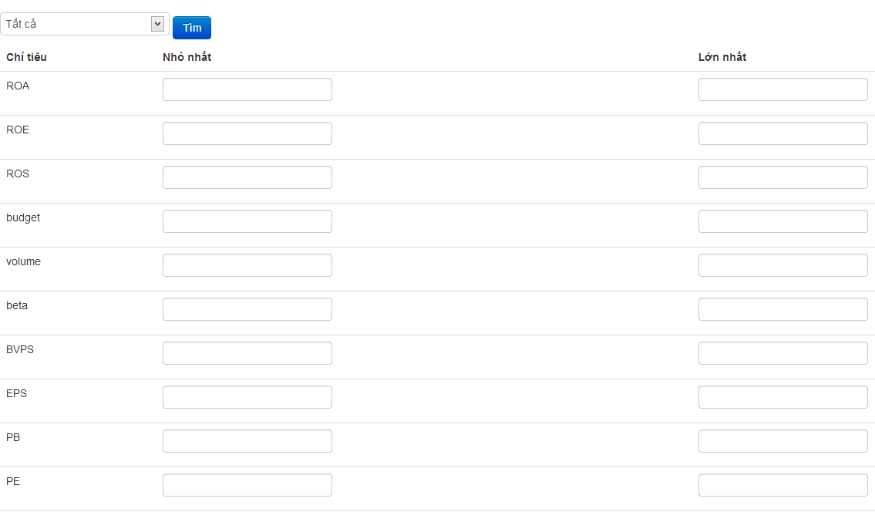
Software Requirement
Stock filter

Slide 48
Software Requirement
Stock filter

Slide 49
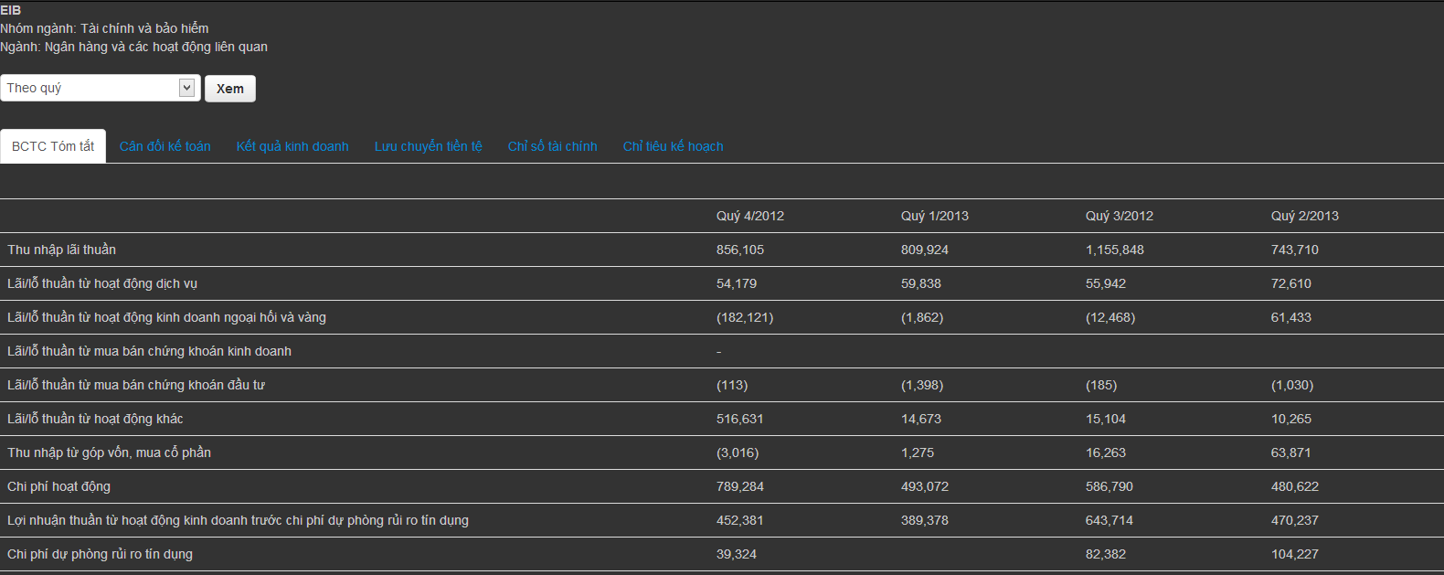
Software Requirement
Company detail

Slide 50
System Design
1
System architecture
2
Database design
3
Sequence diagram
4
Techniques

Slide 51
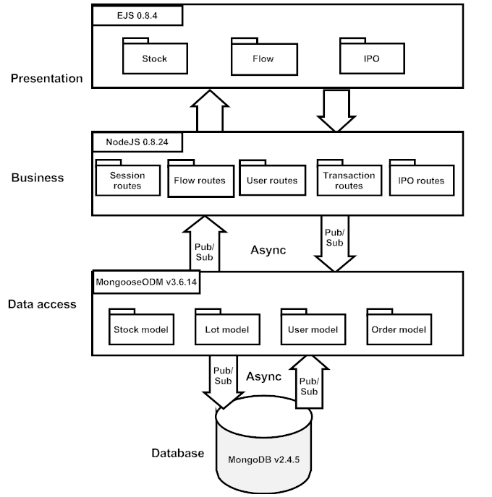
System Design
1
System architecture

Slide 52
System Design
2
Database design

Slide 53

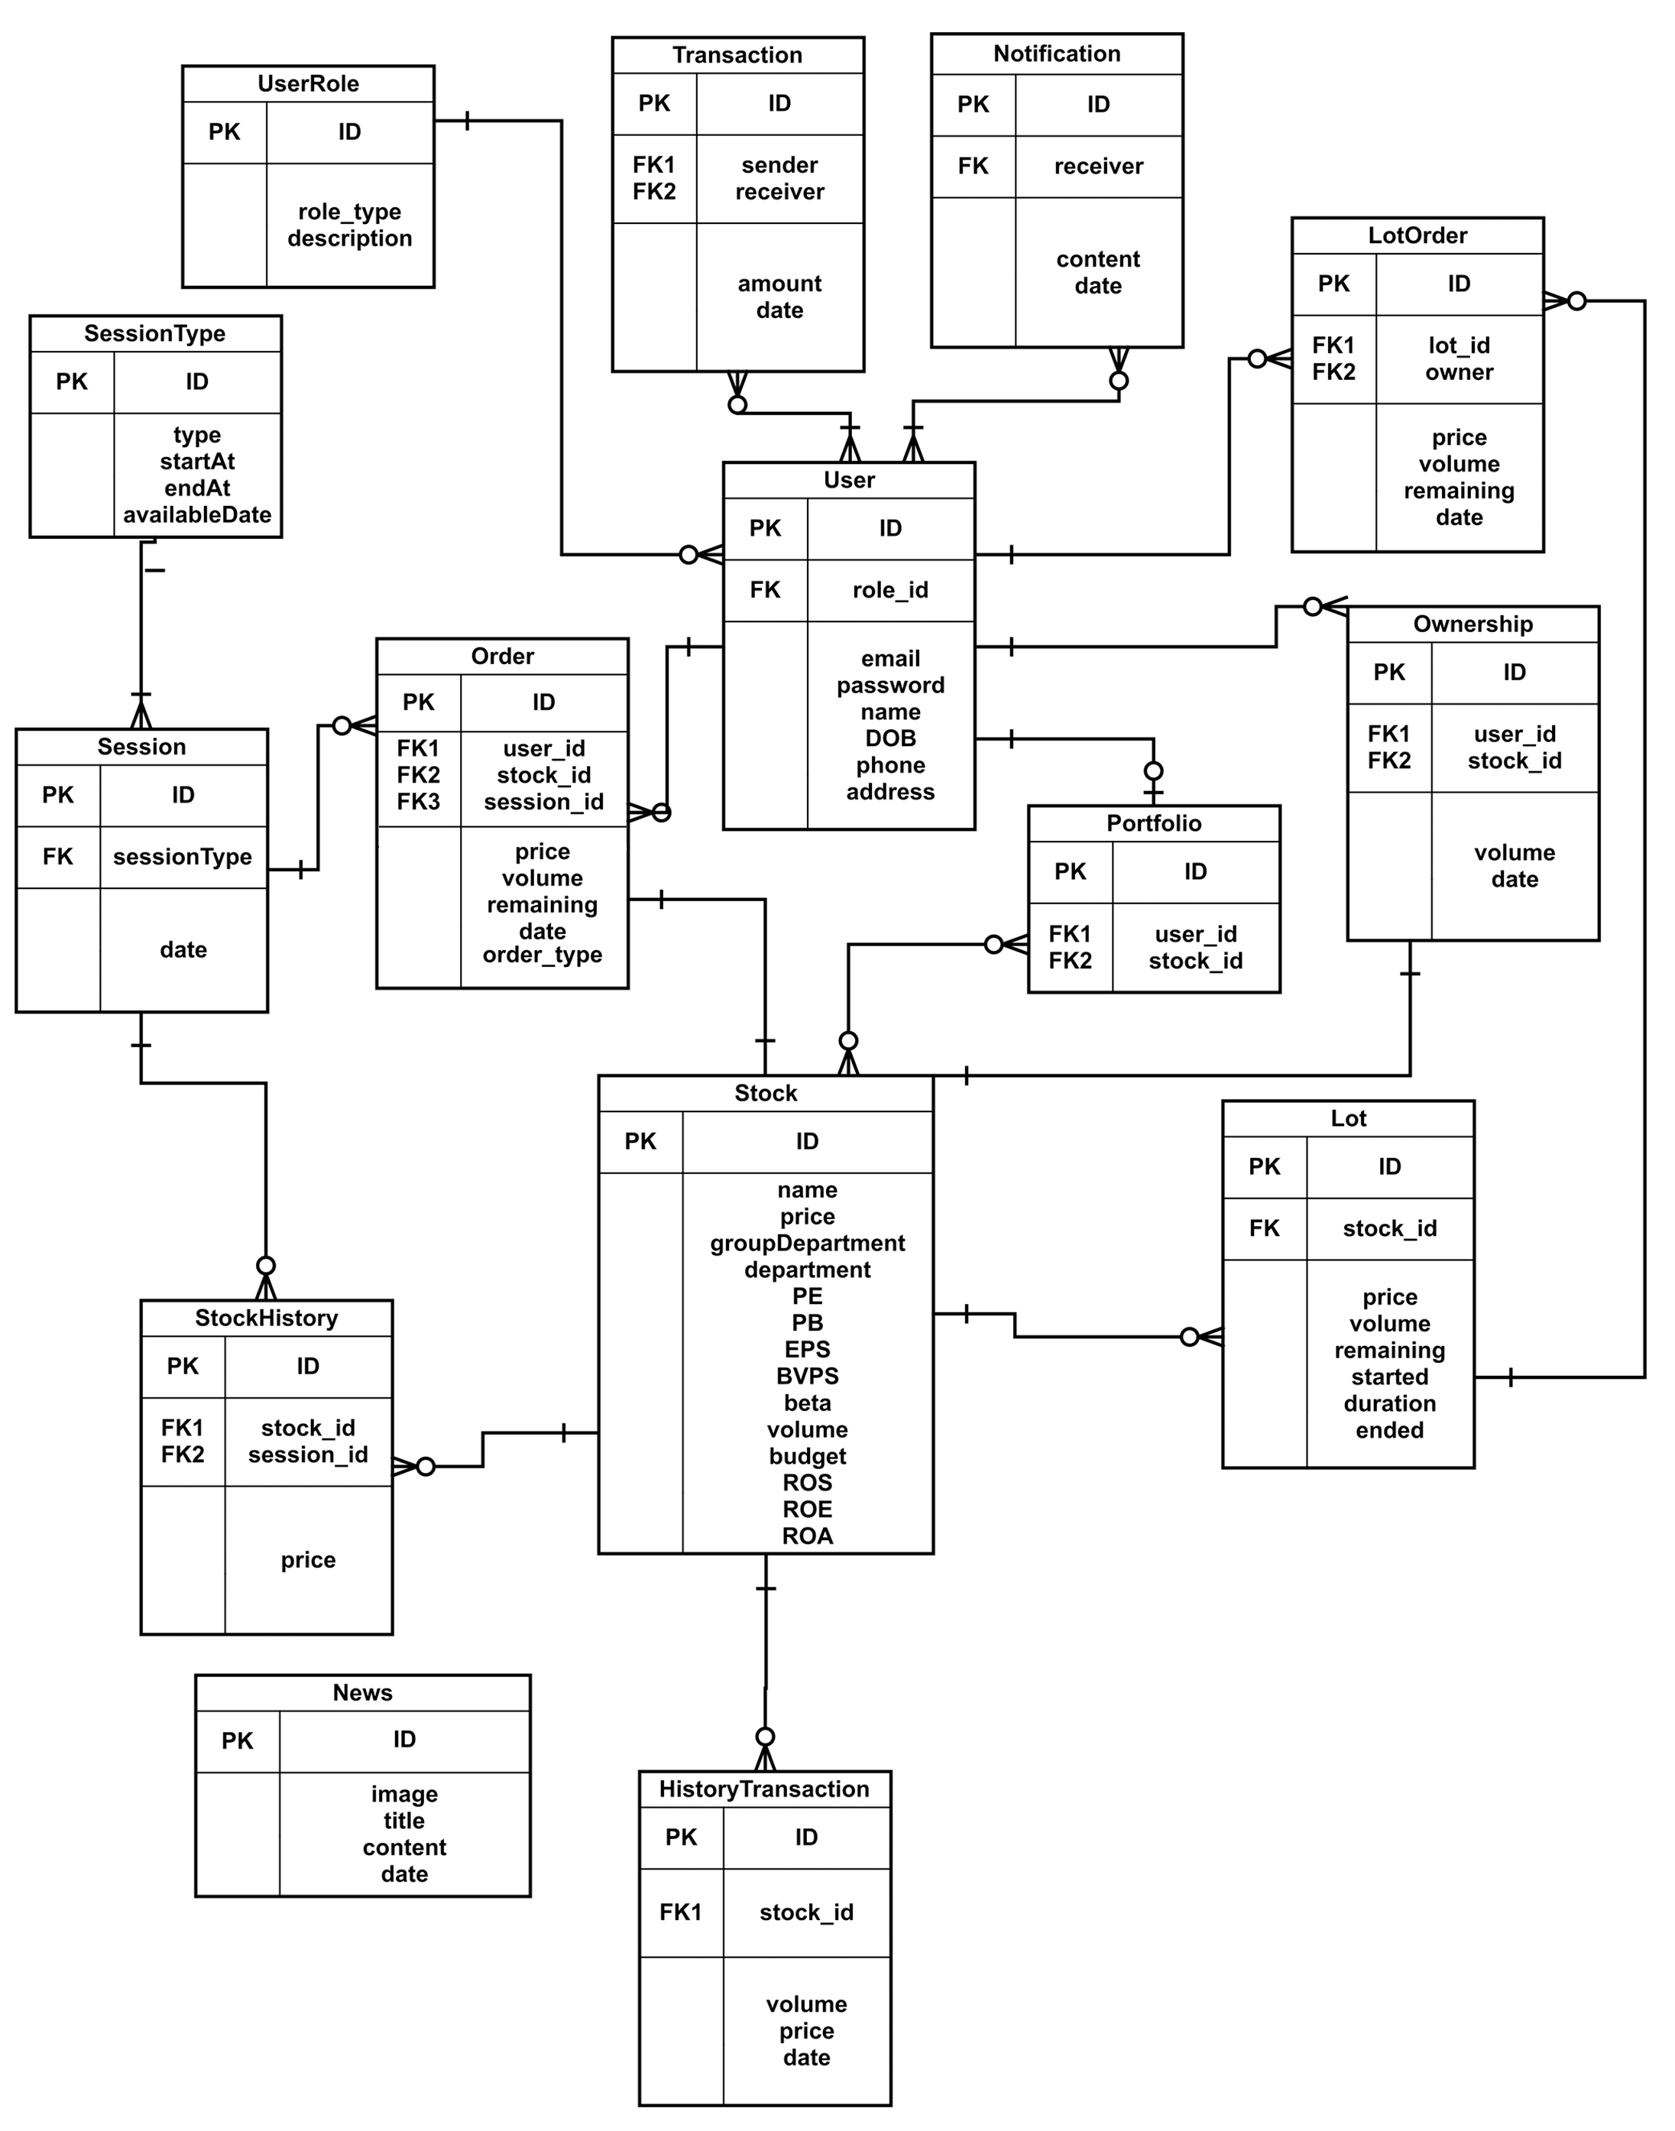

Slide 54
System Design
3
Sequence diagram

Slide 55
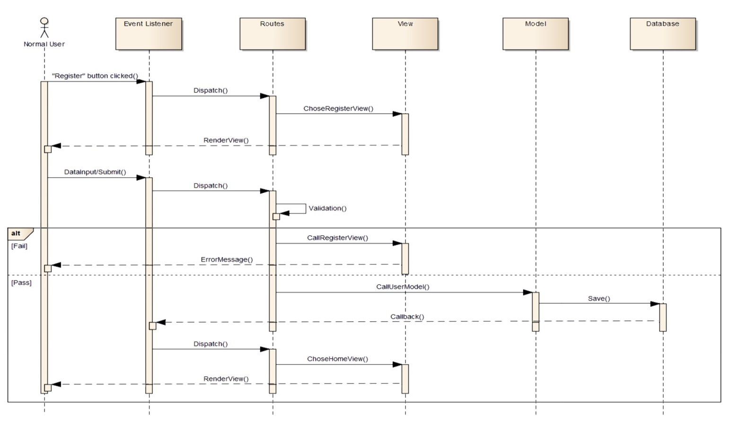

Slide 56
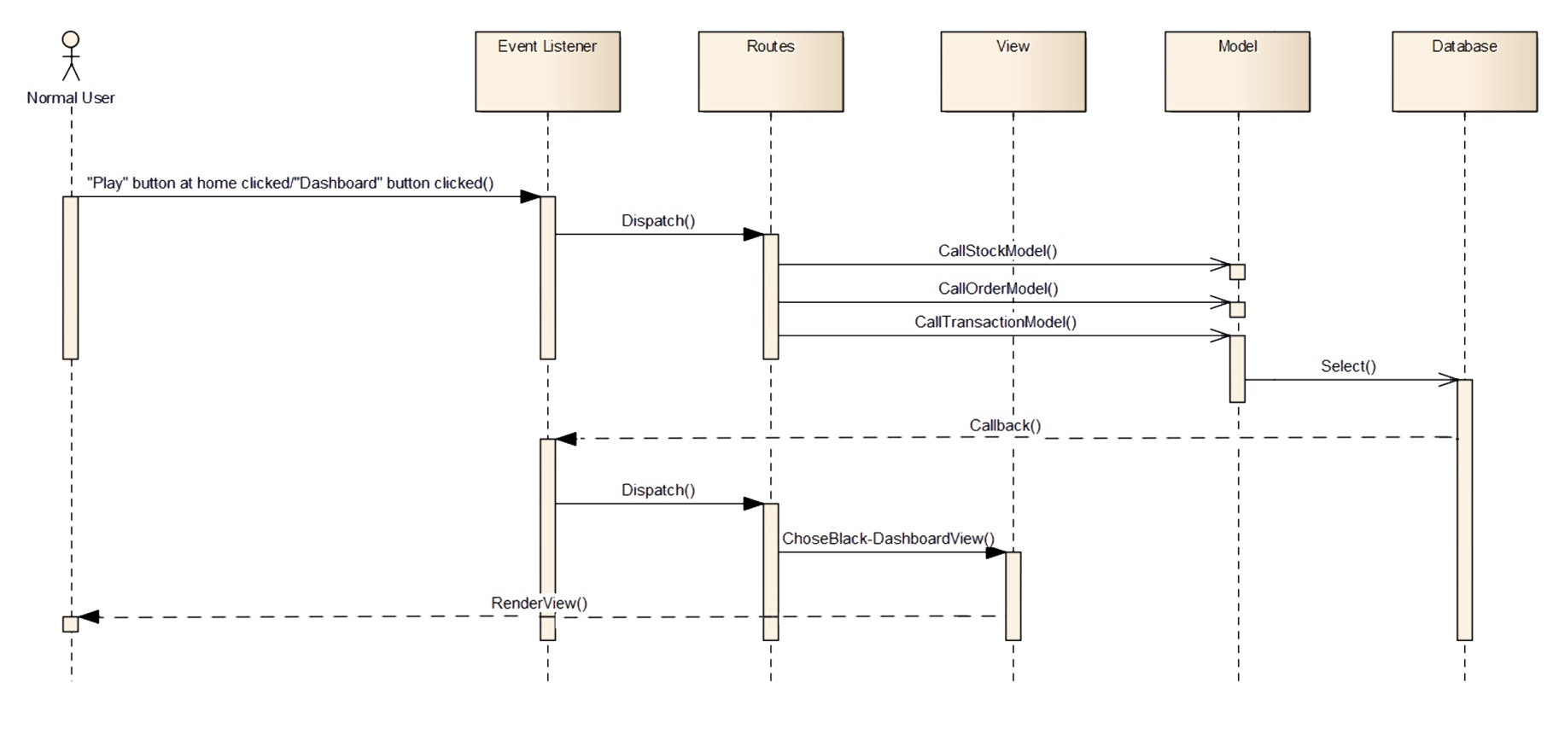

Slide 57
System Design
4
Techniques
Continuous matching

Slide 58
True
Find all buy order in same session have price >= placed order price
Sort by descending price
Match highest price
Have lower price
LO ORDER
Sell
False
Start
Place LO Order
Buy/Sell
End
Buy
False
Find all sell order in same session have price <= placed order price
Sort by ascending price
Match lowest price
Have higher price
True

Slide 59
True
Find all buy order in same session which have same stock symbol
Sort by descending price
Match highest price
Have lower price
MP ORDER
Sell
False
Start
Place MP Order
Buy/Sell
End
Buy
False
Find all sell order in same session which have same stock symbol
Sort by ascending price
Match lowest price
Have higher price
True

Slide 60
PERIODIC MATCHING
Loop for each stock symbol
Find all placed orders in opening/closing session
Calculate total buy and sell volume of each price value
Recalculate total buy and sell volume of each price value
End of opening/closing session
Find all ATO/ATC order
Start
Find all LO order
Matching price of each stock is the price which has most buy and sell volume
End

Slide 61
Testing
1
Test stages
2
Test process
3
Test plan
4
Features to be tested
5
Test environment
6
Test result
7
Defect log

Slide 62
Testing
1
Test stages
Function Test
GUI Test
Scenario Test
Unit Test
2000
2004
2008

Slide 63
Testing
2
Test process
Create
check
list &
test case
Review
check
list &
test case
Execute
test
Test
report
Test plan

Slide 64
Testing
3
Test plan
Test Schedule | Start Date | End Date
Phase 1: Pilot project | 13/05/2013 | 20/06/2013
Unit Testing | 13/05/2013 | 20/06/2013
Phase 2: Main features | 03/06/2013 | 26/07/2013
Unit Testing | 04/06/2013 | 26/07/2013
User Interface Testing | 15/06/2013 | 29/06/2013
Functional Testing | 21/06/2013 | 26/07/2013
Scenario Tests | 22/07/2013 | 26/07/2013
Phase 3: Other features and optimization | 29/07/2013 | 16/08/2013
Unit Testing | 26/07/2013 | 09/08/2013
User Interface Testing | 29/07/2013 | 02/08/2013
Functional Testing | 26/07/2013 | 16/08/2013
Scenario Tests | 12/08/2013 | 16/08/2013

Slide 65
Testing
4
Features to be tested

Slide 66
User Role | Function | Description
Admin | Login | Login to FUSE system with Admin Role
 | Logout | Logout of Wish system
 | View list of users | View list of users
 | Delete user | Delete an user
 | Fetch data | Gather data from HOSE and vietstock
 | Create IPO lot | Create an IPO lot
 | Delete IPO lot | Delete an IPO lot
 | Configure time of session | Set start time, end time and available date of session
 | Create news post | Create a news post
 | Delete post | Delete a news post
 | Change admin password | Change admin account password
 | Set money for new registered account | Set money for new user account
 | View portfolio | View portfolio
 | Add portfolio | Add stock to portfolio
 | View stock detail | View detail information of one stock

Slide 67
User Role | Function | Description
Normal - User | Register | User register a new account to login
 | Confirm email | After register, user must confirm email to complete
 | Login | Login to FUSE system through email and password
 | Logout | Logout of FUSE system
 | View profile | View owner profile
 | Edit profile | User update profile by editing
 | Change password | Change user password
 | Find forgotten password | Find forgotten password
 | Read news | Read news post
 | Check account balance, stock quantity, trading history | View user current balance, stock quantity and trading history
 | View stock detail | View detail information of one stock
 | Make order | Make a normal trading order
 | Make IPO order | Make an IPO order
 | View portfolio | View portfolio
 | Add stock to portfolio | Add stock to portfolio
 | Delete stock from portfolio | Delete stock from porfolio

Slide 68

Testing
5
Test environment
Window
7
PC
Google
Chrome
Firefox

Slide 69
Test result
6
Test result

Slide 70
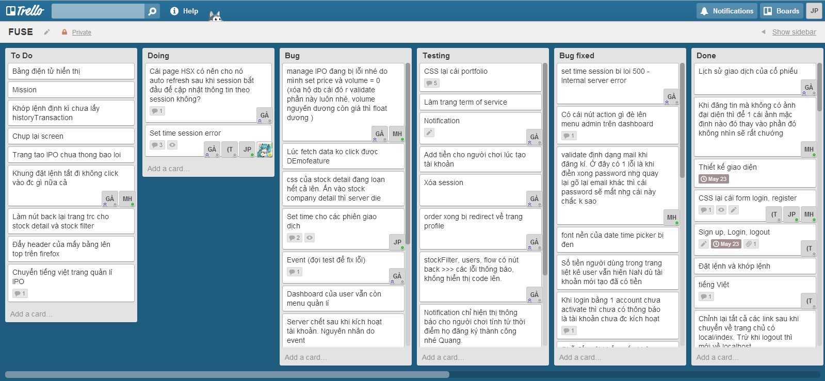
Testing
7
Defect log

Slide 71
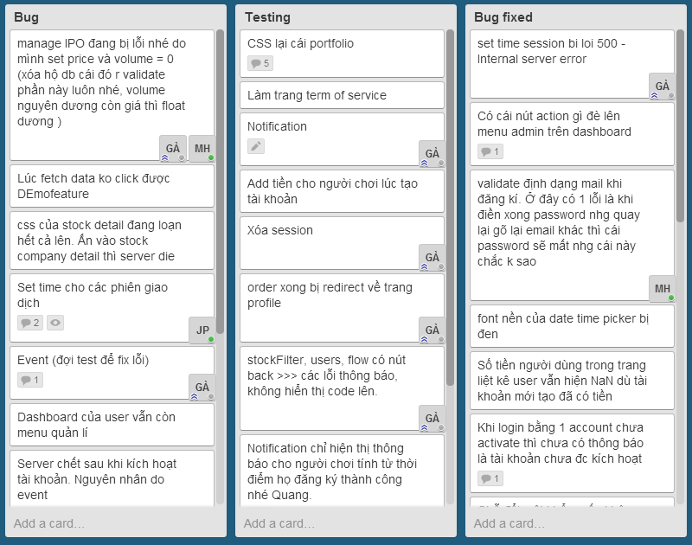
Testing
7
Defect log

Slide 72
Thank You!

