Slide 1


Programming Contest
Management System
Supervisor:
Lecturer Phan Trường Lâm
Students:
    Hoàng Quang Mạnh
    Trần Đình Tuấn
    Nguyễn Thành Trung
    Phạm Thị Hồng Hà
    Đinh Hoàng Tuấn Dương

Slide 2
Agenda
1. Introduction
2. Project Management Plan
3. Requirement Specifications
4. Design Description
5. Implementation
6. Test Documentation
7. Summary
8. Demo & QA
Notes:
Tuấn nói 1 vs 3
Mạnh nói 2 vs 4 phần design của client + server
Trung nói design QB vs database
Dương nói 5
Hà nói 6 vs 7
Demo …

Slide 3
Part 1: Introduction
Background
Literature Review
Our Proposal
Products
Notes:
Các phần nói trong introduction

Slide 4
Background
Application of IT in examination.
Organizing and grading exam
  Take a lot of time
  Human effort
Notes:
Ứng dụng CNTT trong giảng dạy cũng như kiểm tra hiện nay
Tổ chức kì thi cũng như chấm bài mất nhiều thời gian và công sức

Slide 5


Literature Review
PC², a client – server system that used in the ACM
Application difficult to deploy in Vietnam
Notes:
Giới thiệu về pc2 từ lịch sử phát triển đến các chức năng mình đã tìm hiểu được.
Khá phức tạp để áp dụng và cần nhiều thời gian để trainning

Slide 6



Our Proposal
Minimizing human effort
Ensure fairness in the course of the exam
Fully information
Auto grading
Resource
Exam
Network
User Friendly
Easy to connect to server
Validate using Active Directory
Simple Interface
Easy to use

Slide 7
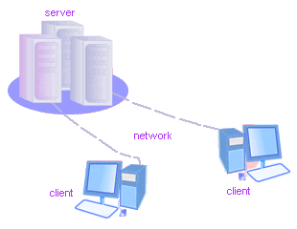

Products
The product is a client-server application named Programming Contest Management System (PCMS)
Tools that help manage questions in the Question Bank Management
Notes:
Các chức năng của hệ thống
Client
Server
QBM

Slide 8
Part 2 : Software project management plan
The proposed system
Development Environment
Process
Project organization
Project Planning

Slide 9
The proposed system
Question bank management:
  Manage question bank: language, subject, chapter, question.
  Manage exam: exam, paper.
  Random paper.
  Export exam doc, paper file.
Client
  Authentication
  Check solution
  Submit solution
Server
  Manage exams.
    Start/stop exam.
    Manage students in the exam (authenticate, status…)
    Store solution of student.
  Automatic grade solutions.
  View result and create report of exam.

Slide 10

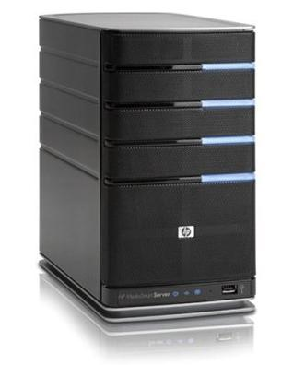
Development Environment - Hardware
Development Hardware
2 Gb of RAM
100Gb of hard disk
Core 2 Duo 2.0 Ghz
Server Hardware
4 Gb of RAM
100Gb of hard disk
Core 2 Duo 2.0 Ghz

Slide 11







Development Environment - Software

Slide 12
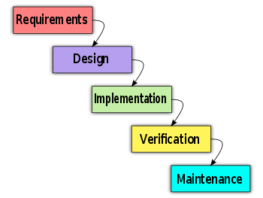
Process
Follow Waterfall model

Slide 13
Project Organization
Hoàng Quang Mạnh
PM
Hoàng Quang Mạnh
Tech Lead
Phạm Thị Hồng Hà
Test Lead
Nguyễn Thành Trung
QA
Đinh Hoàng
Tuấn Dương
CM
Trần Đình Tuấn
Designer
Trần Đình Tuấn
Dev
Phạm Thị
Hồng Hà
Dev
Trần Đình Tuấn
Tester
Hoàng Quang Mạnh
Tester
Đinh Hoàng
Tuấn Dương
Dev
Nguyễn Thành Trung
Dev
Đinh Hoàng
Tuấn Dương
Tester
Nguyễn Thành Trung
Tester

Slide 14

Project Planning
Follow Capstone Project requirements
Buffer: 2 weeks
Submit all reports on time
No overtime

Slide 15
Part 3: Requirement Specifications
User Requirement
System Requirement

Slide 16
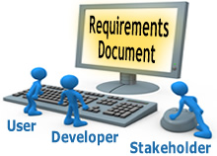
User Requirements
Client Application
Server Application
Question Bank Management Application

Slide 17

Client Application
Authentication
Check solution
Submit solution

Slide 18
Server Application
Manage the exam
  Create the exam. Import and load file Exam Paper from Question Bank
  Start exam.
  Finish exam.
Manage student. Add or remove students in exam.
Show exams information
Automatic grade solutions
View result of the exam
Create report of the exam
Store student’s solution

Slide 19






Question bank Management Application

Slide 20
System Requirements
Document requirements for each use case
Each includes:
  Use case diagram
  Actor
  Summary
  Goals
  Triggers
  Preconditions
  Post conditions
  Success scenarios
  Alternative scenarios

Slide 21
Non-functional Requirement
Usability
Availability
Reliability
Security
Performance
Maintainability

Slide 22
Part 4: Software Design Description
Architectural design
Detailed design
Database design

Slide 23
Architectural design
Overall design
Components
Patterns

Slide 24
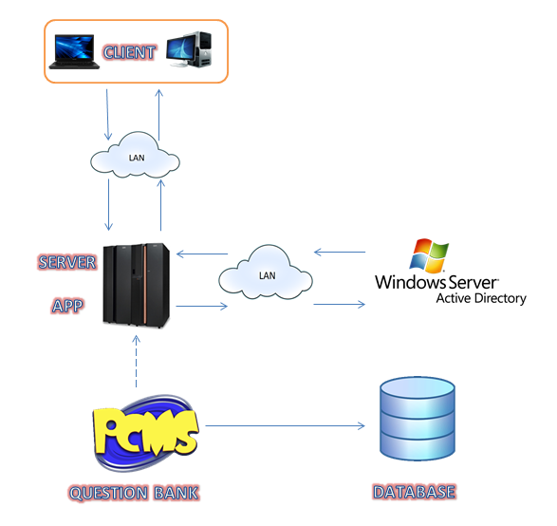
Architecture - Overall Design

Slide 25
Architecture – Client component

Slide 26
Architecture – Server component

Slide 27
Architecture – Question bank management component

Slide 28
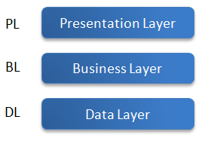
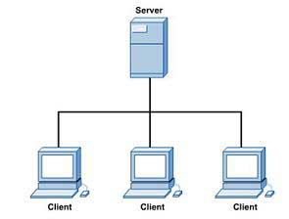
Architectural & design patterns
3-layer
Client-Server
.Net remote Single call

Slide 29
Detailed design
Design for each use case
Class diagram
Class explanation
Sequence diagram

Slide 30
Class diagram example

Slide 31
Sequence diagram example

Slide 32
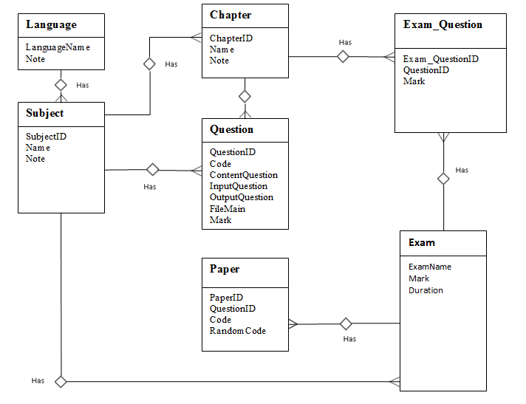
Database design - ERD

Slide 33
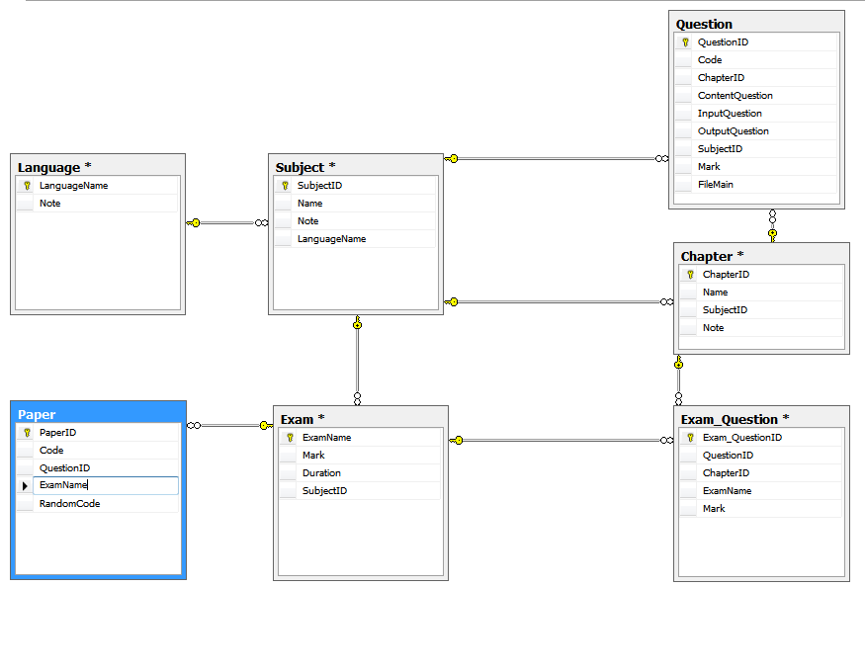
Database design - Table

Slide 34
Part 5: Implementation
Technologies
Tools
Coding convention
Code review
Unit test
Performance considerations
Security considerations

Slide 35


Technologies

Slide 36




Tools

Slide 37


Coding conventions
Follow general .NET conventions
Specific conventions for the project
Notes:
Coding conventions:
Follow general .NET coding conventions
e.g. Pascal Casing, Camel Casing…
Follow FxCop rules
e.g. avoid empty interface (FxCop Microsoft.Design CA1040)
Create specific conventions for the project
e.g. all strings must be trimmed before inserting to the database

Slide 38
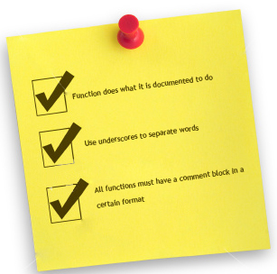
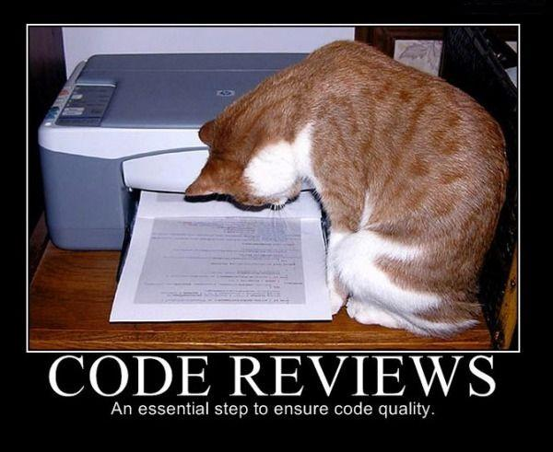
Code review
By technical lead
Peer review

Slide 39

Unit test
Do unit test personally

Slide 40

Performance considerations
Compress solutions to increase transfer speed

Slide 41

Security considerations
Login validation
Encrypt sensitive data: paper file, submit file
Session key
Use limited access rights user for executing solution

Slide 42
Part 6: Test Documentation
Include:
  Features to be tested
  Features not to be tested
  Test case
  Check list

Slide 43
Test Result
Number of test cases: 230
Number of passed cases: 230
Number of failed cases: 10 (fixed all)
Number of not tested cases: 0

Slide 44
Part 7: Summary
Capstone Project: completed (in next 30’ ☺)
Product: deployed to Server FPT University
Future:
Continue developing
Invest in this product (anyone interested?)

Slide 45
Demo

