Slide 1
Cooking recipes sharing website
Supervisor: Mr. Huỳnh Anh Dũng
Mr. Nguyễn Tất Trung
Students:
Trần Trung Kiên - 01017
Đặng Xuân Toàn - 01143
Trần Sỹ Tùng – 01302
Bùi Trung Kiên - 01359
Ngô Thị Việt Anh - 01286

Slide 2
The People
Supervisor
KienTT
ToanDX
KienBT
TungTS
AnhNTV

Slide 3
Contents
Introduction
Project Management Plan
Requirement Specifications
Design Description
Implementation
Test Documentation
Summary
Demo & Q&A

Slide 4
Part 1: Introduction
Background
Literature Review
Our Proposal

Slide 5
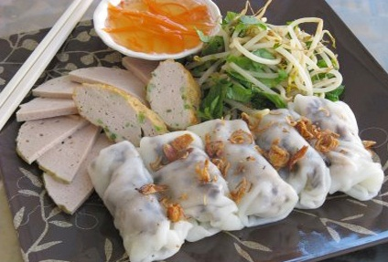
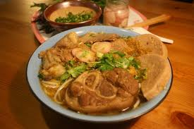
Background
Vietnamese cuisine
The richness and diversity of the Vietnamese dishes
The need of
learning how to
cook dishes

Slide 6
Literature Review
http://afamily.vn/an-ngon
http://epicurious.com
http://allrecipes.com
http://camnangnaunuong.com
http://delish.com

Slide 7
Literature Review
Contents are provided by admin.
Closed website – news website

Slide 8
Literature Review
Sub-page of website afamily.vn – news website
User can not create recipes directly on the web

Slide 9
Literature Review
Foreign language website
Foreign food recipes sharing

Slide 10
Our Proposal
Vietnam users
Vietnamese food recipes
Contribution and opinion from all users
Give the best information they need
Vietnamese
Information
Network
User Friendly
More interesting
More interactive
Make the system user-friendly
Have good performance

Slide 11
Part 2: Software Project Management Plan
The proposed system
Development Environment
Process
Project organization
Project Planning

Slide 12
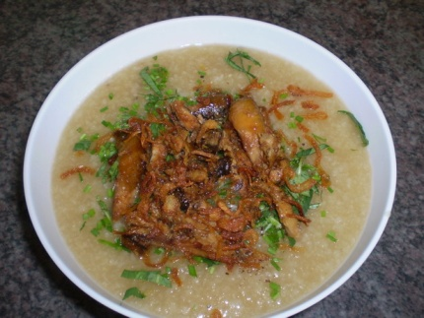
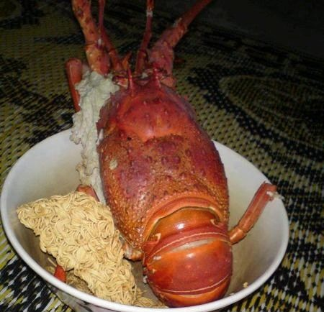
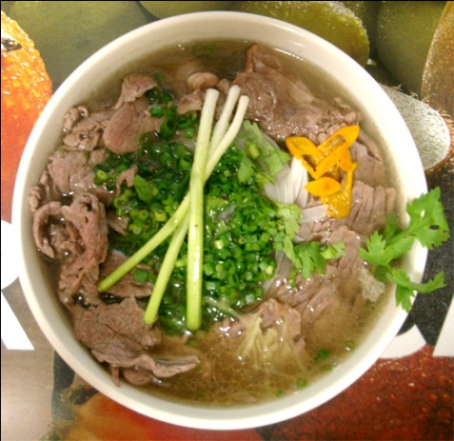
Idea Proposal
Problem

Slide 13
Idea Proposal
Solution
Build a centralized website where people can go to and share cooking recipes, search for recipes in need, share and learn experience to cook better

Slide 14
Idea Proposal
Specialized for Vietnamese users and Vietnamese dishes.
Each cooking guide is reviewed, evaluated, rated... by other users, so we will give users the best information they need.
Utilized newest technologies to make the system user-friendly and have best performance. We provide picture-guides step by step, easy to understand, remember and follow, so you will save time, money…
With the contribution and opinion from all users, the interaction among users is increased. Our website can be the place that connects people who have common cooking interest.

Slide 15
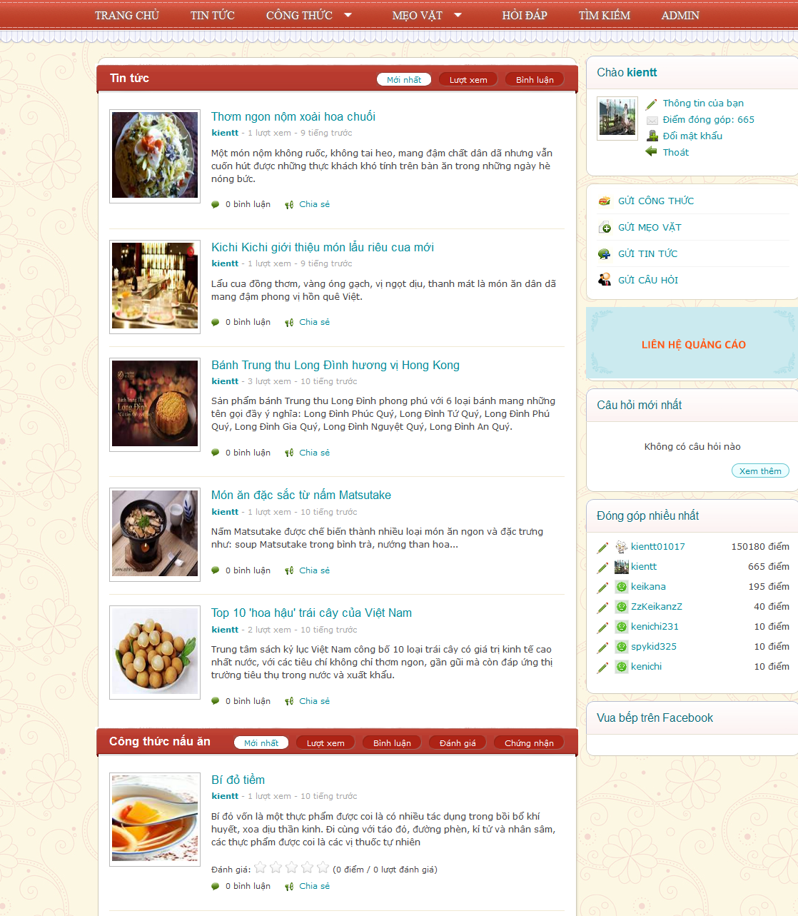
The Proposed System – Front-End
Anyone : view, search
Authenticated users:
Post recipe, tip and news
Evaluate recipe, tip
Rating
Review
Comments
Edit recipe, tip and news information
Ask for particular purpose (Q/A)
Integrate with popular networks

Slide 16
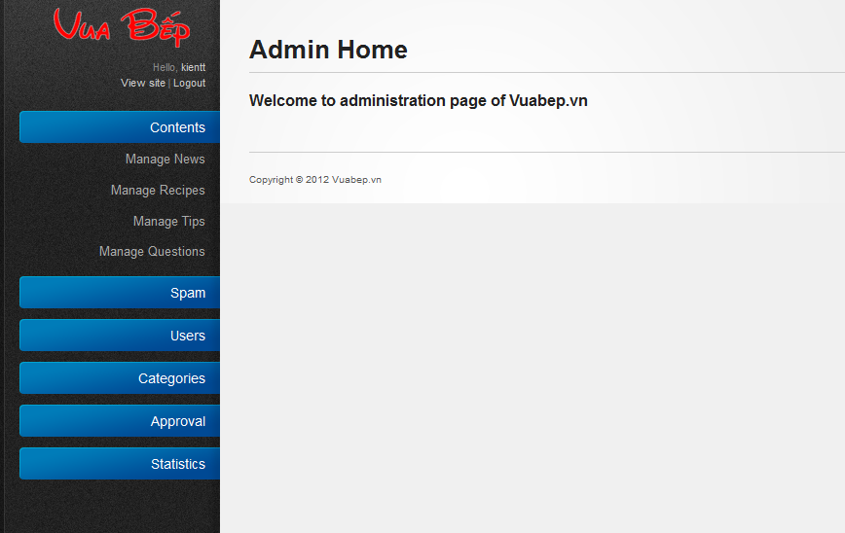
The Proposed System- Back-End
Manage users
Manage categories
Manage roles
Manage contents
Manage reports

Slide 17
Development Evironment
Development Hardware
3 Gb of RAM
100Gb of hard disk
Core 2 Duo 2.0 Ghz
Server Hardware
4 Gb of RAM
100Gb of hard disk
Core 2 Duo 2.0 Ghz

Slide 18
Development Evironment

Slide 19
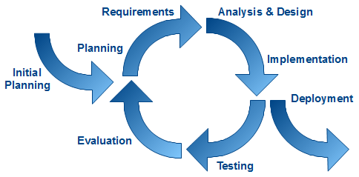
Process
Follow iterative model

Slide 20
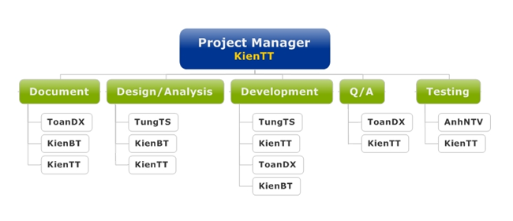
Project Organization

Slide 21
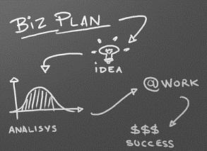
Project Planing
Follow Capstone Project requirements, Master plan
Working 6h/day and 5d/week
Buffer: 20% (about 3 weeks)
Submit all reports on time

Slide 22
Part 3: System Requirement Specifications
User Requirements
System Requirements
Non-functional requirements*

Slide 23
User Requirement
User
Administration
Ranking
Comments / Answer
Recipes
Tips, Q&A, News
Search

Slide 24
User
Create a new account & login to the system
Change password & information
Search for recipes, tips, Q&A and news
Create & edit recipe, tip, Q&A and news
Write, delete, vote & report comments
View, rate & share contents( recipes, tips,..)

Slide 25
Administration
Contents
Spam
User
Categories
Approval
Statistic

Slide 26
Ranking
User Point is calculated as follow:
Starter point for every user is 10
Create a recipes | 30
Create a tip | 20
Create a news | 15
Max point per day | 120

Slide 27
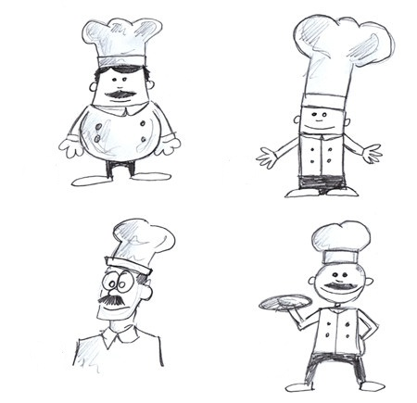
Ranking
CP will be used to set rank for user:
Phụ bếp | 0
Đầu bếp tập sự | 100
Đầu bếp chính thức | 500
Đầu bếp trứ danh | 1000
Bếp phó | 2000
Bếp trưởng | 3500
Siêu đầu bếp | 6000
Vua đầu bếp | 10000

Slide 28
Comment/Answer
Any authenticated users can comment/answer
Can be voted, reported

Slide 29
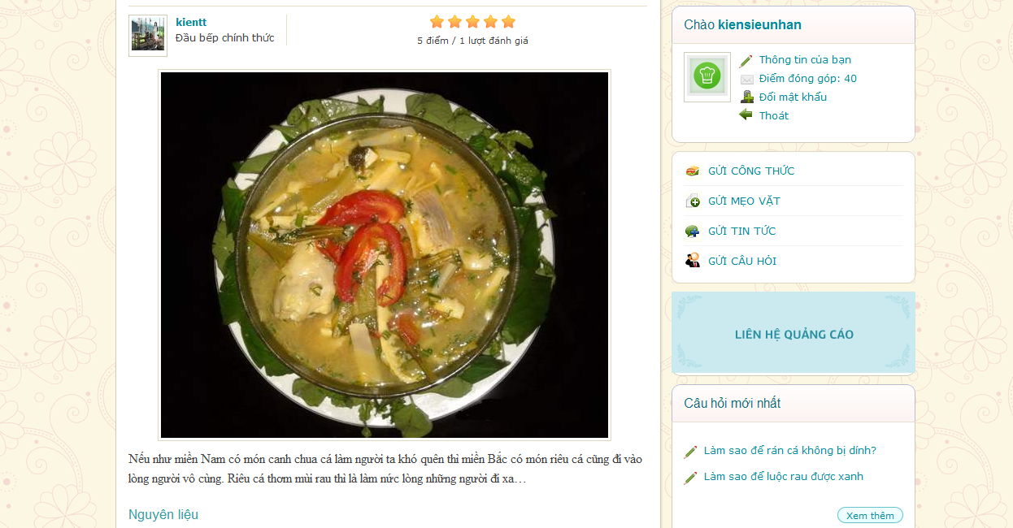
Recipe
Title
Add to favorite book
Description
Category
Rating
Share
Visited number
View number
Recipe Images
Contents
Suggestion List: 10 newest recipes and 5 hottest and newest recipes in the same category

Slide 30
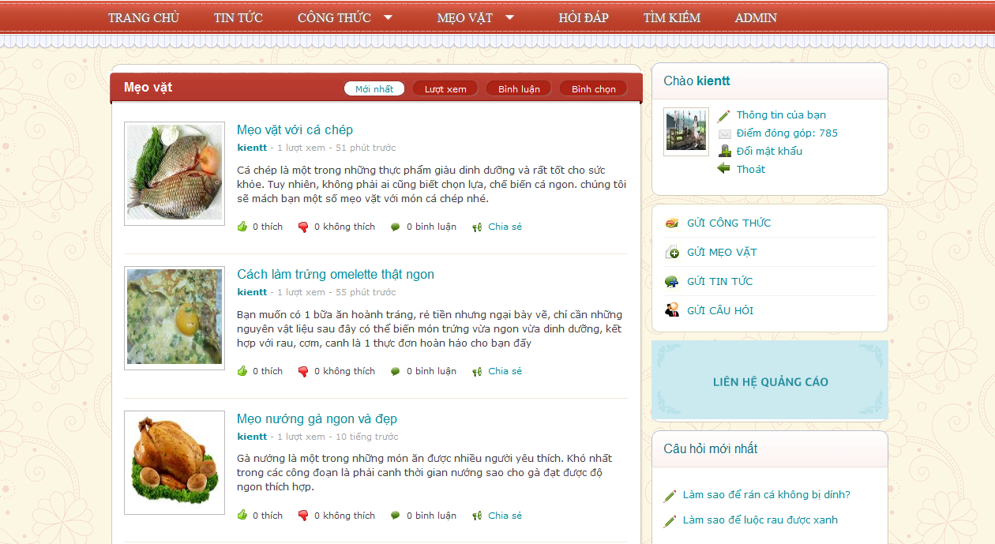
Tips
Title
Description
Category
Rating
Share
Visited number
View number
Contents
Suggestion List: 10 newest recipes
and 5 hottest and newest tips in the same category

Slide 31
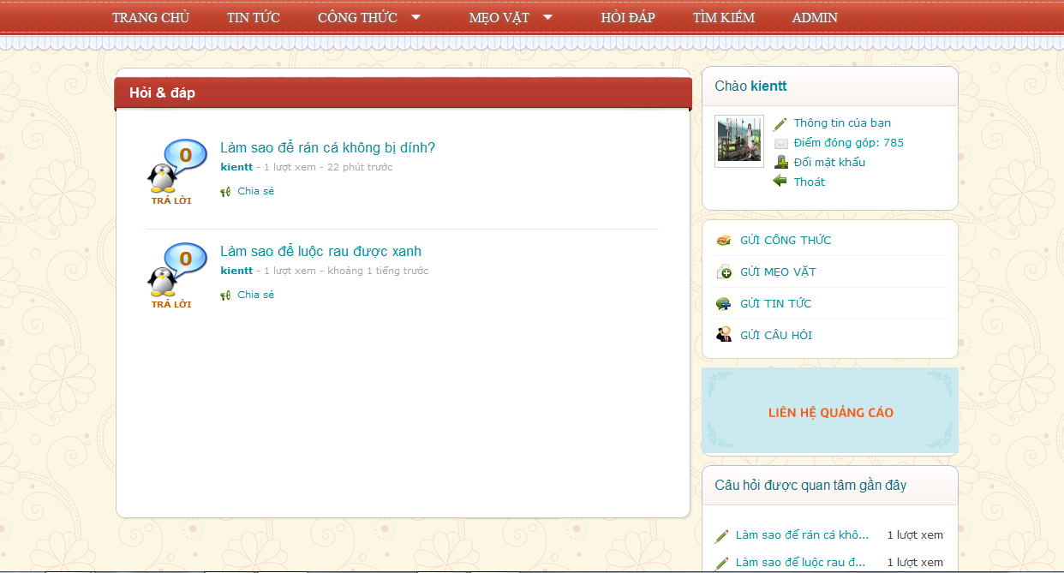
Question/Answer
Title
Description
Rating
Share
Visited number
View number
Contents
Suggestion List: 10 top care question
and top 10 question answered

Slide 32
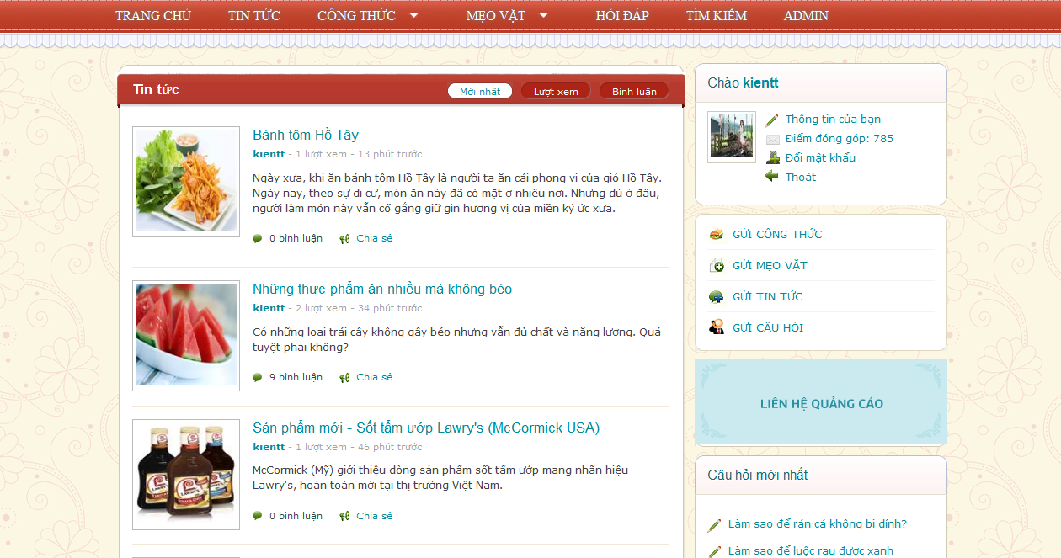
News
Title
Description
Category
Share
Visited number
View number
News Images
Contents
Suggestion List: 10 newest news

Slide 33
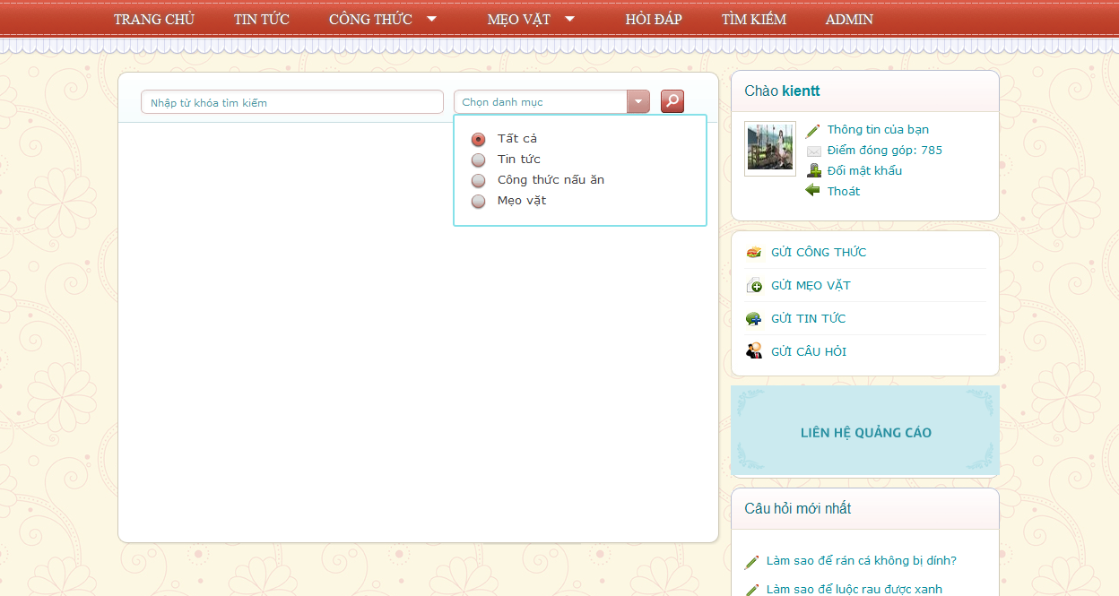
Search
Search by category
Search by key word

Slide 34
System Requirements
Document requirements for each use case
Each includes:
Use case diagram
Actor
Summary
Goals
Triggers
Preconditions
Post conditions
Success scenarios
Alternative scenarios
Exceptions
Relationship
Business rules
Description
Screen
Data field definitions
Button definitions

Slide 35
Non-functional requirements
Usability
Availability
Reliability
Security
Security
Performance
Maintainability

Slide 36
Risk management
Risk Description | Risk type | Prob-ability (1-5) | Effect (1- 5) | Risk Strategy | Resolution
Member’ illness | People | 2 | 4 | Build a reasonable working schedule. | - PTL and PM monitor other members’ tasks and always ready to do these tasks instead of them if can - Using buffer timeto recover works
Bad attitude of team member: in-cohesive with team, breach of discipline | People | 3 | 5 | - Engage teamwork. - Team-building | Create team’s policies: rewarding and punishment
Workingproductivityis not high | Technical | 4 | 4 | - Define standards to be followed to meet the performance criteria - Training technology seriously and research all related problem | - Using buffer timeto recover works - Cross-review tasks to track working process
Working progress is not meeting schedule | Time | 3 | 3 | Create buffer in plan | Using buffer timeto recover works

Slide 37
Quality Plan
Milestones | Description | Output | Deliverables | Resources Needed
Initial idea | Start discussing about topic of capstone project | Topic of capstone project | Deliver initiator idea before 07/05/2012 | 5 people for 2 weeks
Create Project plan | Create project plan | Project plan | Deliver project plan before 22/05/2012 | 2 people for 1 weeks
Create Software Requirements Specification | Create Software Requirements Specification | Software Requirements Specification (SRS) document | Deliver SRS document before 26/06/2012 | 4 people for 4 weeks
Design Database | Create logical and physical database design | Database design and database script | Deliver database design and database script before 05/06/2012 | 2 people for 2 days
Create Soft Design Description (SDD) | Design the system in OOP manner | Architecture design, detailed design, diagrams and design specification | Deliver SDD before 10/07/2012 | 3 people for 2 weeks
Layout Design | Create the main GUI for layout, and create global styles that will be applied to the GUI | HTML layout and CSS files | None | 1 person for 4 days
Create Coding Framework | Map the architecture design into source code, create the project solution files and common classes, and implement common functions | Visual Studio project and solution files containing coding framework | Deliver coding framework before 11/06/2012 | 1 person for 4 days
Coding | Implement the system to reflect the requirements | Source code of the project, unit test reports | Executable programs and source code before 15/08/2012 | 4 people for 4 weeks
System Test | Perform system test for the system | System test report | Deliver Software Test Documentation before 17/08/2012 | 5 people for 1.5 weeks
Input initial data | Input Initial data | Initial data | Deliver before 17/08/2012 | 5 people for 1 weeks
Deployment | Deploy the system to the internet | Running website with domain and hosting | None | 2 people for 3 days

Slide 38
Architectural Design
Overall Design
Components
Patterns

Slide 39
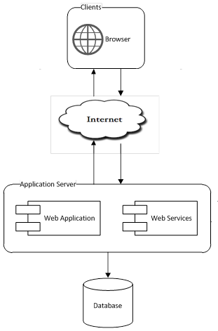
Architectural Design: Overall Design

Slide 40
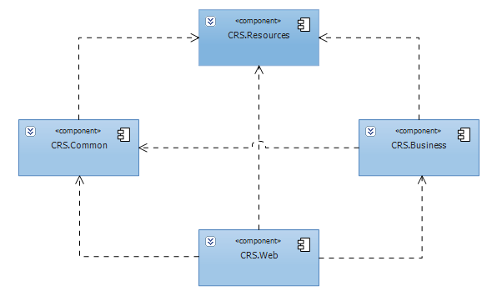
Architectural Design
Components:
Business
Common
Resources
Web

Slide 41
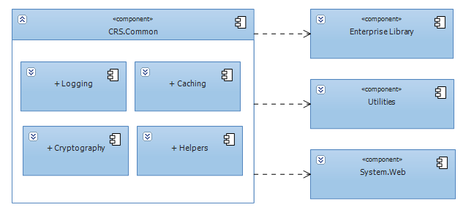
Architectural Design
Common Component

Slide 42
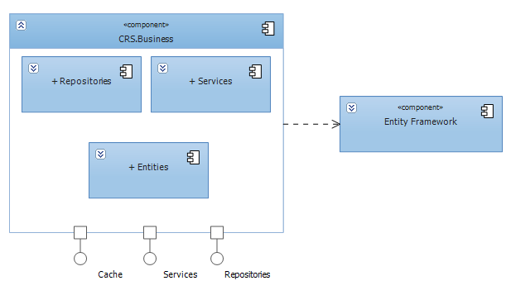
Architectural Design
Business Component

Slide 43
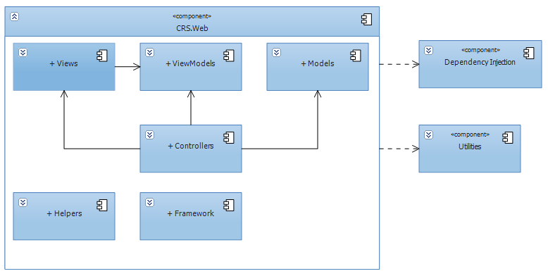
Architectural Design
Web Component

Slide 44
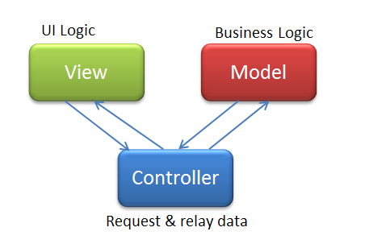
Architectural Design
Patterns:
MVC
Client - Server
Repository
Dependency Injection
Singleton
Service Locator

Slide 45
Database
Business Tables
Support tables: Statistics, config…
Every table has a primary key named Id which is of type: INT NOT NULL IDENTIFY (1, 1)
Max length and null ability strictly follow field definitions

Slide 46
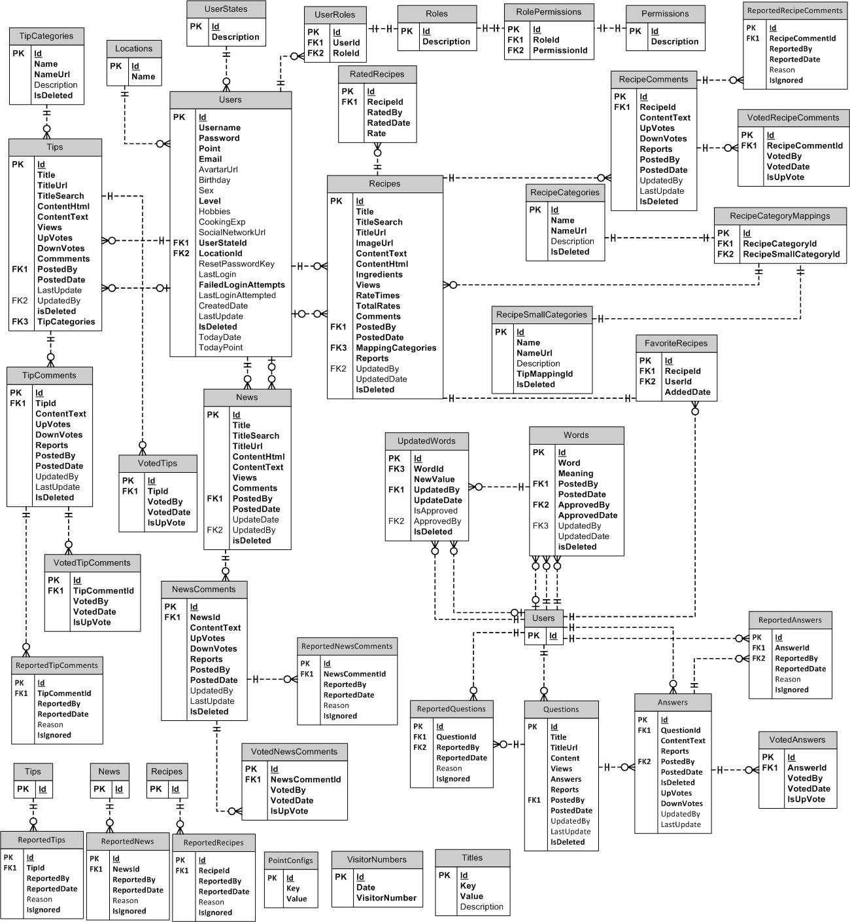
Database – ERD

Slide 47
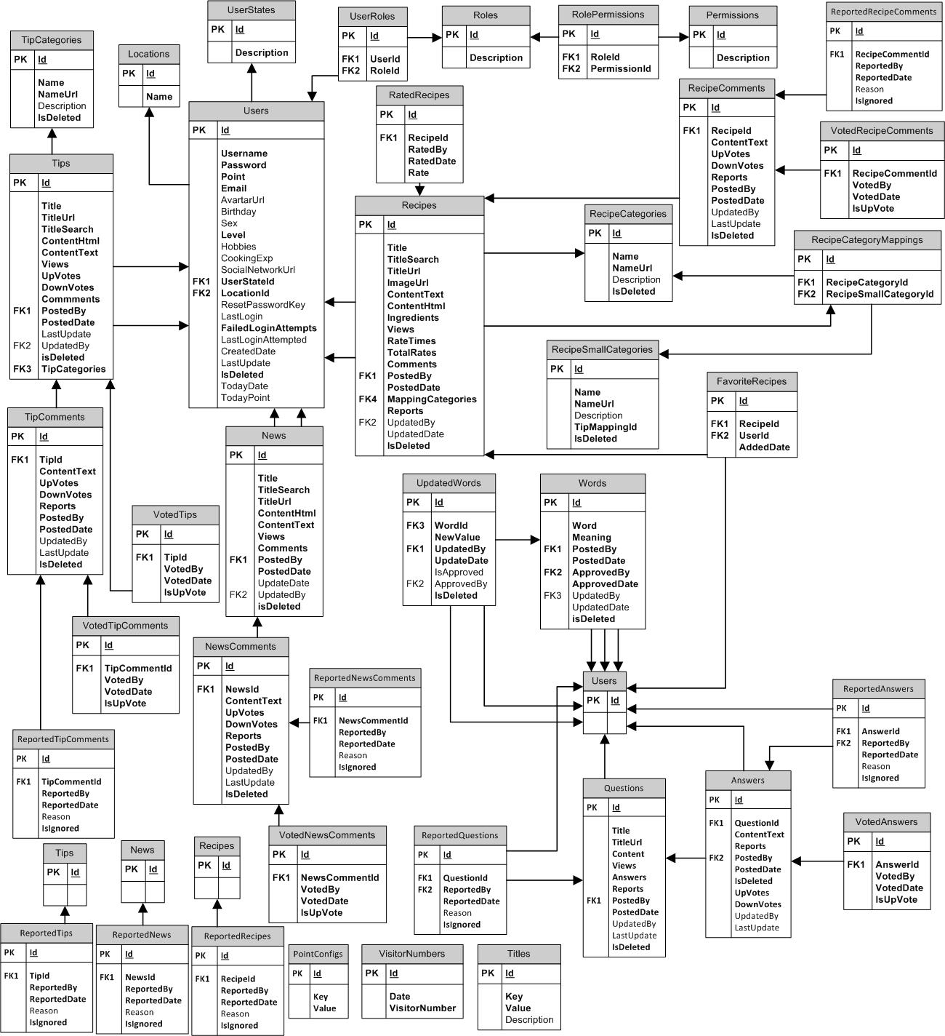
Database – Tables

Slide 48
Detailed Design
Design for each use case
Class diagram
Class explanation
Sequence diagram

Slide 49
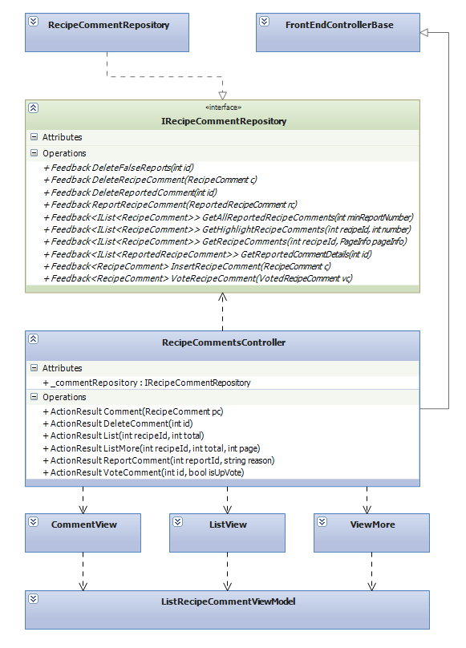
Detailed Design: Class Diagram

Slide 50
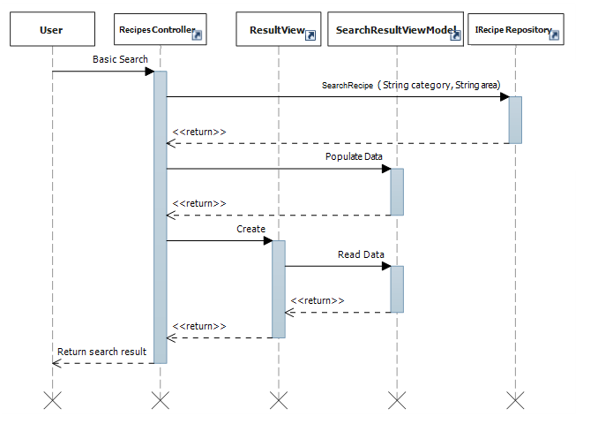
Detailed Design: Sequence Diagram

Slide 51
Technologies

Slide 52
Tools

Slide 53
Coding convention
Follow general .NET conventions
Follow FxCop rules
Specific conventions for the project

Slide 54
Code view
By technical lead
Peer view

Slide 55
Unit test
Mainly for data access layer and framework
Follow A/A/A pattern (Arrange/Act/Assert)

Slide 56
Performance considerations
Caching in 3 layers: database, memory, output (HTML)
Use SQL Profiler to investigate all data access methods
Minimize requests to the server and database hit
Use JSON with AJAX
Compress and create thumbnail images
…

Slide 57
Security considerations
Client side and server side validation
No SQL injection
No XSS vulnerability
Encrypt sensitive data: password, cookies

Slide 58
Part 6: Software Test Document
Features to be tested
Features not to be tested
Test case
Check list

Slide 59
Test results
Module code | Pass | Fail | Untested | N/A | Number of test cases
Total | 617 | 10 | 0 | 0 | 627
Admin: Content | 21 | 0 | 0 | 0 | 21
Admin: Users | 16 | 0 | 0 | 0 | 16
Admin: Approval | 10 | 0 | 0 | 0 | 10
Admin: Dictionary | 13 | 0 | 0 | 0 | 13
Admin: Categories | 45 | 6 | 0 | 0 | 51
Admin: Manage Reported News | 22 | 1 | 0 | 0 | 23
Admin: Manage Reported Recipes | 22 | 1 | 0 | 0 | 23
Admin: Manage Reported Tips | 22 | 1 | 0 | 0 | 23
Admin: Manage Reported Questions | 25 | 0 | 0 | 0 | 25
Admin: Manage Reported Answers | 26 | 0 | 0 | 0 | 26
Admin: Reported News Comments | 26 | 0 | 0 | 0 | 26
Admin: Reported Recipes Comments | 23 | 0 | 0 | 0 | 23
Admin: Reported Tips Comments | 22 | 1 | 0 | 0 | 23
Users | 51 | 0 | 0 | 0 | 51
Homepage | 13 | 0 | 0 | 0 | 13
News | 81 | 0 | 0 | 0 | 81
Recipes | 95 | 0 | 0 | 0 | 95
Tips | 97 | 0 | 0 | 0 | 97
Search | 3 | 0 | 0 | 0 | 3
Dictionary | 11 | 0 | 0 | 0 | 11
Q&A | 70 | 0 | 0 | 0 | 70

Slide 60
Tested vs. not tested
Tested
Unit test
Not tested
PEN test
Integration
System test
Network and security test
Performance test

Slide 61
Summary
Capstone Project: completed (in next 30’ )
Product: deployed to http://www.vuabep.vn/
Future:
Continue developing with more features
Invest in this product (anyone interested?)

Slide 62
Demo

Slide 63
Q&A

