Slide 1
Middle School Management
Supervisor
Trần Đình Trí
Trần Văn Hiếu- 00338
Vũ Tiến Đức- 00202
Nguyễn Mạnh Toàn- 00460
Phạm Xuân Khắc- 00536
Nguyễn Đăng Định- 00681

Slide 2
Contents
Introduction
Project Management
Software Requirement
Software Architecture
Testing
Demo

Slide 3
Introduction
Designed for better interaction between
Teacher
Pupil, Parent
Management
Required to support functions such as planning, organizing, creating schedules and managing pupils, teachers for Managers

Slide 4
Introduction
Supports teachers manage class about attendance and grade of pupils .
Students and parents can monitor their learning or their child’s learning through the school website.

Slide 5
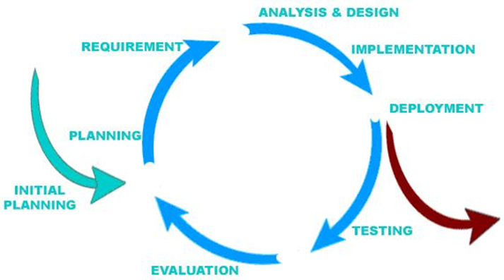
Project Management
Software Process Model
Develop iteratively
Manage requirements
Use components
Model visually
Ensure quality

Slide 6
Project Management
Organization Structure
Project Management
Development
Analysis and Design
QA Team
Hieutv
Ducvt
Toannm
Khacpx
Dinhnd
Hieutv
Toannm
Khacpx
Hieutv

Slide 7
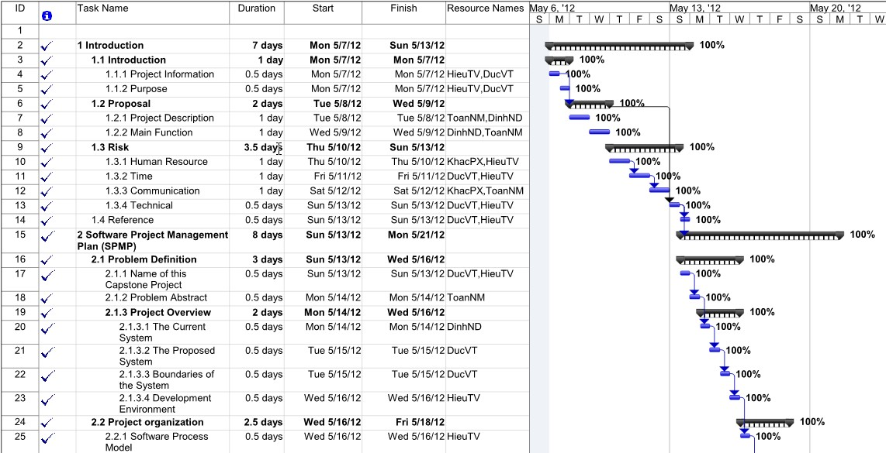
Project Management
Plan

Slide 8
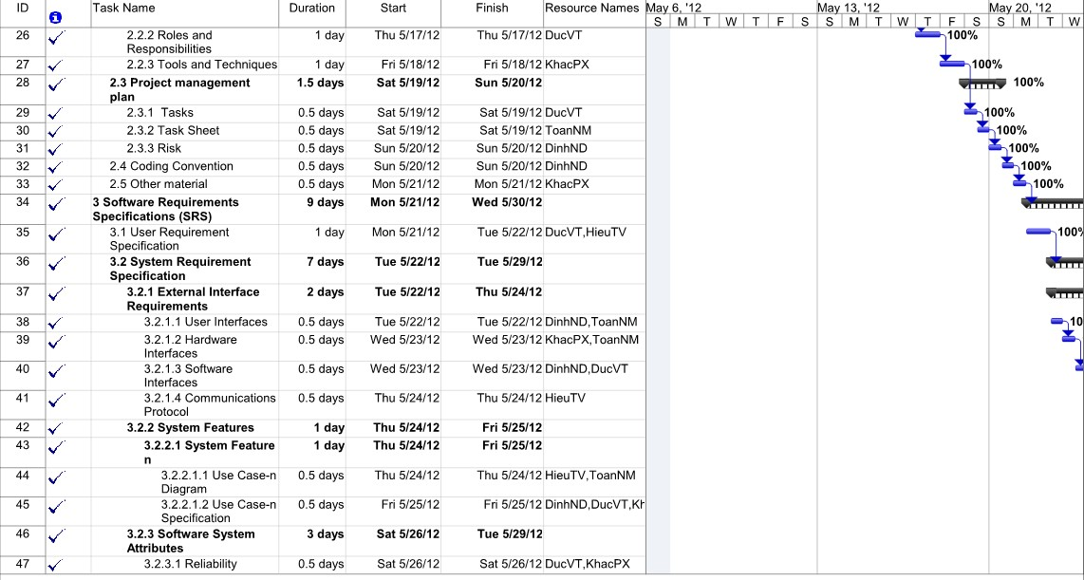
Project Management

Slide 9
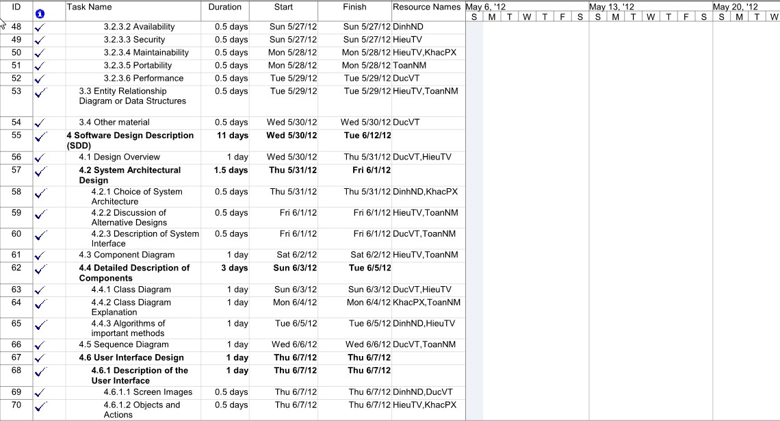
Project Management

Slide 10
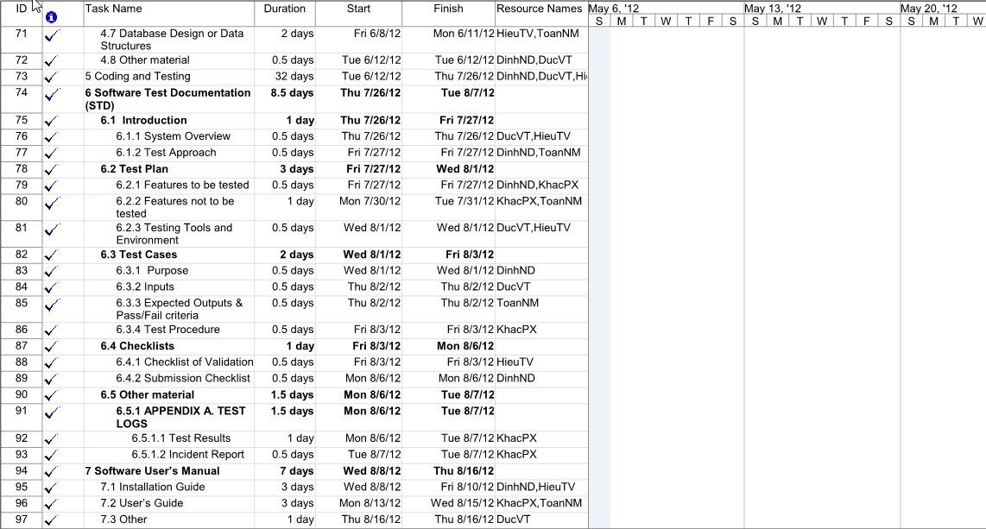
Project Management

Slide 11
Project Management
Meeting Schedule
Report their tasks in previous week
Issues , knowledge and rules will be shared
PM conduct the discussion about the plan for next week
Activities, the issues will be discussed and reported
Supervisor will instruct the direction for project team to deal with the problems
With Team Members
With Team Supervisor

Slide 12
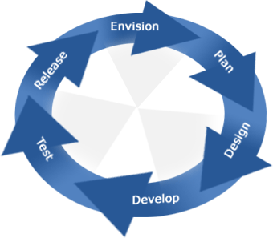
Project Management
Risk Management
Human Resource
Discipline of team member
Lack of team work
Time and Communication
- Team members can not spend enough time for project
- Hard to connect team member due to the difference place
Technical
- In-experience in designing e-commerce project

Slide 13
Software Requirement
Functionality requirement
Managers
User management
Teachers
Take grade
View Schedule
Pupils and parents
View grade report
View attendance report
Teacher, pupil management
Class, subject management
Schedule management
Take attendance
View schedule

Slide 14
Software Requirement
Non-functionality Requirement
Availability
Reliability
Security
Maintainability
Portability
Performance

Slide 15
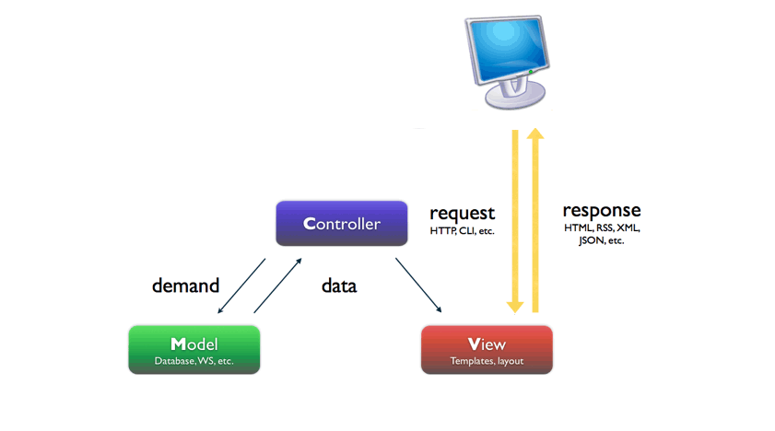
Software Architectural Design
Software Model

Slide 16
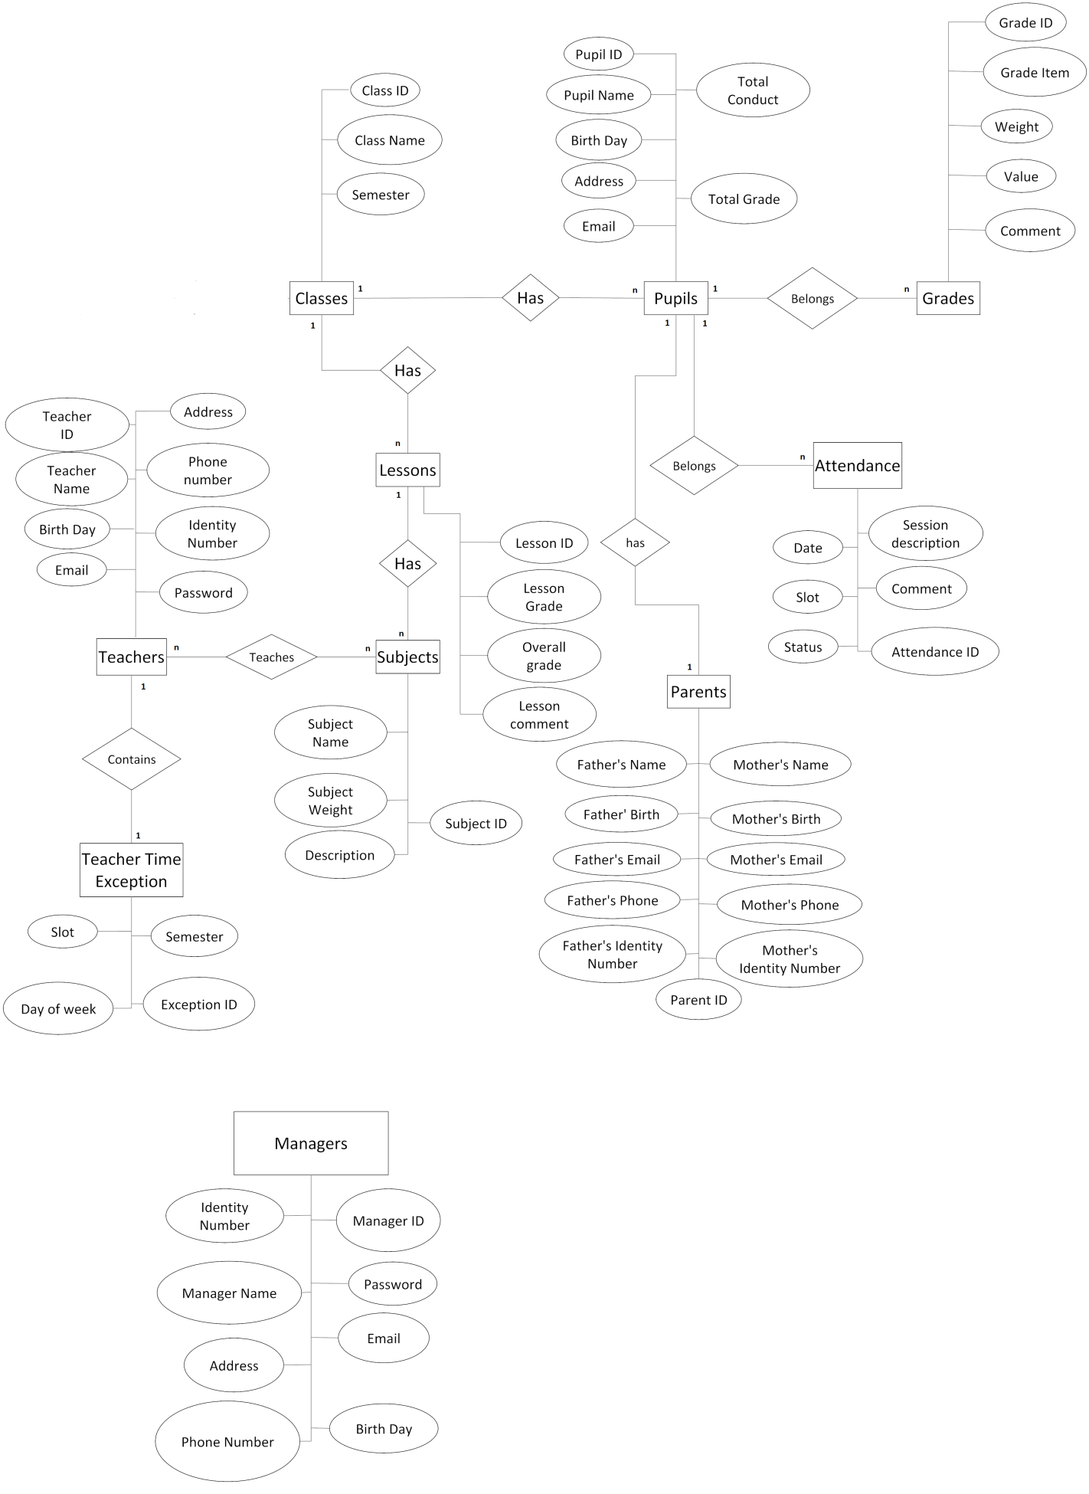
Software Architectural Design
ERD

Slide 17
Software Architectural Design
Technology

Slide 18
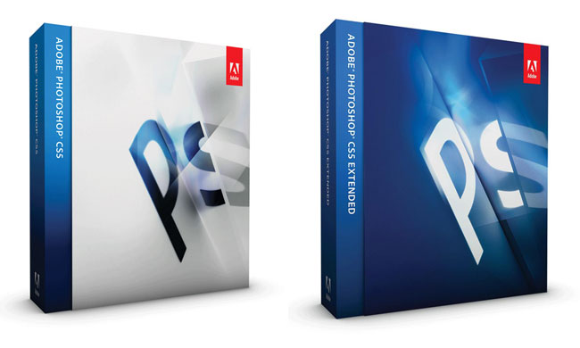
Software Architectural Design
Tool

Slide 19
Testing
Test Plan
Developing
Testing
Requirements
Acceptance
System design
System
Software Architecture design
Integration
Module design
Unit
Coding

Slide 20
Testing
Test Process
Create TC template
Write TC (based on SRS)
Review TC
Test Execution
Test Plan

Slide 21
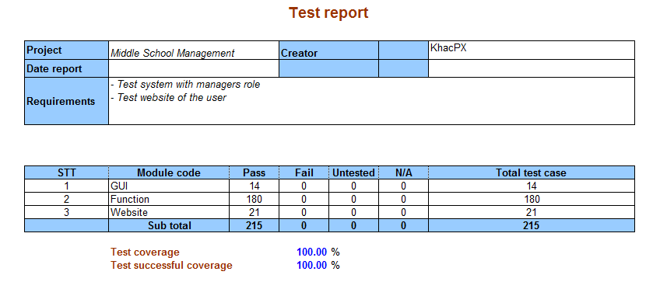
Testing
Test Report

Slide 22
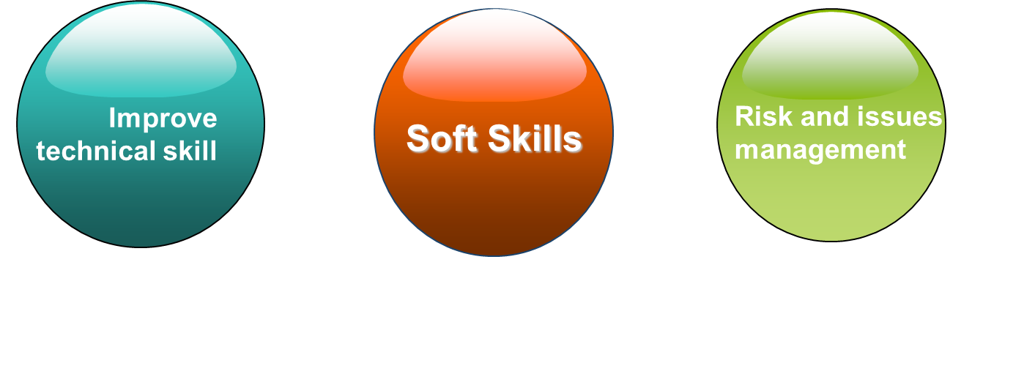
Result
Lesson Learnt

Slide 23
Demo

