Slide 1
HOTEL ROOM BOOKING

Slide 2
Contents
I. Introduction
II. Goals
III. System features
IV. Organization
V. Q&A

Slide 3
I. Introduction
Name: Hotel Room Booking System
Purpose: the Capstone project for graduation of FPT University
Content: A system helps
Customer book hotel rooms.
Hotel staff manage rooms and booking
Products: a website and other web services

Slide 4
I. Introduction (cont.)
Hotels researched:
Sông Nhuệ hotel at Hà Đông
Tùng Cường motel at Từ Liêm
Information researched:
Three star hotel standards
Hotel business policy

Slide 5
I. Introduction (cont.)
Booking process at common hotels:
Customer calls receptionist
Customer books online
Receptionist checks for available rooms and picks a room
Receptionist saves the reservation in the database (or the records)

Slide 6
II. Goals
How things worked with our system
HRBS
Customer
Reception desk
➔ Disadvantages

Slide 7
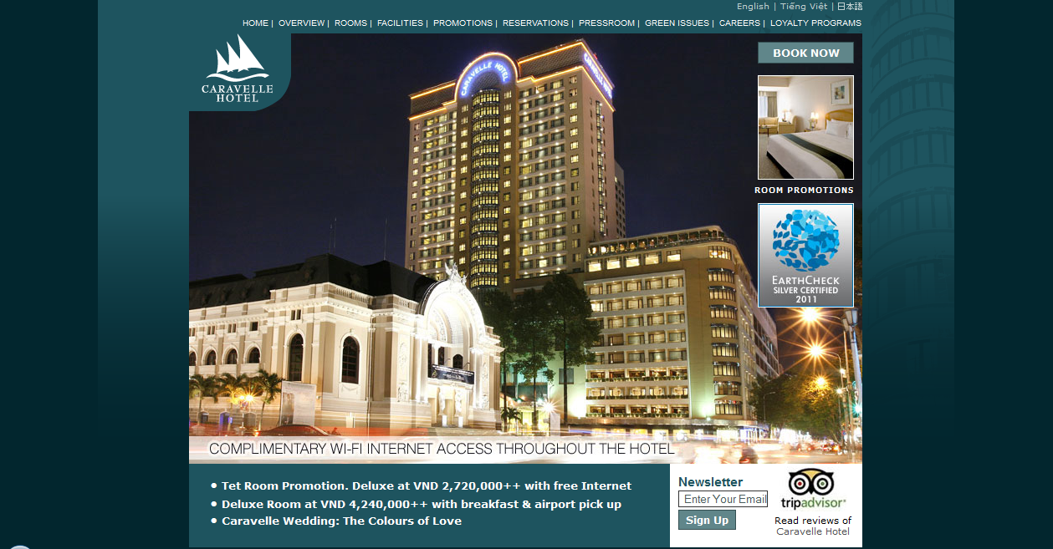
II. Goals (cont.)
Similar systems

Slide 8
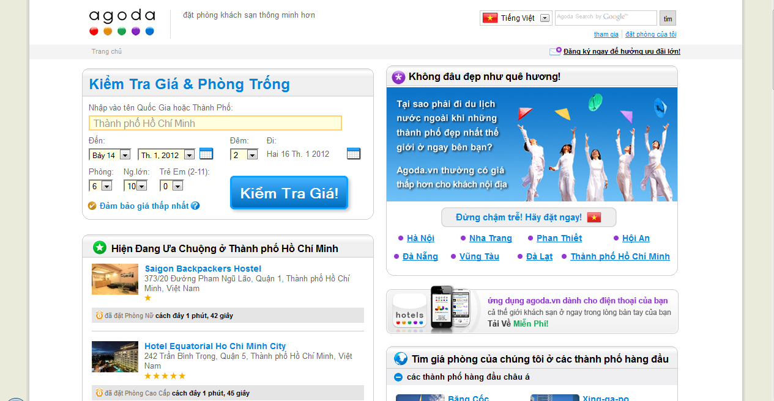
II. Goals (cont.)
Similar systems

Slide 9
II. Goals (cont.)
Disadvantages of similar systems:
Unable to inform the customers immediately whether the hotel has accepted their reservations
Only allow to book for rooms in a same room type, do not allow mixed types
Have no automatic room arrange function

Slide 10
II. Goals (cont.)
Our proposal:
Full Automation
Notes:
Full automation
Room capacity maximization

Slide 11
III. Goals (cont.)
Our proposal:
Most effective when hotel is nearly full
Arrange the room reservations automatically each day by our algorithm
Use as few as possible rooms to satisfy customer’s needs
Room Capacity Maximized
Notes:
Full automation
Room capacity maximization

Slide 12
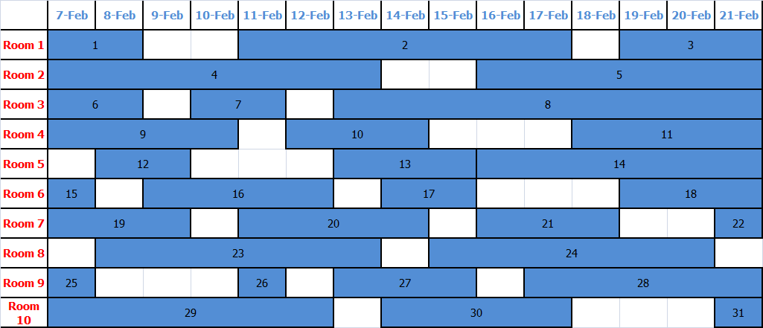
III. Goals (cont.)
Room arranging algorithm illustration: Before
Notes:
Full automation
Room capacity maximization

Slide 13
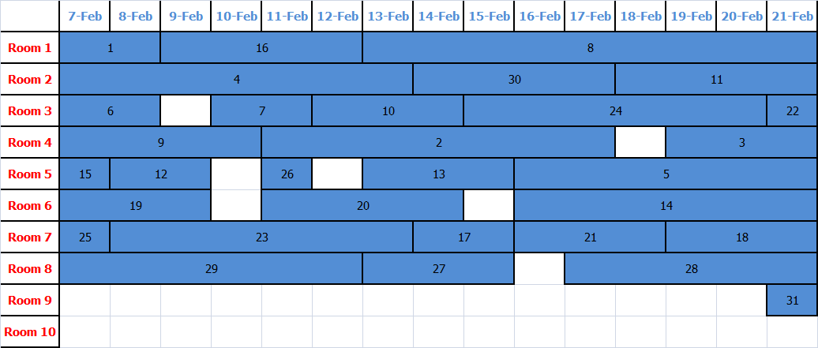
II. Goals (cont.)
Room arranging algorithm illustration: After
Notes:
Full automation
Room capacity maximization

Slide 14
III. System features
HRBS
Customer
Staff
Manager
Admin

Slide 15
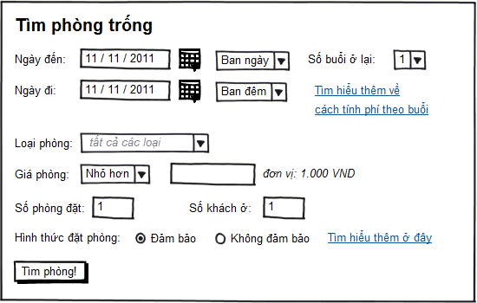
III. System features (cont.)
Customer
View hotel’s information: room types & price, hotel’s location, number of rooms...
Search for available rooms
Make reservations
Customers do not know which room they will get, they only know whether there is available room for their needs or not

Slide 16
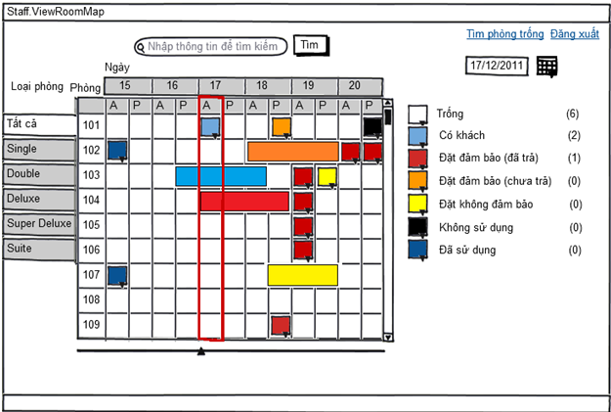
III. System features (cont.)
Staff
Manage room reservations
Checking available room for customer
Check in/check out for customer

Slide 17
III. System features (cont.)
Manager
Manage information of all rooms & room types (add, edit, delete room/room type)
Manage staff activities
View statistic graphs: room type usage by month, % of current available/unavailable rooms, % usage of total rooms last year

Slide 18
III. System features (cont.)

Slide 19
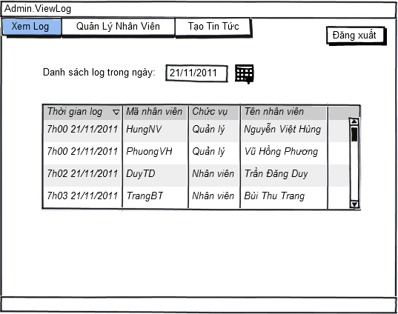
III. System features (cont.)
Admin
Create, edit and delete accounts for staff and manager
View activity logs of other accounts
Create news of the hotel on website

Slide 20
IV. Organization (cont.)
Technology:
ASP .NET Framework 4.0
MVC3
HTML5
MS SQL Server

Slide 21
IV. Organization (cont.)
Supervisor: Mr. DươngTB
Project Manager: CươngND
Technical Leader: CườngNB
Developer: CườngNB, VinhTQ
Tester: NgânĐTT, TrânDHB
QA: TrânDHB

Slide 22
V. Q&A
Q&A

Slide 23
Thank You !
Hotel Room Booking System
Click to edit company slogan .

