Slide 1

Expert Management System
Capstone Project
Supervisor:
MR. Nguyen Van Sang
Members:
00605 Nguyen Khoa Chung
00623 Dao Trong Luan
00597 Nguyen Thi Le
00648 Nguyen Phan Nam
Ha Noi - Summer 2011

Slide 2

Content
PROJECT OVERVIEW
PROJECT MANAGEMENT
ARCHITECTURES
RESULT
DEMO

Slide 3
PROJECT OVERVIEW
CURRENT SITUATION
IDEAS – PROJECT APPROACH
FUNCTIONAL OVERVIEW & SYSTEM OVERVIEW

Slide 4
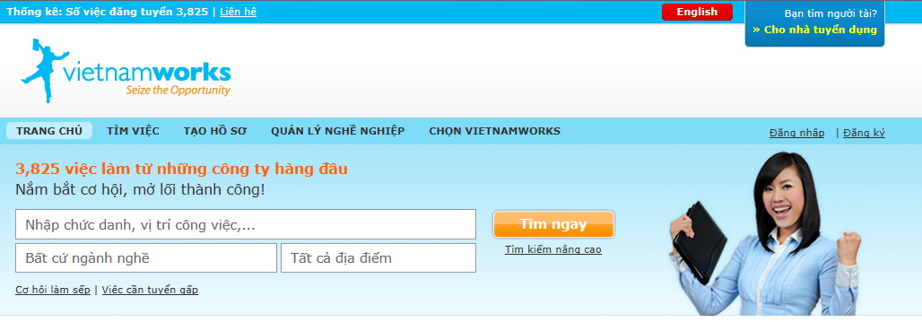
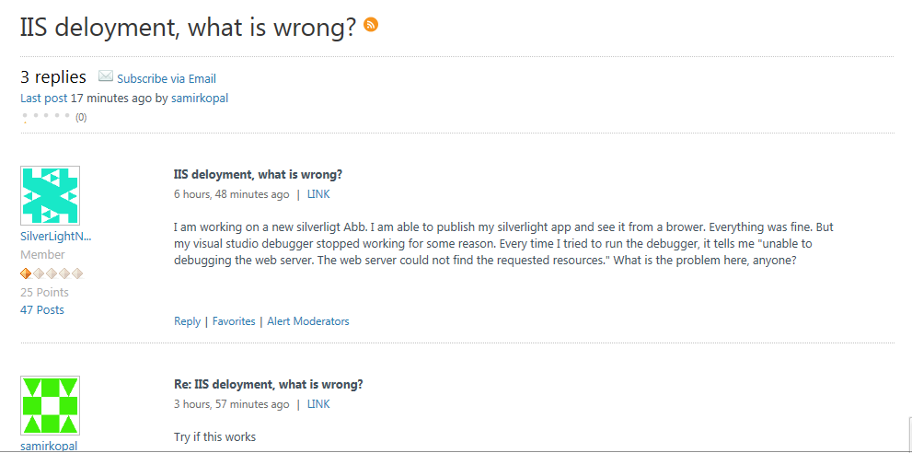
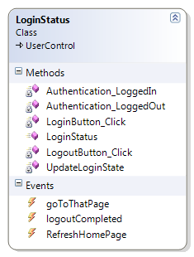
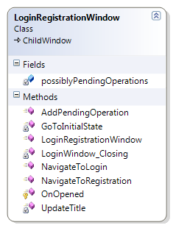
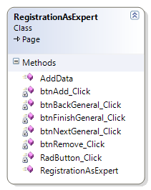
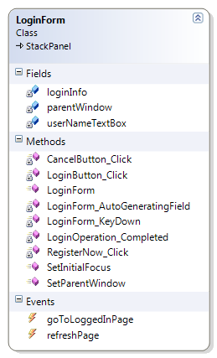
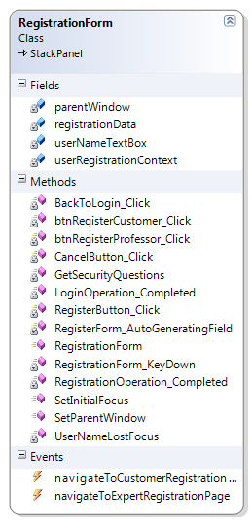
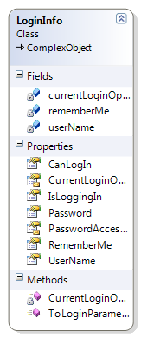
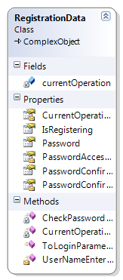
PROJECT OVERVIEW
CURRENT SITUATION
Use
Use

Slide 5
PROJECT OVERVIEW
CURRENT SITUATION
Current Situation
Demand of business
Connect recruitment & candidates
Outsourcing is developing
Existing has limitation
Use
Use

Slide 6

PROJECT OVERVIEW
IDEAS – PROJECT APPROACH
Free lances
Short time works
I
Work Detail
Notes:
Objective dua tren

Slide 7
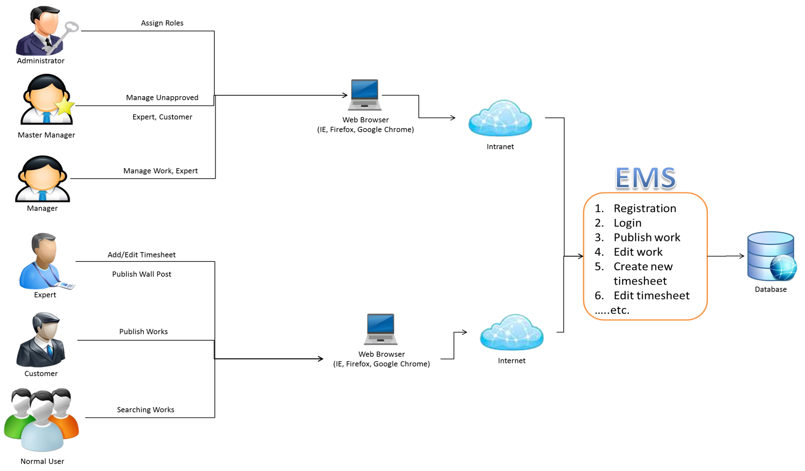
PROJECT OVERVIEW
FUNCTIONAL OVERVIEW & SYSTEM OVERVIEW

Slide 8
PROJECT OVERVIEW
FUNCTIONAL OVERVIEW & SYSTEM OVERVIEW
Authentication Service
Management Service
Information Sharing Service
Account Management Service

Slide 9
PROJECT MANAGEMENT
PROCESS MODEL
ORGANIZATION
MASTER SCHEDULE
MEETING MINUTES SCHEDULE
OBJECTIVE & DELIVERABLE
QUALITY MANAGEMENT
Notes:
Them project lifecycle

Slide 10
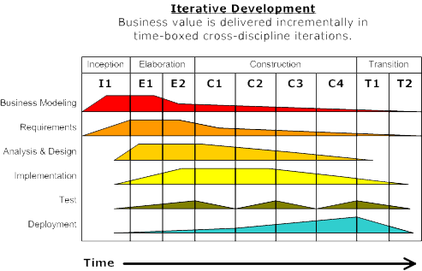
PROJECT MANAGEMENT
PROCESS MODEL
Notes:
Them project lifecycle

Slide 11
PROJECT MANAGEMENT
PROCESS MODEL
Inception
Elaboration
Construction
Transition
Requirement
Plan
Risk
Clear Requirement
Prototype
Develop
Beta Testing
Maintaining
Metrics | Unit | Committed
Start Date | date | 20/4/2011
End Date | date | 25/08/2011
Duration | days | 91
Maximum Team Size | Person | 4
Stage | Deliverable | Delivery date
Inception | Report No.1 Introduction | Fri 13/05/11
Inception | Report No.2 Software Project Management Plan | Mon 23/05/11
Elaboration | Report No.3 Software Requirements Specifications | Fri 03/06/11
Elaboration | Report No.4 Software Design Description | Mon 20/06/11
Construction | All coding | Mon 25/07/11
Construction | Report No.5 Software Test Documentation (STD) | Mon 01/08/11
Transition | Report No.6 Software User’s Manual | Mon 01/08/11
Transition | The last Document and CD source code | Mon 18/08/11
Notes:
Them project lifecycle

Slide 12
PROJECT MANAGEMENT
PROJECT LIFE CYCLE
Requirement Analysis
Design & Development
Quality Assurance & Testing
Implementation & Development
Maintenance & Support
Stage | Deliverable | Delivery date
Inception | Report No.1 Introduction | Fri 13/05/11
Inception | Report No.2 Software Project Management Plan | Mon 23/05/11
Elaboration | Report No.3 Software Requirements Specifications | Fri 03/06/11
Elaboration | Report No.4 Software Design Description | Mon 20/06/11
Construction | All coding | Mon 25/07/11
Construction | Report No.5 Software Test Documentation (STD) | Mon 01/08/11
Transition | Report No.6 Software User’s Manual | Mon 01/08/11
Transition | The last Document and CD source code | Mon 18/08/11
Notes:
Them project lifecycle

Slide 13
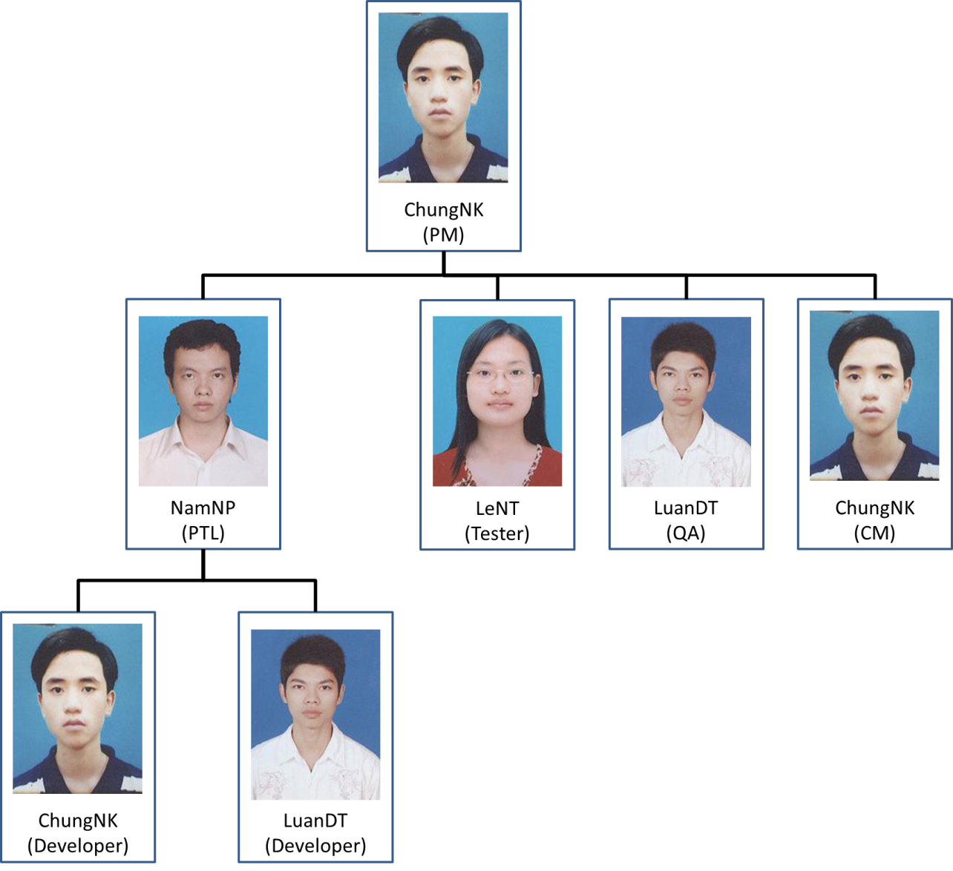
PROJECT MANAGEMENT
ORGANIZATION

Slide 14
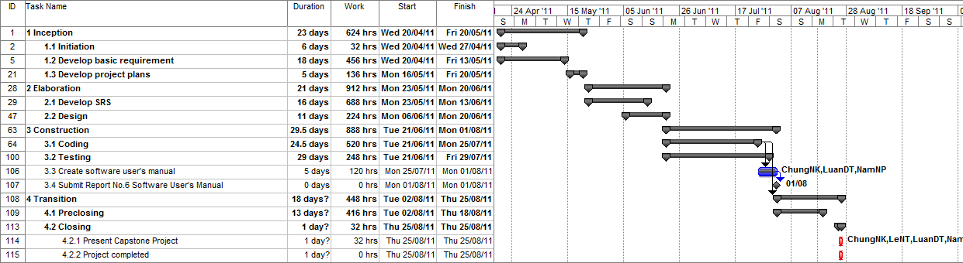
PROJECT MANAGEMENT
MASTER SCHEDULE

Slide 15

PROJECT MANAGEMENT
MEETING MINUTES SCHEDULE
Report task, issues.
Meeting minutes are tracked.
Discuss plan next week

Slide 16
PROJECT MANAGEMENT
OBJECTIVE & DELIVERABLE
OBJECTIVE
Deliver on time
Requirement Completion
UT test case destiny
CT test case destiny
Bug ratio
DELIVERABLE
Inception
Elaboration
Construction
Transition
Notes:
Bo sung Deliver table

Slide 17
PROJECT MANAGEMENT
OBJECTIVE & DELIVERABLE
OBJECTIVE
Metrics | Unit | Committed
Start Date | date | 20/4/2011
End Date | date | 25/08/2011
Duration | days | 91
Maximum Team Size | Person | 4
Notes:
Bo sung Deliver table

Slide 18
PROJECT MANAGEMENT
OBJECTIVE & DELIVERABLE
DELIVERABLE
No | Stage | Deliverable | Delivery date
1 | Inception | Report No.1 Introduction | Fri 13/05/11
2 | Inception | Report No.2 Software Project Management Plan | Mon 23/05/11
3 | Elaboration | Report No.3 Software Requirements Specifications | Fri 03/06/11
4 | Elaboration | Report No.4 Software Design Description | Mon 20/06/11
5 | Construction | All coding | Mon 25/07/11
6 | Construction | Report No.5 Software Test Documentation (STD) | Mon 01/08/11
7 | Transition | Report No.6 Software User’s Manual | Mon 01/08/11
8 | Transition | The last Document and CD source code | Mon 18/08/11
Notes:
Bo sung Deliver table

Slide 19
PROJECT MANAGEMENT
QUALITY MANAGEMENT
Test approach
Test base on user’s role in system
Black box test & white box test
Ensure quality
Unit test
Integration test
System test
Notes:
Quality objective & type of test

Slide 20
PROJECT MANAGEMENT
QUALITY MANAGEMENT
Metrics | Unit | Targeted
Timeliness | % | 100
Requirement completion | % | 100
UT test case destiny | Test cases/KStep | 80
CT test case destiny | Test cases/KStep | 40
Bug ratio | Bugs/KStep | 10
Notes:
Quality objective & type of test

Slide 21
PROJECT MANAGEMENT
QUALITY MANAGEMENT
Test Scope
No | Group Function | Function
1 | HOME PAGE | Top Page
2 | EXPERT MANAGEMENT | Profile Registration
3 |  | Schedule & Timesheet Display
4 | CUSTOMER MANAGEMENT | Profile Registration
5 |  | Customer’s Job
6 | JOB MANAGEMENT | Manage Job
7 | OTHER | Login
8 |  | Authority Setting
Notes:
Quality objective & type of test

Slide 22
ARCHITECTURES
ARCHITECTURE REPRESENTATION
WHY CHOOSE TECHNOLOGY
COMPONENT VIEW

Slide 23
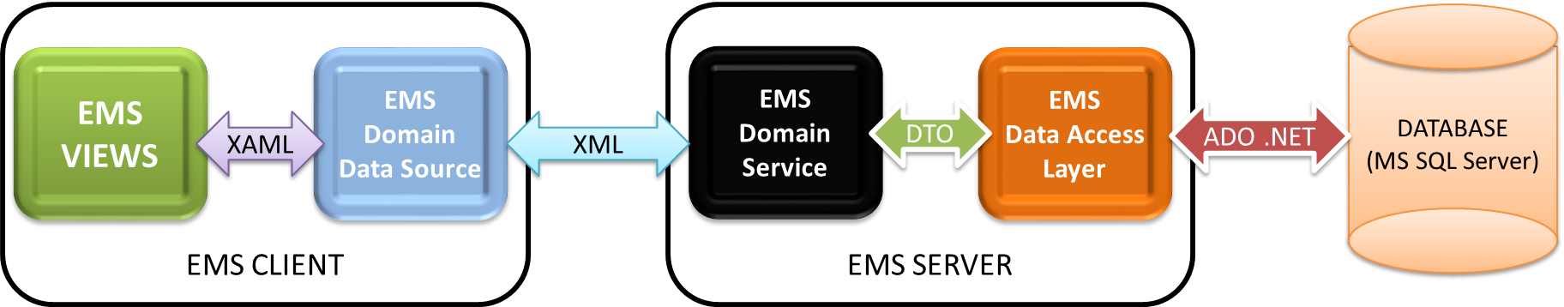




ARCHITECTURES
ARCHITECTURE REPRESENTATION

Slide 24

ARCHITECTURES
WHY CHOOSE TECHNOLOGY
.NET is familiar
RIA Service is easy to apply
LINQ is easy to study
Silverlight can reduce effort

Slide 25
ARCHITECTURES
COMPONENT VIEW

Slide 26
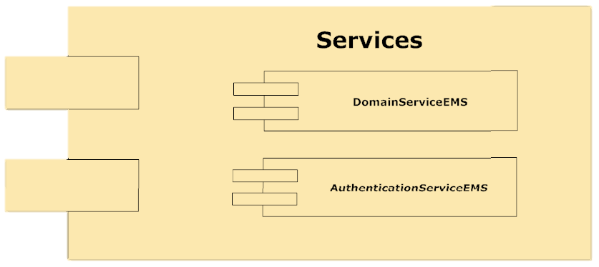
ARCHITECTURES
COMPONENT VIEW

Slide 27
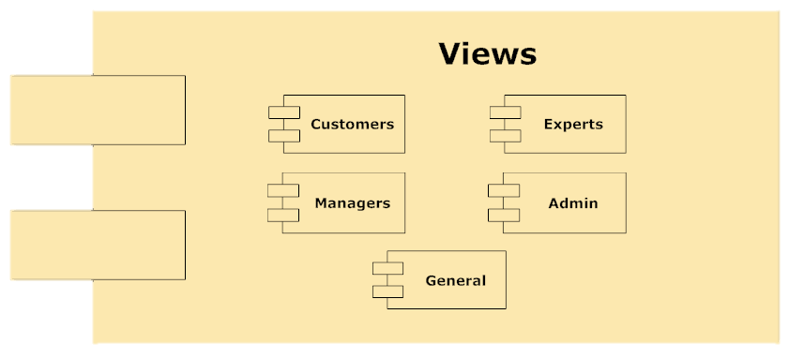
ARCHITECTURES
COMPONENT VIEW

Slide 28
RESULT
OBJECTIVE COMPARE WITH RESULT
LESSON LEARNT
Notes:
Bo sung huong phat trien

Slide 29
RESULT
OBJECTIVE COMPARE WITH RESULT
Product
Product satisfy requirement
Product is delivered on time
User Interface is not satisfy all user
Technology
System use technology as designed
Developing team studied new technology as target
Resource
Developing process is completed in budget of human resource
Notes:
Bo sung huong phat trien

Slide 30
RESULT
OBJECTIVE COMPARE WITH RESULT
Metrics | Objective | Actual
Start Date | 20/4/2011 | 20/4/2011
End Date | 25/08/2011 | 25/8.2011
Duration | 91 | 91
Notes:
Bo sung huong phat trien

Slide 31
RESULT
QUALITY OBJECTIVE COMPARE WITH RESULT
Metrics | Objective | Actual
Timeliness | 100% | 100%
Requirement completion | 100% | 100%
UT test case destiny | 80 Test cases/KStep | 80 Test cases/KStep
CT test case destiny | 40 Test cases/KStep | 40 Test cases/KStep
Bug ratio | 10 Bugs/KStep | 10 Bugs/KStep
Notes:
Bo sung huong phat trien

Slide 32





RESULT
FUTURE DEVELOPMENT
Offline system
Windows Mobile version
Human resource functions
Notes:
Bo sung huong phat trien

Slide 33
Bad
Time Management
Requirement
Over time
Good
Choosing technology
Communication
Exploring time
Manage code
RESULT
LESSON LEARNT
Notes:
Good & bad practice

Slide 34
DEMO
SCENARIO 1: WORK AS CUSTOMER
SCENARIO 2: WORK AS MASTER MANAGER
SCENARIO 3: WORK AS MANAGER
SCENARIO 4: WORK AS EXPERT

Slide 35
DEMO
SCENARIO 1: WORK AS CUSTOMER
Login as customer
Publish a Work
Add Expert Request

Slide 36
DEMO
SCENARIO 2: WORK AS MASTER MANAGER
Login as Master Manager
Work with Customer
Work with expert
Send work to manager

Slide 37
DEMO
SCENARIO 3: WORK AS MANAGER
Login as Manager
Work with Customer
Assign expert
View expert detail

Slide 38
DEMO
SCENARIO 4: WORK AS EXPERT
Login as Expert
View Works
Complete Timesheet

Slide 39
THANK YOU!

