Slide 2
Project members
4 Up

Slide 3
Table of content
Introduction
Project Management
Requirements
Design and Implementation
Testing
Result and Future
Demo and Q&A
1
2
3
4
5
6
7

Slide 4
1. Introduction Background
Travel develop so fast.
Too much luggage!
Mobile application.
Notes:
- Du lịch phát triển nhanh
- Khó khăn khi đi du lịch: mang theo bản đồ, tìm địa điểm hay, sách Ngôn ngữ (nhưng câu nói thông dụng), đổi tiền. Lỉnh kỉnh, phức tạp.

Slide 5
1. Introduction Literature review
Advantage:
Fast.
Rich of information.
Rich of function.
Disadvantage:
Only support for alone traveler.
Not focus on travel.

Slide 6
1. Introduction Proposed system
Advantage:
Hotel, flight information.
Book room or flight.
Best for prepare a trip.
Disadvantage:
Not support on travel time.

Slide 7
1. Introduction Proposed system
New Feature:
Travel with group.
Easy to chat and share.
Support foreign travel
(common conversation).
Inheritance from existing system:
International travel.
Digital map.

Slide 8
1. Introduction Technology choices
Server
Client
.Net 4.0
Web Service
Tools:
VS 2010
MS SQL 2008 R2
IIS7
MVC
Java
Tools:
Java Deployment Toolkit (JDK)
Eclipse (Galileo/Helios) for develop J2EE application
Google App Engine SDK for Java
The Google Plug-in for Eclipse
Plug-in ADT for eclipse
Android SDK
Notes:
can co version cua tool
+ cong nghe can noi ve uu diem nhuoc diem cua tool
+ cong nghe da chon SQL server 2008 R2
+ tai sao chon android
phat trien manh
ngay cang pho bien
dua ra them thong tin tham khao

Slide 9
2. Project management Project goal
Scope
Success
Time
Cost
Notes:
Mucj tiêu cho project
Time
Scope
Cost

Slide 10
2. Project management Process model
Difficult in specify all requirement
always have a running version of the program
Save effort when requirement changed
Limit time and experience
Notes:
Neu li do chon model Iterative and incremental
Neu loi ich cua viec dung model nay

Slide 11
2. Project management Project organization
Notes:
Tổ chức của team

Slide 12
2. Project management Milestone
May | June | July | August
Intro
R1
Project plan
R2
Requirement
R3
Design
R4
Coding
Unit testing
Testing
R5
User
Manual
R6
Notes:
Để đạt được target về time thì define ra các milestones

Slide 13
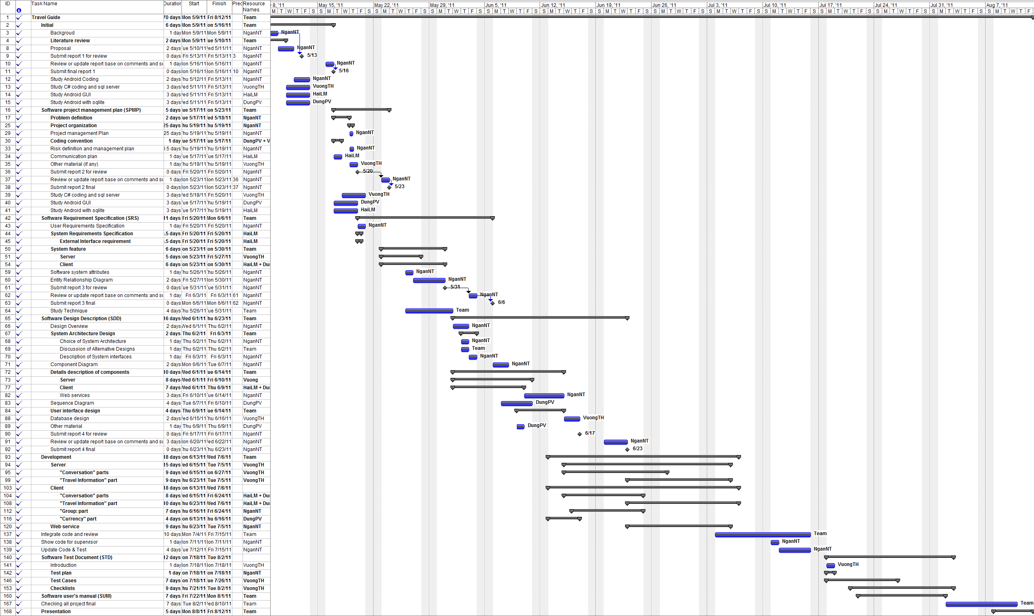
2. Project management Project Plan

Slide 14
2. Project management Time management
Weekly meeting
Assign Task
Personal working
Individual Report

Slide 15
2. Project management Approach Methodology
Brainstorming
Personal working
Raise issue if any
Summary

Slide 16
2. Project management Risk Management
1
1
New Technology
Study
2
2
Requirement Changes
Clarify requirement
3
3
Time Management
Team Rules
4
4
Management Experience
Supervisor’s advices

Slide 17
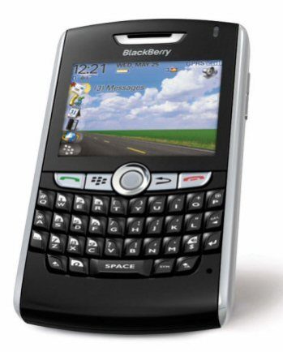
2. Project management Communicate tools
3 times per week
keep track with the team’s work everywhere
Daily report, problem sharing , etc.
Emergency case

Slide 18
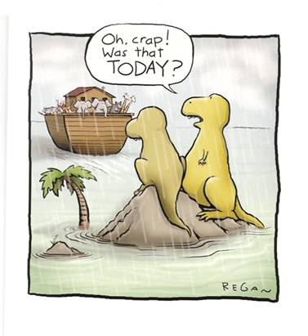
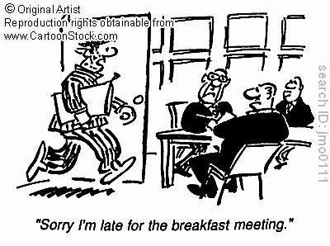
2. Project management Team rules
5-10k
5k
Notes:
Noi ve rule cua team
Miss deadline 5k
Gap van de ma ko raise len phat 10k
Toi hop team muon 5k
…

Slide 19
3. Requirement Specification Server App – Functional requirement
Manage data (manual by particular record and automatic by excel)
Insert
Update
Delete
View

Slide 20
3. Requirement Specification Client App – Functional requirement
Common conversations in multiple language.
Currency exchange application with up-to-date rate.
View and search places
Provide facilities for group of user
Notes:
Thêm ảnh vào slide này nhé
1- ảnh part 1
2- ảnh part 3
3- ảnh part 2
4- ảnh tổng hợp các tiện ích cho group user

Slide 21
3. Requirement Specification Non-Functional requirement
Reliability
Availability
Maintainability
Performance

Slide 22
4. Design and Implementation System Overview
Client
SERVER
DB
Web services
http/json
Window – App
Administrator
SOURCE

Slide 23
4. Design and Implementation Server App – Architecture
Client
Data Source
Data Source
Internet
Services
Travel Information
Travel Conversation
Common
Controller
Validation
.NET FRAMEWORK
Objects
Utilities
Data Access
Database

Slide 24
4. Design and Implementation Server App – Class Diagram

Slide 25
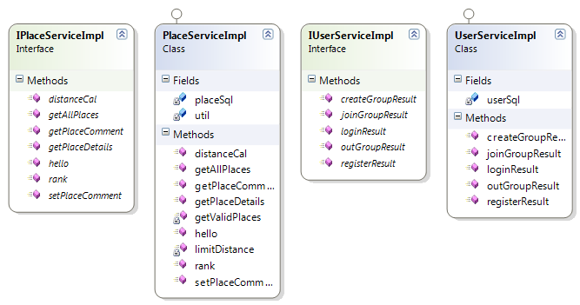
4. Design and Implementation Service – Class Diagram

Slide 26
4. Design and Implementation Sequence Diagram

Slide 27
4. Design and Implementation Client App – Architecture
Layout
Service
Common
Home
Conversation
Logging
Currency
Place & Group
Message
DB Adapter
SQLite
Notes:
Client được phát triển theo mô hình MVC
Tầng giao diện được implement bằng package Layout
Tầng bussiness được implement bằng các package: home,…
Tầng tương tác với cơ sở dữ liệu được implement bằng package DB Adapter

Slide 28
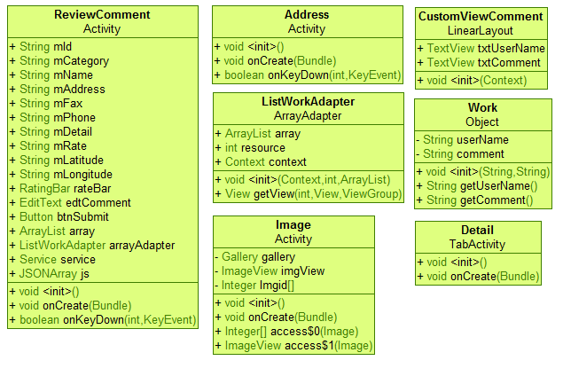
4. Design and Implementation Client App – Class diagram

Slide 29
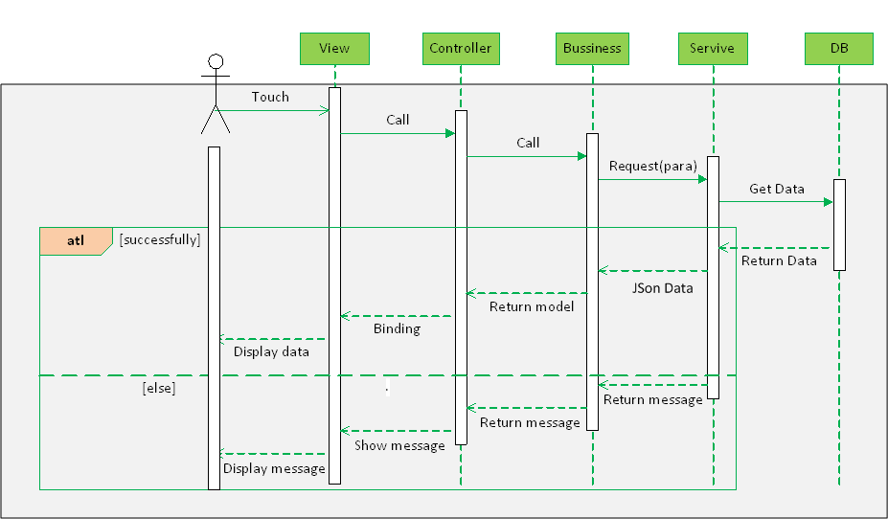
4. Design and Implementation Client App – Sequence Diagram

Slide 30
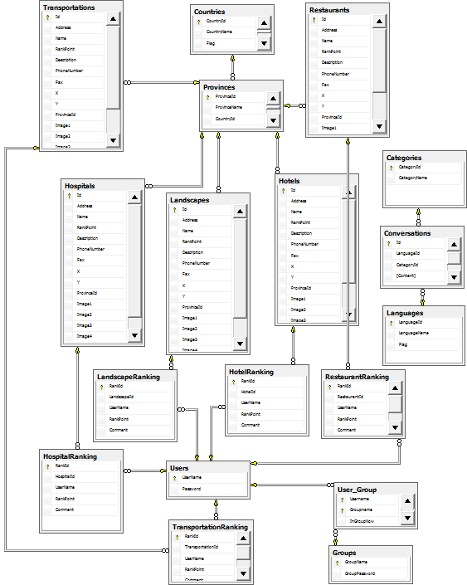
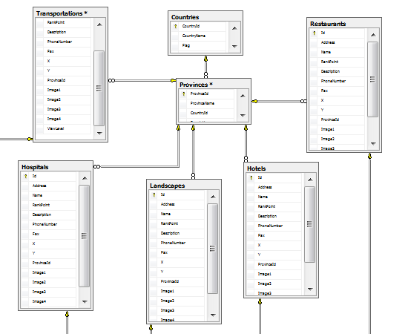
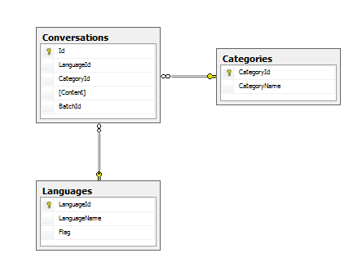
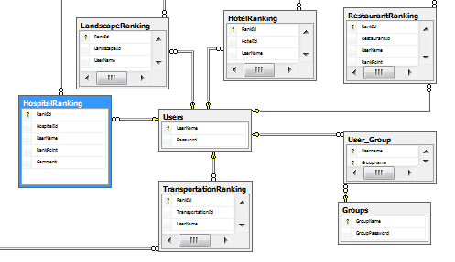
4. Design and Implementation Database
ranking & comment
group

Slide 31
5. Testing Test strategy
Test types:
Functional testing
User interface testing
Data Volume testing
Installation testing

Slide 32
5. Testing Test stage
Type of Tests | Stage of Test
 | Unit | Integration | System
Functional Tests | x | x | x
User Interface Tests |  |  | x
Data Volume Tests | x | x

Slide 33
5. Testing Test schedule
Test Schedule | Start Date | End Date
Unit Testing | 01/07/2011 | 23/07/2011
Integration Testing | 25/07/2011 | 30/07/2011
System Testing | 01/08/2011 | 06/08/2011

Slide 34
5. Testing Test plan
Features to be tested:
All features listed in requirement
Component | Module | Total testcase | Tester | Plan start date | Plan finish date | Actual start date | Actual finish date
Server Application |  | 91
 | Main menu | 6 | VuongTH
 | Conversation management | 41 | VuongTH
 | Place management | 44 | VuongTH
Client Application |  | 37
 | Main menu | 4 | HaiLM
 | Conversation | 5 | HaiLM
 | Place | 24 | DungPV + NganNT
 | Currency | 4 | HaiLM
Features not to be tested:
Features not listed in requirement.

Slide 35
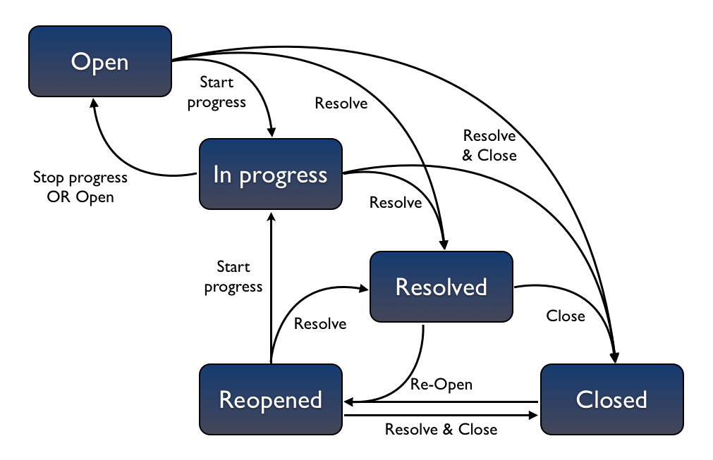
5. Testing How to test

Slide 36
5. Testing Test report
Component | Module | Total testcase | Not run | Pass | Fail | Block | N/A
Server Application |  | 91 |  | 91
 | Main menu | 6 |  | 6
 | Conversation management | 41 |  | 41
 | Place management | 44 |  | 44
Client Application |  | 37 |  | 37
 | Main menu | 4 |  | 4
 | Conversation | 5 |  | 5
 | Place | 24 |  | 24
 | Currency | 4 |  | 4

Slide 37
6. Lesson learn
Requirement specify
Project management
Team work

Slide 38
Demo & QA

