Slide 1


METRO CALENDAR
A new way to manage your life

Slide 2


Table of contents
Introduction
Problem definition
What’s metro calendar
Project organization
Project plan
Requirements
Software Design
Testing
Demo

Slide 3


Introduction

Slide 4
Team Antares
Name | Roles
Lã Ngọc Quang | Supervisor
Lê Hoàng Hưng | Group Member
Lê Xuân Nghĩa
Vũ Thanh Bình
Trương Trung Nghĩa
Trần Thái Sơn

Slide 5

Problem definition

Slide 6
Problem definition
People do not manage their tasks effectively. They need an application to help control their tasks.
The majority of high-tech users require a project management tool.
This is the tablet’s era, we should aim to that target.

Slide 7
What’s metro calendar

Slide 8
What’s Metro calendar
"Metro" is based on the design principles of classic Swiss graphic design.
An easy to use tasks management software
Especially made for developer with project management function which follow the waterfall model .

Slide 9
Literature Review
Google Calendar is a free time-management web application offered by Google
Yahoo! Calendar is a Web-based calendar service from Yahoo!
Windows 8 Calendar is a application calendar service from Nicrosoft

Slide 10
Why Metro calendar?
Work offline
Timeline view
Modern user interface
Lunar calendar
Dynamic weather background
Localization with 3 languages: Vietnamese, English and Japanese

Slide 11
Project organization

Slide 12
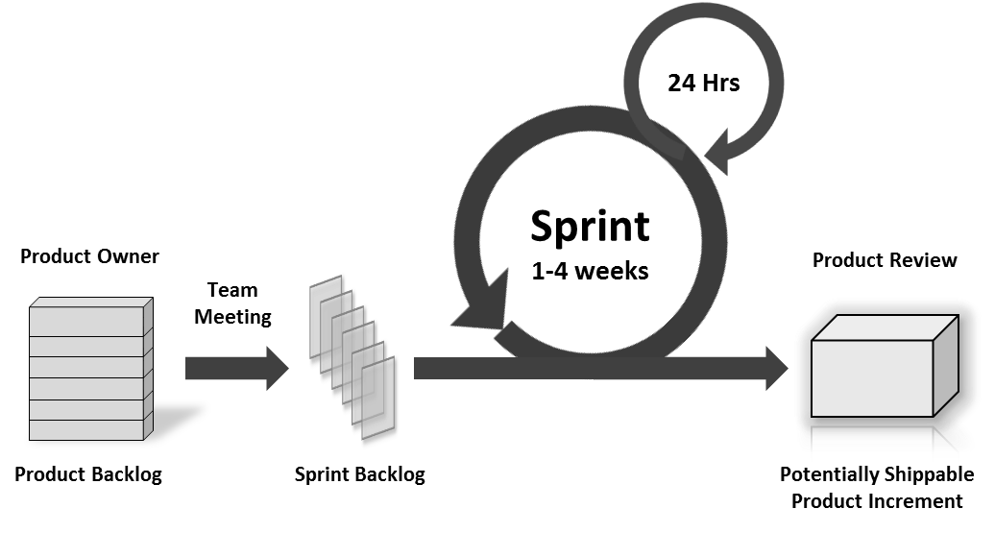
Software project model

Slide 13
Roles and responsibilities
Scrum Master
HungLH
Product Owner
NghiaLX
Development team
Technical leader
Coder
NghiaLX
NghiaTT
Quality Assurance
HungLH
BinhVT
SonTT
BinhVT

Slide 14
Project plan

Slide 15
Project plan
Project Kickoff Sep, 10th
Sprint 1 Sep, 24th
Sprint 3 Nov, 5th
Release Candidate Dec, 18th
Oct, 14th
Nov, 25th
Sprint 0 Sep, 10th
Sep, 23rd
Sprint 2 Oct, 15th
Nov, 4th
Sprint 4 Nov, 26th
Dec, 16h

Slide 16
Risks
Risk Description | Risk type | Prob-ability (1-5) | Effect (1- 5) | Risk Strategy | Resolution
Members’ illness | People | 2 | 4 | Build a reasonable working schedule. | - PTL and PM monitor other members’ tasks and always ready to do these tasks instead of them if can - Using buffer timeto recover works
Bad attitude of team member: in-cohesive with team, breach of discipline | People | 3 | 5 | - Engage teamwork. - Team-building | Create team’s policies: rewarding and punishment
Workingproductivityis not high | Technical | 4 | 4 | - Define standards to be followed to meet the performance criteria -Training technology seriously and research all related problem | - Using buffer timeto recover works - Cross-review tasks to track working process
Design Difficulty: Interface is notattractive, reasonable | Technical | 3 | 3 | Before designing, research in existing system to find out their advantage and disadvantage. | Design the interface with the instructions of an expert.
Working progress is notmeeting schedule | Time | 3 | 5 | Create buffer in plan | Using buffer timeto recover works

Slide 17
Requirements

Slide 18
Functional requirements
Authentication
  Login
User information management
  Edit profile
  View other’s profile
Tasks management
  Create, edit, delete

Slide 19
Functional requirements
Project management
  Create project, Edit project
Project’s member management
  Request add member
  Accept, reject request
  Remove member
  Mark active, inactive member

Slide 20
Functional requirements
Project’s tasks management
  Create, edit, delete task
  Accept, reject task
Weather forecast
  Display 15 days weather forecast
  Change units from Celsius to Fahrenheit and vice versa
Refresh data
  Refresh data from azure server

Slide 21
Functional requirements
Localization
  Localize user interface
  Lunar calendar
Search
  Search tasks, users and projects
Notification
  Live tile
  Toast notification

Slide 22
Non-functional requirements
Usability
Availability
Security
Maintainability
Portability
Performance
Windows store certification

Slide 23
Software design

Slide 24



System architecture
Service connection
Azure Service
e Service
View Model
Repository
Entity framework
Http protocol
Http Client
Database
View
Weather Service
Http protocol
Common
Windows live service
Live SDK
Http protocol
Client application

Slide 25
System architecture

Slide 26
System architecture

Slide 27
System architecture

Slide 28
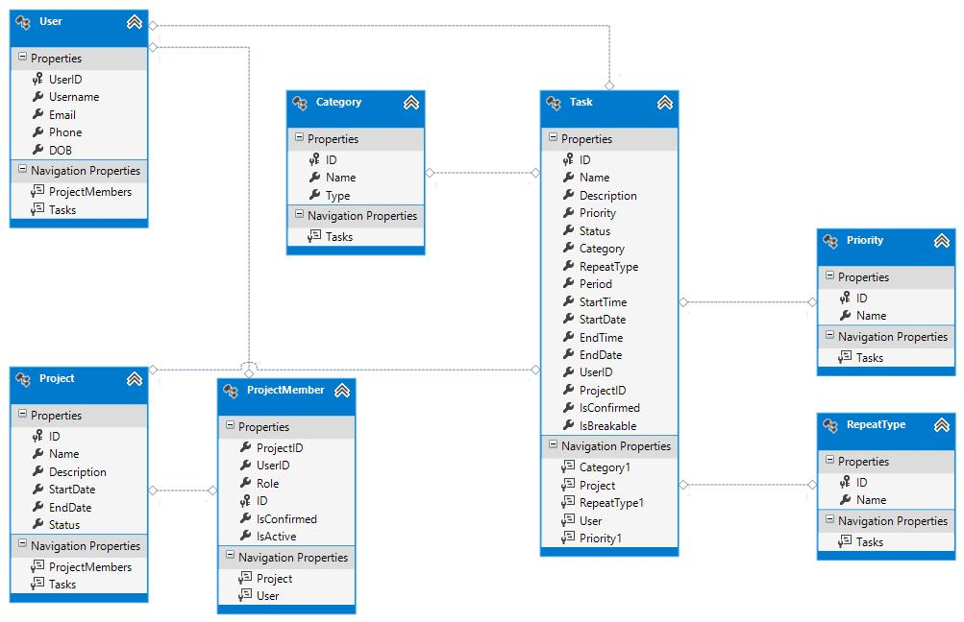
Database diagram

Slide 29
Testing

Slide 30
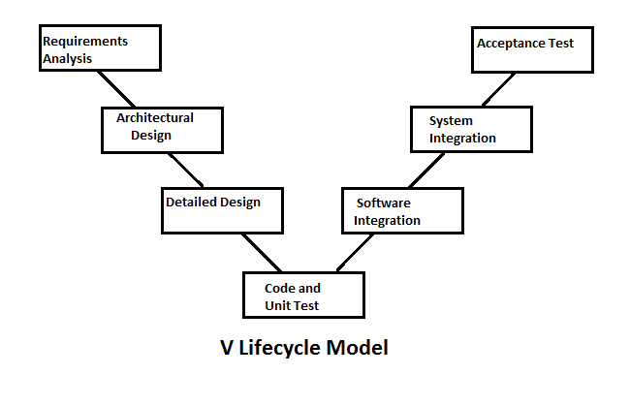
Test approach

Slide 31
Test results
Module code | Pass | Fail | Untested | N/A | Number of test cases
Total | 161 | 2 | 0 | 0 | 163
Authentication | 3 | 0 | 0 | 0 | 3
Presentation | 10 | 0 | 0 | 0 | 13
User information manager | 4 | 0 | 0 | 0 | 4
Manage project | 11 | 0 | 0 | 0 | 11
Manage project members | 6 | 0 | 0 | 0 | 6
Manage project task (project manager) | 27 | 0 | 0 | 0 | 27
Manage project (project member) | 5 | 0 | 0 | 0 | 8
Manage personal tasks | 28 | 0 | 0 | 0 | 28
Search | 11 | 2 | 0 | 0 | 13
Localization | 35 | 0 | 0 | 0 | 35
Weather | 6 | 0 | 0 | 0 | 6
Notification | 2 | 0 | 0 | 0 | 2
State view | 4 | 0 | 1 | 0 | 4
Refresh content | 6 | 0 | 1 | 0 | 6

Slide 32

Demo

Slide 33
Q&A

Slide 34
Thanks for listening

