Slide 1
WEBSITE OF LAW FIRM MANAGEMENT SYSTEM
SUPERVISOR:
TEAM MEMBERS:
MR. NGUYEN VAN SANG
SE60744 LE DUY HOANG
SE60595 DANG NGUYEN KHIEM
SE60631 TRAN ANH TUAN
SE60634 PHAM VAN DUY

Slide 2
PRESENTATION OUTLINE
1. Project overview
3. Software specification
4. Software design
6. Project result
7. Demo
2. Project management
5. Testing

Slide 3
Problem
Solution
Idea
PROJECT
OVERVIEW

Slide 4
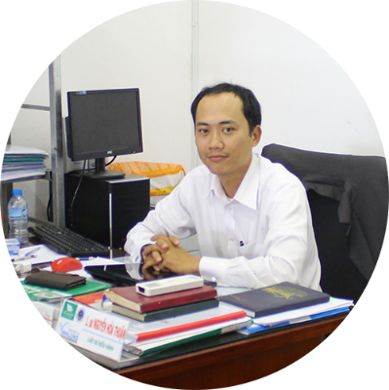
PROJECT OVERVIEW - Problem
Nowadays, most of law firm does not use technology for manage document.
The requirements from "Thuan Nguyen Law Firm" in Vinh Long City.
Manager of
Notes:
Tinh trang ung dung cong nghe thong tin vao van phong luat nhu the nao
Gioi thieu so ve van phong luat thuan Nguyen
Neu hien trang ung dung phen mem trong viec quan ly van phong

Slide 5
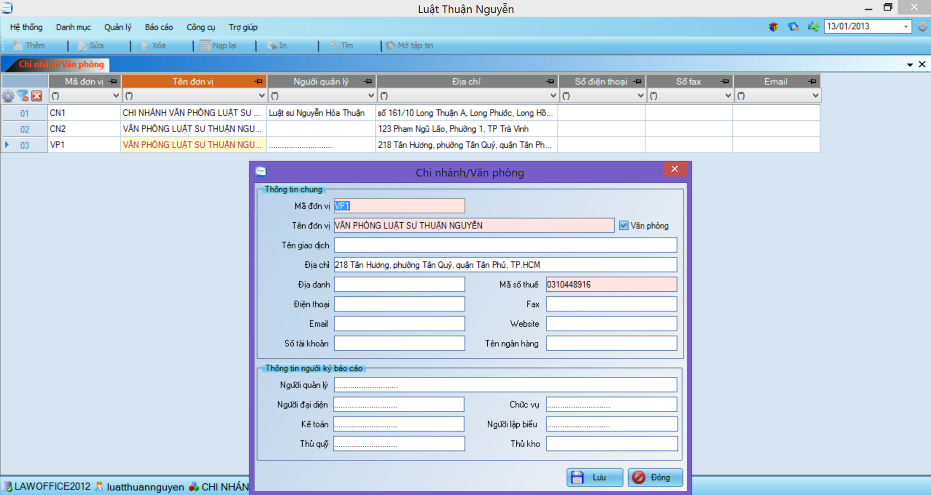
PROJECT OVERVIEW - Problem

Slide 6
PROJECT OVERVIEW - Problem
Many errors occur
Difficult to upgrade or maintain
Limit number of devices can use
Manage only 1 office
Manage with only text information
Notes:
Phan tich xu huong cong nghe hien nay de dua ra sua lua chon xay dung nen tang cong nghe

Slide 7
PROJECT OVERVIEW - Idea
Functional:
Manage Case
Manage Staff, Customer, Service…
Storage Document
Calendar
Statistic

Slide 8
PROJECT OVERVIEW - Idea
Non-Functional:
Steady running
Easy upgrade and maintenance
Multiple devices can use at the same time
Can be used for many types of office
Manage multimedia data
Notes:
Dua tren viec phan tich cac van de thuan Nguyen, nhom phat trien phan mem dap ung duoc cac yeu cau
Cac yeu cau chuc nang va phi chuc nang (khai quat quan ly)

Slide 9
PROJECT OVERVIEW - Solution
Why choose Website & .NET?
Popularity
Rich class library
Remote access
Run on multi-device
Experience

Slide 10
Project Model
Organization Structure
Master Schedule
Deliverables
Tools & Environment
Project Life cycle
Objectives
PROJECT
MANAGEMENT

Slide 11
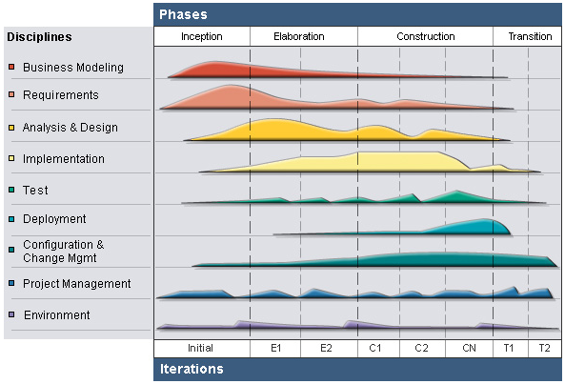
PROJECT MANAGEMENT – Project Model
RUP Model
Notes:
Theo so do nay mo hinh RUP chia lam cac phase. Theo chieu ngang va theo chieu doc nhu the nao

Slide 12
PROJECT MANAGEMENT – Project Model
Why choose RUP?
Develop iteratively
Supports an iterative approach to development that addresses the highest risk items at every stage in the lifecycle, significantly reducing a project’s risk.
Very important for inexperienced team in controlling issues like us.
Manage requirements
Managing requirements during the whole development process ensures project team develops the right system with right requirements

Slide 13
PROJECT MANAGEMENT – Project Model
Why choose RUP?
Verify software quality
Testing process is implemented in all the cycles of application development time
Reduce risks

Slide 14
PROJECT MANAGEMENT – Project Life Cycle
Phase 1: Inception
Study business case and feasibility study of project
Complete project management plan
Complete draft ERD of system
Complete draft screen prototypes
Complete draft requirements
Determine project scopes

Slide 15
PROJECT MANAGEMENT – Project Life Cycle
Phase 2: Elaboration
Complete user requirement specification
Complete software requirement specification
Complete ERD, final prototypes
Complete database model
Complete system architecture design

Slide 16
PROJECT MANAGEMENT – Project Life Cycle
Phase 3: Construction
Complete coding and unit test
Complete user manual
Complete functional and regression test
Phase 4: Transition
Deploy website
Complete all reports and documents
Deliver source code

Slide 17
PROJECT MANAGEMENT – Organization Structure
Project Manager
HoangLD
QA Team
HoangLD
Test Team
TuanTA
Develop Team
HoangLD
KhiemDN
HoangLD
DuyPV
TuanTA
TuanTA
HoangLD
DuyPV
KhiemDN
SRS Analysis Team
KhiemDN
Design Team
DuyPV
Supervisior
Mr. SangNV
DuyPV
HoangLD
TuanTA
HoangLD
DuyPV
KhiemDN

Slide 18
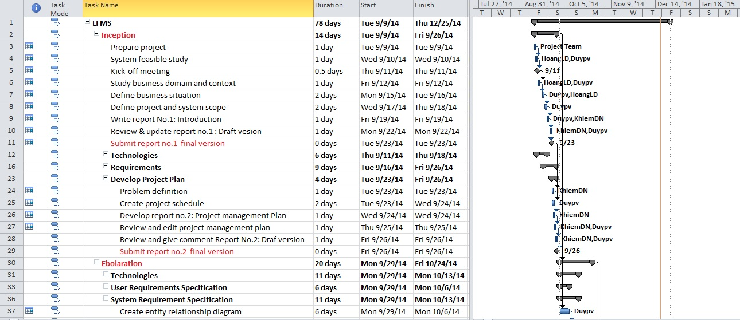
PROJECT MANAGEMENT – Master Schedule

Slide 19
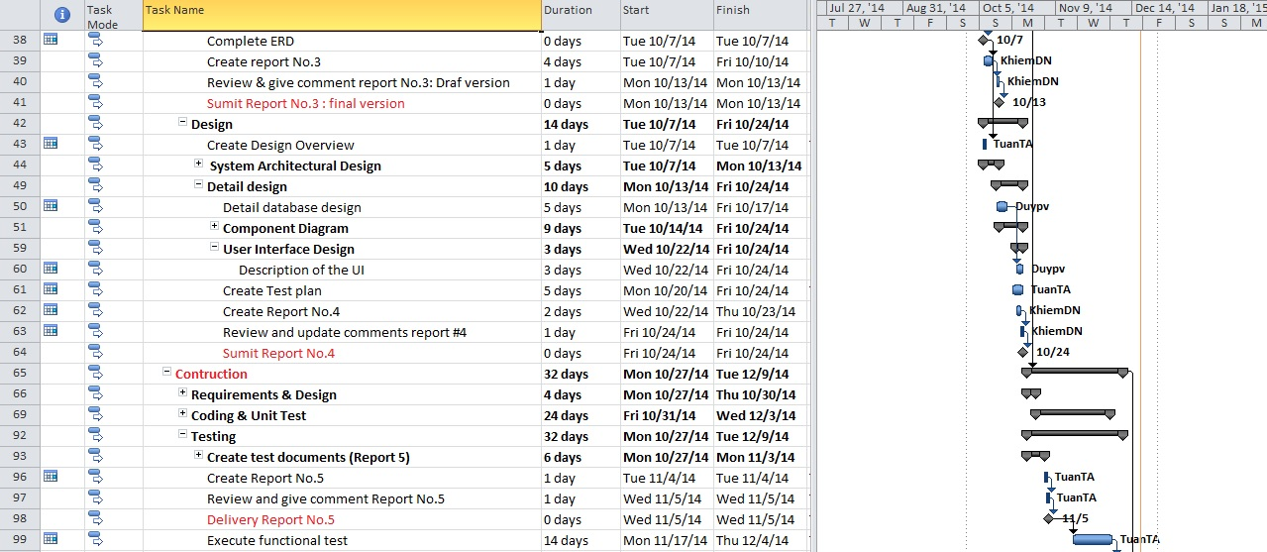
PROJECT MANAGEMENT – Master Schedule

Slide 20
PROJECT MANAGEMENT – Master Schedule

Slide 21
PROJECT MANAGEMENT – Objects
Metrics | Unit | Committed | Actual | Deviation
Start Date | dd-mm-yyyy | 09-09-2014 | 09-09-2014 | 0 days
End Date | dd-mm-yyyy | 25-12-2014 | 27-12-2014 | 2 days
Duration | Elapsed days | 78 days | 80 days | 2 days
Maximum Team Size | Person | 4 | 4 | 0

Slide 22
PROJECT MANAGEMENT – Deliverables
No | Stage | Deliverable/ Milestone | Delivery Date | Delivery Location
1 | Inception | Deliver Report No.1 | 23-09-2014 | Supervisor
2 | Inception | Project plan | 26-09-2014 | Supervisor
3 | Inception | Deliver Report No.2 | 26-09-2014 | Supervisor
4 | Elaboration | Deliver Report No.3 | 13-10-2014 | Supervisor
5 | Elaboration | Deliver Report No.4 | 24-10-2014 | Supervisor
6 | Construction | Complete Coding | 5-12-2014 | Supervisor
7 | Construction | Deliver Report No.5 | 5-11-2014 | Supervisor
8 | Construction | Deliver Report No.6 | 3-12-2014 | Supervisor
9 | Transition | The last Document and CD source code | 16-12-2014 | FU
10 | Transition | Project completed | 25-12-2014 | FU

Slide 23
PROJECT MANAGEMENT – Tools & Environments

Slide 24
System Overview
Functional Requirement
Non Functional Requirement
SOFTWARE
SPECIFICATION

Slide 25
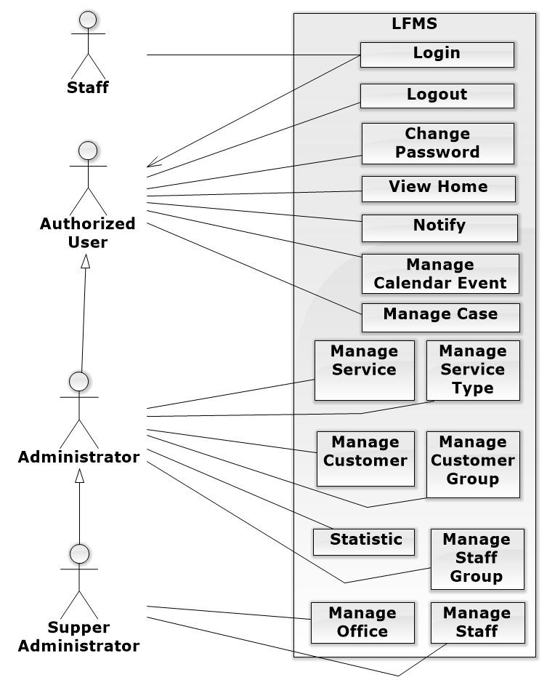
SOFTWARE SPECIFICATION – Deliverables
Notes:
Staff thanh LFMS user

Slide 26
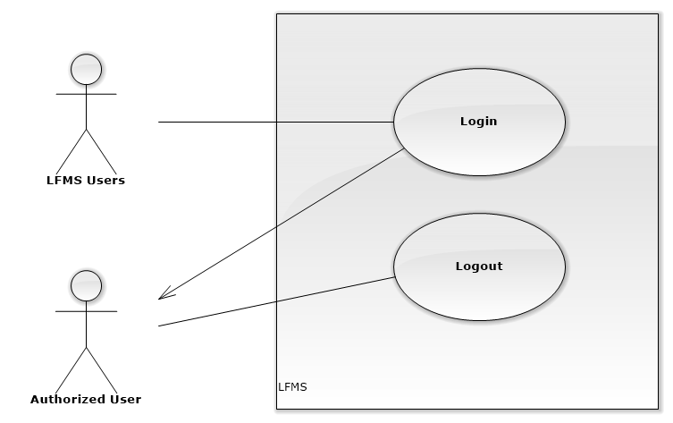
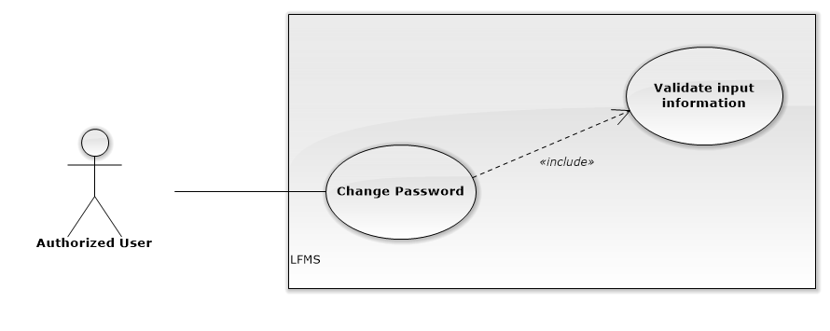
SOFTWARE SPECIFICATION – Functional Requirement
Authentication
Change password

Slide 27
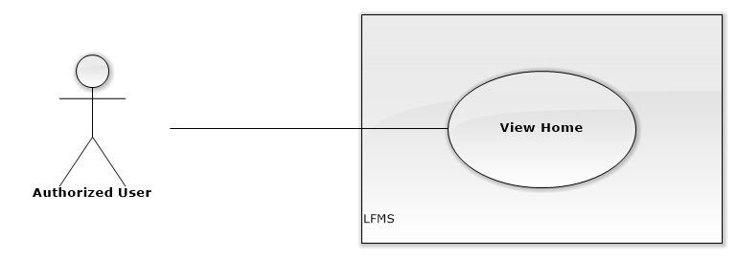
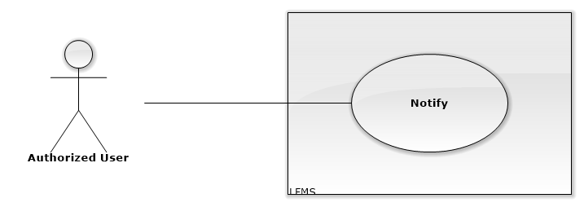
SOFTWARE SPECIFICATION – Functional Requirement
Notify
View Home

Slide 28
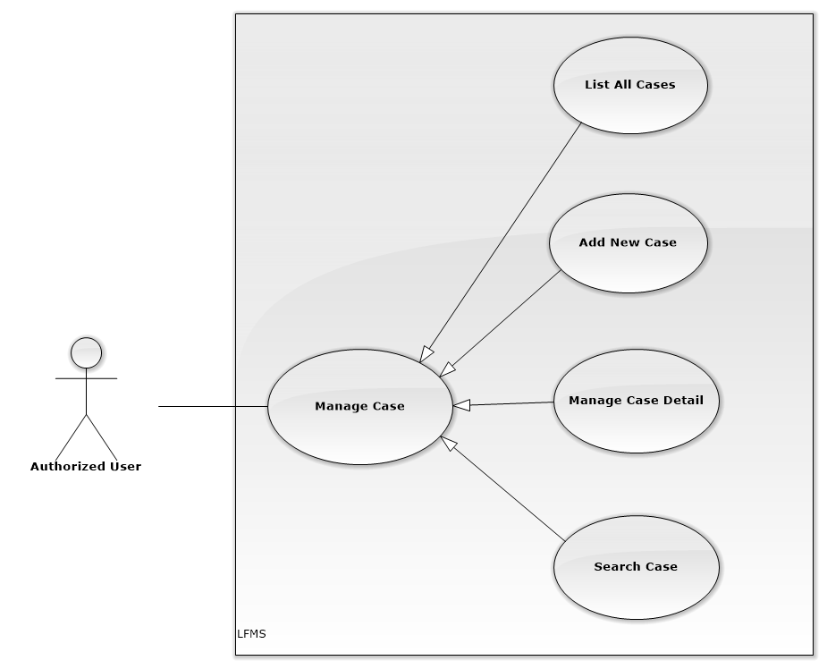
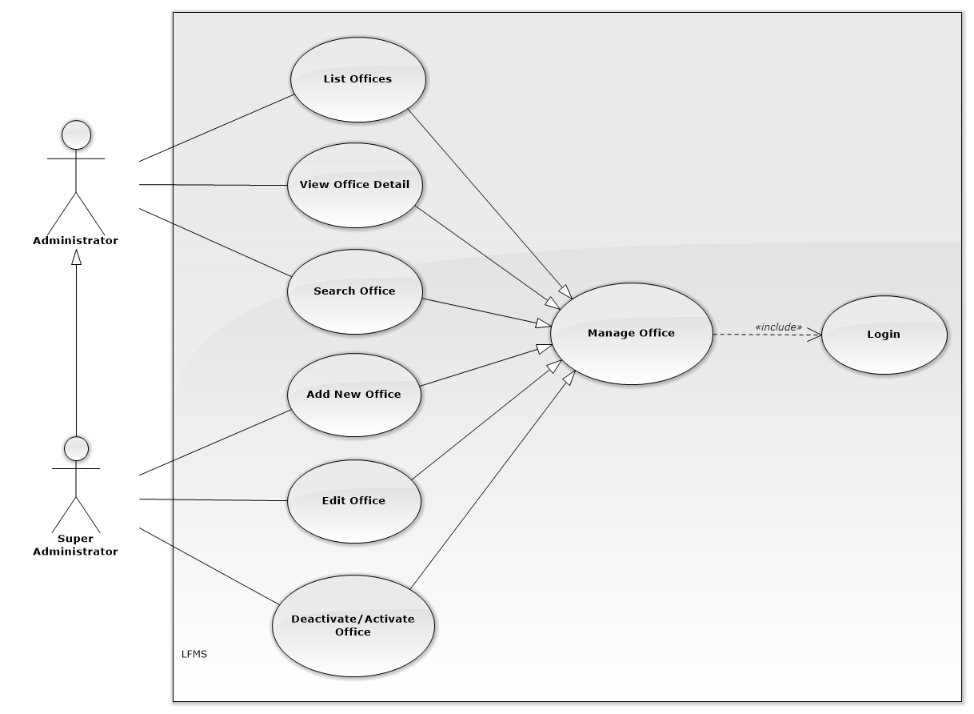
SOFTWARE SPECIFICATION – Functional Requirement
Manage Case
Manage Office

Slide 29
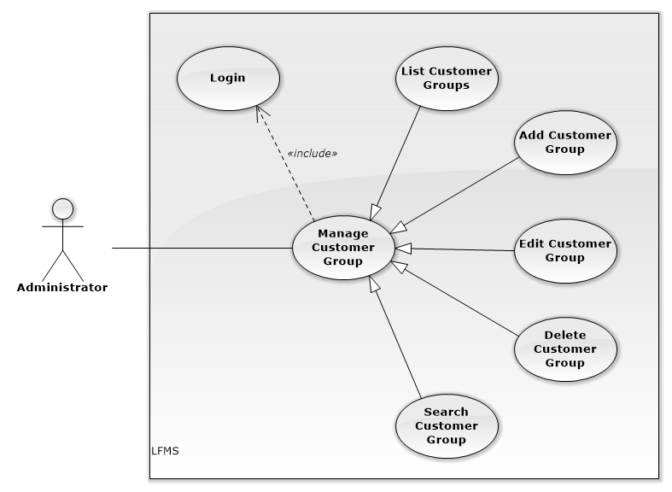
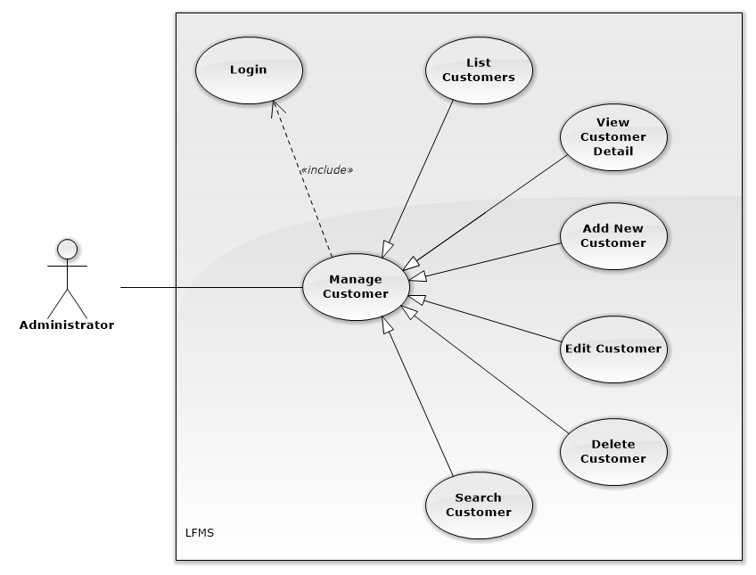
SOFTWARE SPECIFICATION – Functional Requirement
Manage Customer
Manage Customer Group

Slide 30
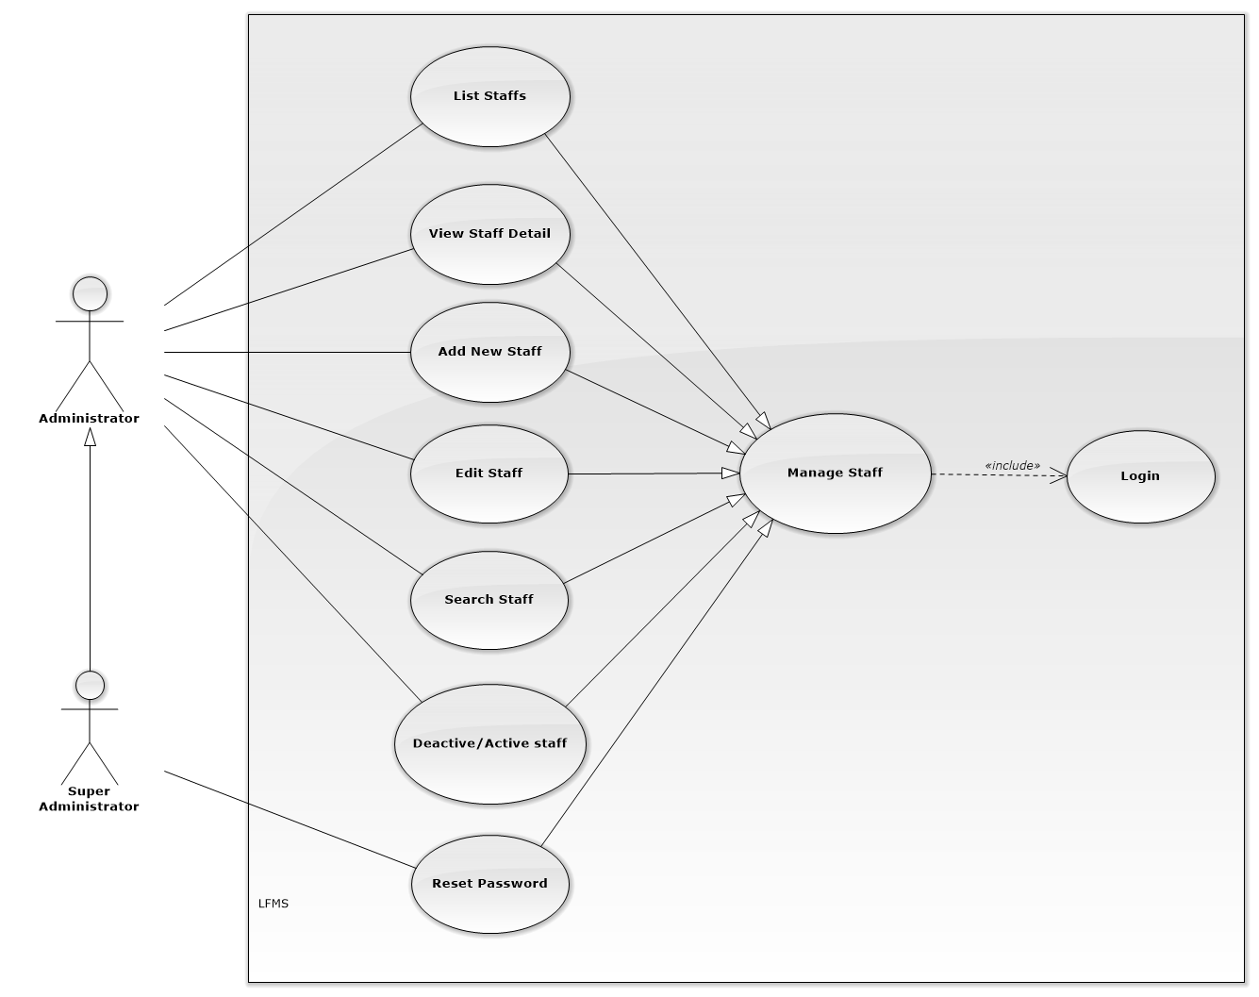
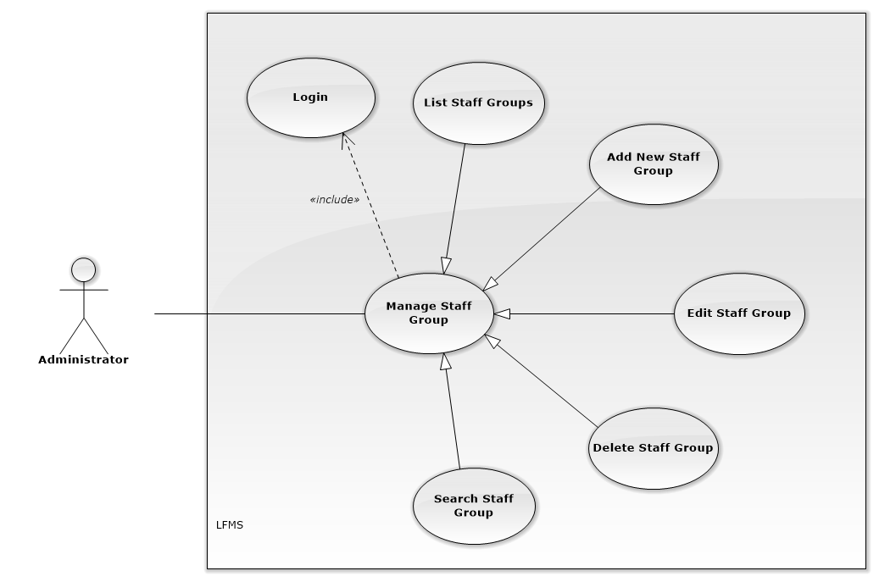
SOFTWARE SPECIFICATION – Functional Requirement
Manage Staff
Manage Staff Group

Slide 31
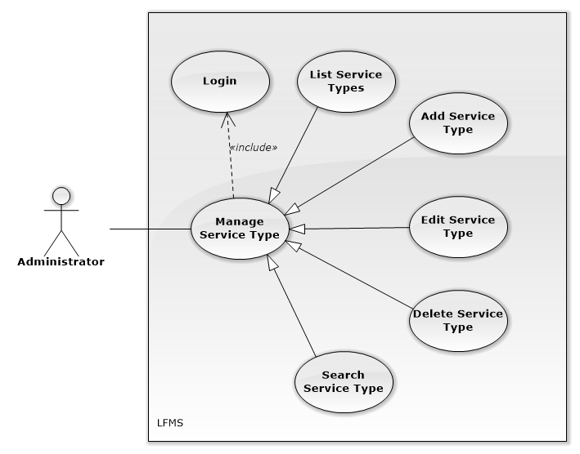
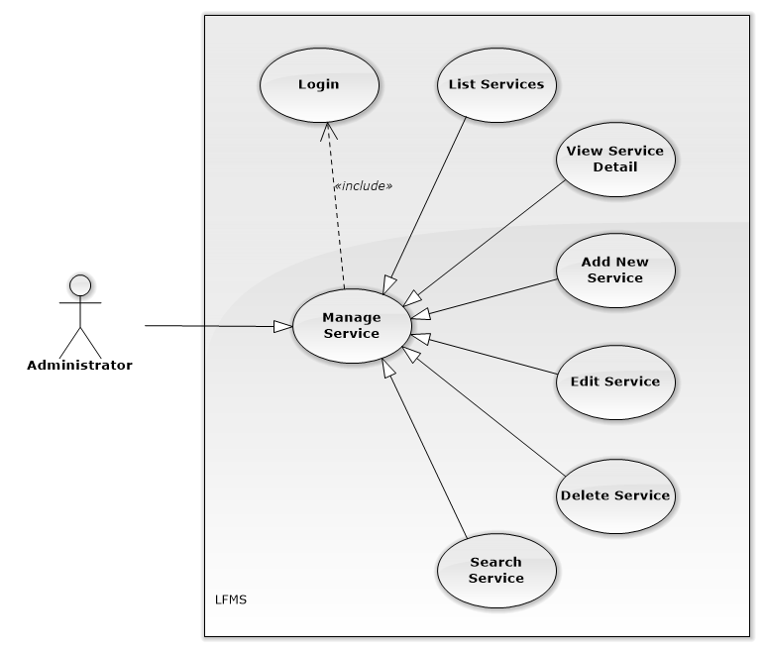
SOFTWARE SPECIFICATION – Functional Requirement
Manage Service
Manage Service Type

Slide 32
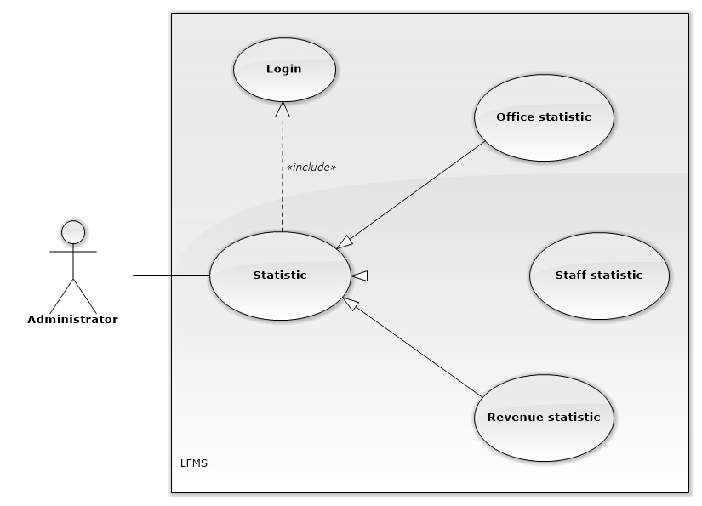
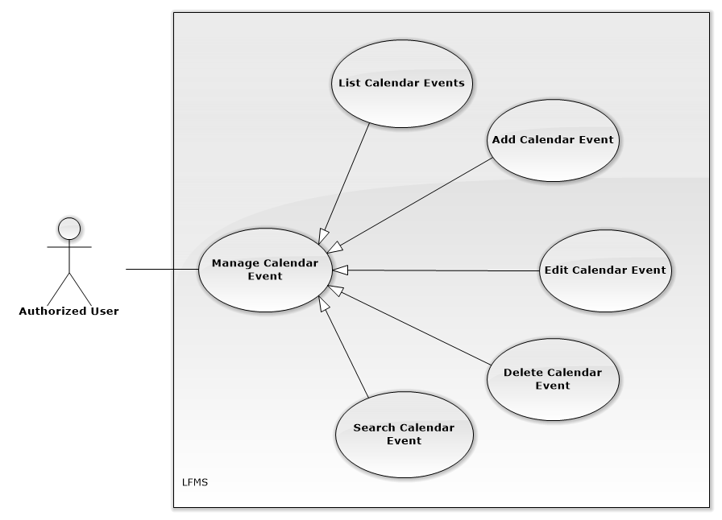
SOFTWARE SPECIFICATION – Functional Requirement
Statistic
Manage Calendar Event

Slide 33
SOFTWARE SPECIFICATION – Nonfunctional Requirement
Learnable
The user interface must be easy to learn, even at the first time looking at the screen, user may immediately understand the function of each button or icon.
Performance
Available 95% of time
Average time to start & run: 5-7s
Average time to process action: <3s
Reability
Mean time between two failure: 10
Number of errors after one week trial: 2
Notes:
Nguoi dung co the su dung phan mem sau bao nhieu ngay dao tao
Hieu suat: cac trang tra ve ket qua trong bao nhieu time.
Do tin cay: Su dung phan mem bao nhieu time se gap loi( Mean time between two failure). So loi co the xay ra trong 1 thang thu nghiem

Slide 34
Architecture Overview
Package Design
Entity Relationship
SOFTWARE
DESIGN

Slide 35
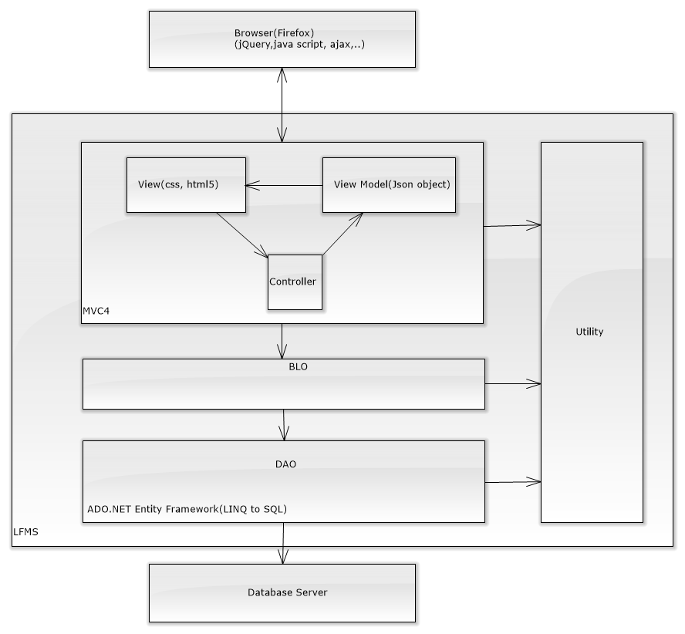
SOFTWARE DESIGN – Architecture Overview

Slide 36
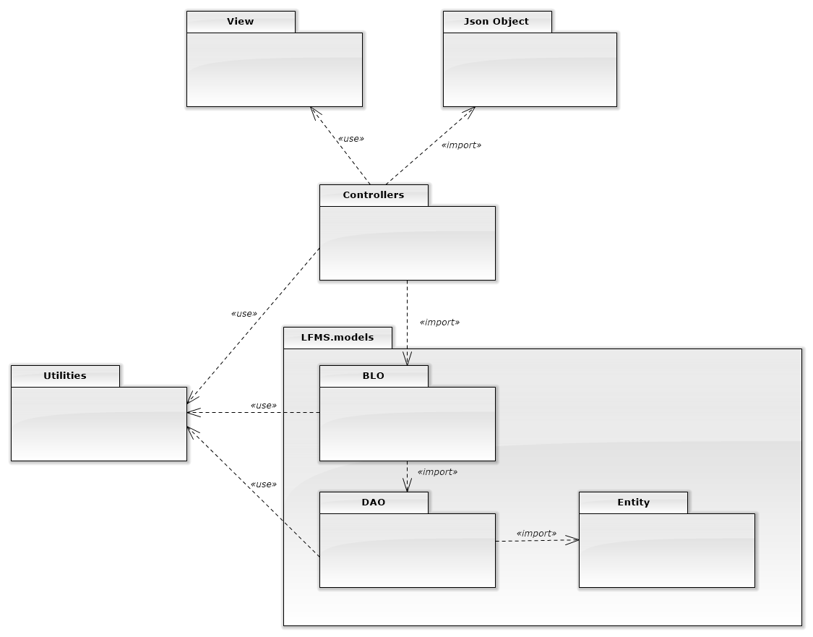
SOFTWARE DESIGN – Package Diagram

Slide 37
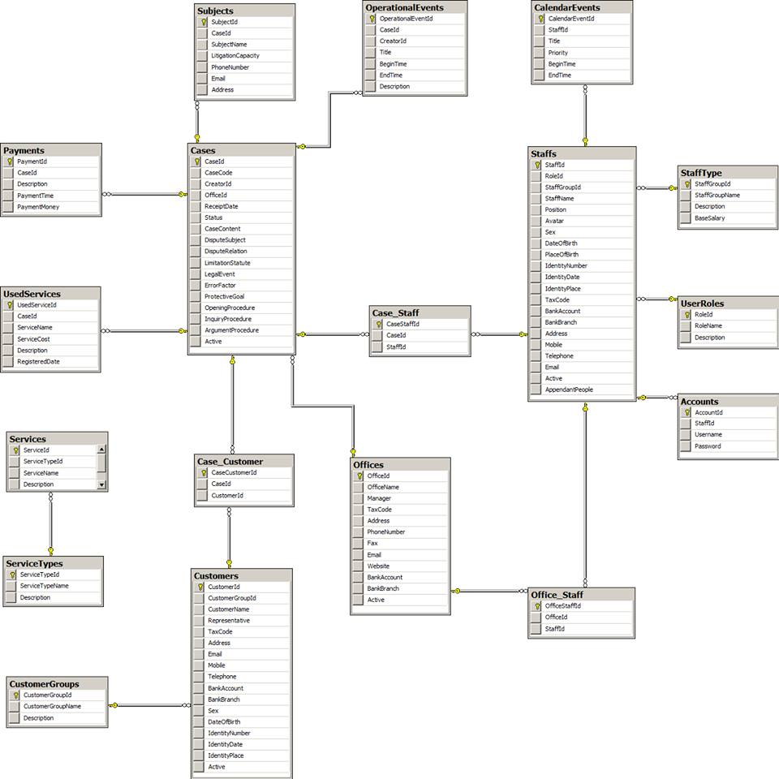
SOFTWARE DESIGN – Database Design

Slide 38
Test Model
Test Process
Test Result
TESTING

Slide 39
TESTING – Test Model
Customer requirement
validate
Acceptance test
Product specifications
verify/validate
System test
verify
High-level design
Integration test
other V&V activities
Low-level design
verify
Component test
Coding & unit test
Notes:
Sua lai V model
Giai thich mo hinh nay la gi. Y Nghia. Quality assurance model. Trong hinh nay co thuc hien khau test nao

Slide 40
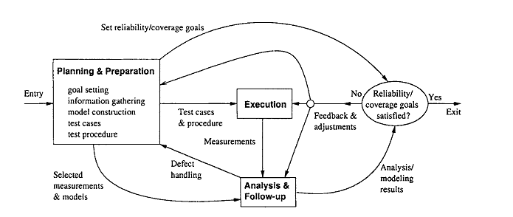
TESTING – Test Process
Notes:
Cac buoc trong quy trinh test

Slide 41
TESTING – Test Model
Planning & Preparation:
Goal setting: test stages, test item etc…
Test cases preparation
Test procedure preparation
Execution:
Executing test
Related activities: retest, report etc...
Analysis & Follow up:
Checking result
Analysis result

Slide 42
TESTING – Test Schedule
Unit test:
Doer : Developer
Time : 7/11 – 3/12
System test:
Doer : Test team
Time : 17/11 – 9/12
Notes:
Chinh lai time

Slide 43
TESTING – Test Result
No | Module | Test Case |  |  |  | Checklist |  |  | Total
 |  | Pass | Fail | Untested | N/A | Pass | Fail | N/A
1 | Manage Calendar event | 11 | 0 | 0 | 0 | 154 | 0 | 111 | 276
2 | Manage Case | 103 | 2 | 0 | 0 | 1166 | 0 | 838 | 2109
3 | Manage Customer | 20 | 0 | 0 | 0 | 183 | 0 | 135 | 338
4 | Manage Staff | 24 | 1 | 0 | 0 | 212 | 0 | 160 | 397
5 | Manage Service | 15 | 1 | 0 | 0 | 183 | 0 | 135 | 334
6 | Statistic | 6 | 0 | 0 | 0 | 87 | 0 | 72 | 164
7 | Manage Office | 17 | 1 | 0 | 0 | 183 | 0 | 135 | 336
8 | Total | 218 | 5 | 0 | 0 | 2263 | 0 | 1659 | 4145
Test coverage:
100%
Test case pass:
99.7%

Slide 44
Project result
Comparison Result
Lesson Learned
PROJECT
RESULT

Slide 45
PROJECT RESULT – Test Result
After closing project, we achieve goal software:
Lawyers can work more effective, easier and simpler way without remember schedule and operation event.
Law firm can manage all information like case, customer, staff service and office easier.
Accounting easier with auto statistical in every year.

Slide 46
PROJECT RESULT – Test Result
We have more experiences of managing a software project: how to manage plan, time, and risk. These experiences help us a lot in our future work.
Know how to communicate with other team members and how to do teamwork efficiently
If this application is developed, we will get a good mark in Capstone Project. It makes our grade better.
Notes:
Hoan thanh phan mem dat duoc nhu muc tieu ban dau

Slide 47
PROJECT RESULT – Comparison Result
Main objectives | Develop a website that helps users can manage all information like case, customer, staff, service and office easier.
Purpose | Lawyers can work more effective, easier and simpler
Items | Plan | Actual
Releases date | 25/12/2013 | 27/12/2013
Releases version | 1.0 | 1.0
Days | 78 | 80
Test cases + checklists |  | 218 test case
Defects |  | 5
Document pages |  | > 500 (include appendix)
Lines of code |  | Approximately 50.000

Slide 48
PROJECT RESULT – Limitation & Expectation
Limitation:
Only support Firefox
Can not search in “Thư viện pháp luật”
Expectation:
Develop more in other browser
Develop search in “Thư viện pháp luật”

Slide 49
PROJECT RESULT – Lesson Learned
Situation | Problem | Lessons learned
Conflict in team | Members are stress Cannot make decision | Talk and listen to each other Analysis situation Make right decisions
Technical difficulties | Take lots of time to solve Miss the deadline | Search in Google or some IT forums Ask group’s supervisor or teachers for some advices

Slide 50
DEMO
Authentication
Homepage – Calendar
Manage Case
Manage Office, Staff, Customer…
Statistic

Slide 52
Thanks for watching

