Slide 1
Capstone project summarization Dư Địa Chí
Supervisor:
Phạm Ngọc Hà
Luyện Minh Hưng - SE02955
Trần Định - SE02623
Nguyễn Huy Hoàng - SE02690
Nguyễn Duy Vương - SE02602
Team members:

Slide 2
OUTLINE
1. Overview
2. Project Management
3. Requirement Specification
4. Software Design
5. Coding
6. Quality Control
7. Summary
8. Demo
9. Q&A

Slide 3
1. Overview

Slide 4
1.1 Our idea
Commit to a meaningful project to complete university years
Many Vietnamese people have heard about Dư Địa Chí, yet can not give a concrete definition or explanation
There is no application about Dư Địa Chí on mobile market
The overall lacking in knowledge about motherland

Slide 5
1.2 A definition
Địa chí hay địa phương chí là thể loại sách ghi chép, biên soạn, giới thiệu về địa lý, lịch sử, phong tục, nhân vật, sản vật, kinh tế, văn hoá... của một địa phương

Slide 6
1.3 Existing applications

Slide 7
1.4 Our purpose
A brave pioneer
Ignite the love for country in our compatriots
Encourage other developers

Slide 8
2. Project Management

Slide 9
Content
2.1 Software Project Life-cycle
2.2 Project Schedule
2.3 Task Management
2.4 Equipment and Tools
2.5 Project Organization
2.6 Communication Management
2.7 Risk Management
2.8 Quality Management

Slide 10
2.1 Software Project Life-cycle
Spiral model
2 big Rounds
Flexible

Slide 11
2.2 Project Schedule
15 weeks from 09/09/2014 to 19/12/2014
Round 1: first 11 weeks
Large amount of time for training Android and researching about Dư Địa Chí. Reviewing .NET and learning graphics also cost time.

Slide 12
2.3 Task Management

Slide 13
2.4 Equipment and Tools

Slide 14
2.5 Project Organization

Slide 15
2.6 Communication Management
Working 3+ days/week, 8 hours each
Meeting 3 times on Monday, Wednesday, and Friday
Meeting with supervisor: once a week

Slide 16
2.7 Risk Management
Rank | Risk | Description | Category | Avoidance | Solution
17 | Key member leaving | Key member leaves | People risk | Have a suitable treatment policy | Find other person
4 | New technical | New technical is applied | Technology risk | Training | Ask for expert
Risk sample

Slide 17
2.8 Quality Management
Review
Test
Ask for comments outside of group

Slide 18
3. Requirement Specification

Slide 19
Content
3.1 Functional Requirement
3.2 Non-functional Requirement
3.3 Screen prototypes

Slide 20
3.1 Functional Requirement
3.1.1 Main Application

Slide 21
3.1 Functional Requirement
3.1.2 Database Administration Application

Slide 22
3.2 Non-functional Requirement
Easy to use
Styles, color and terminologies are consistent and exact
No spelling error
Quick response

Slide 23
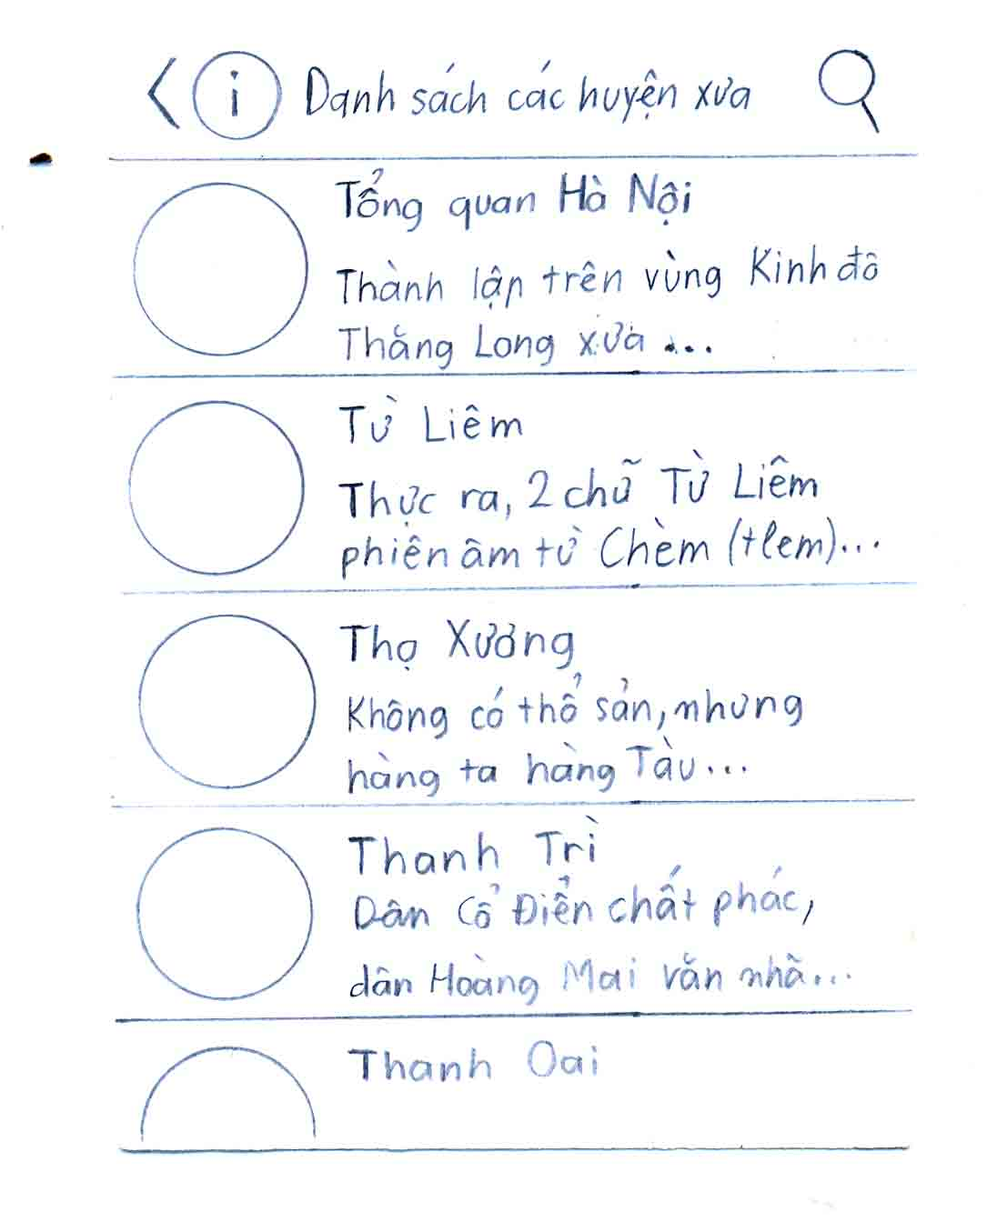
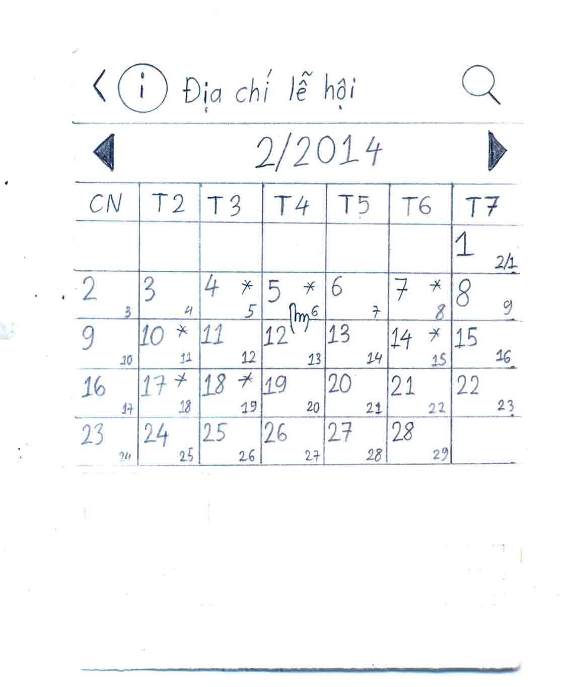
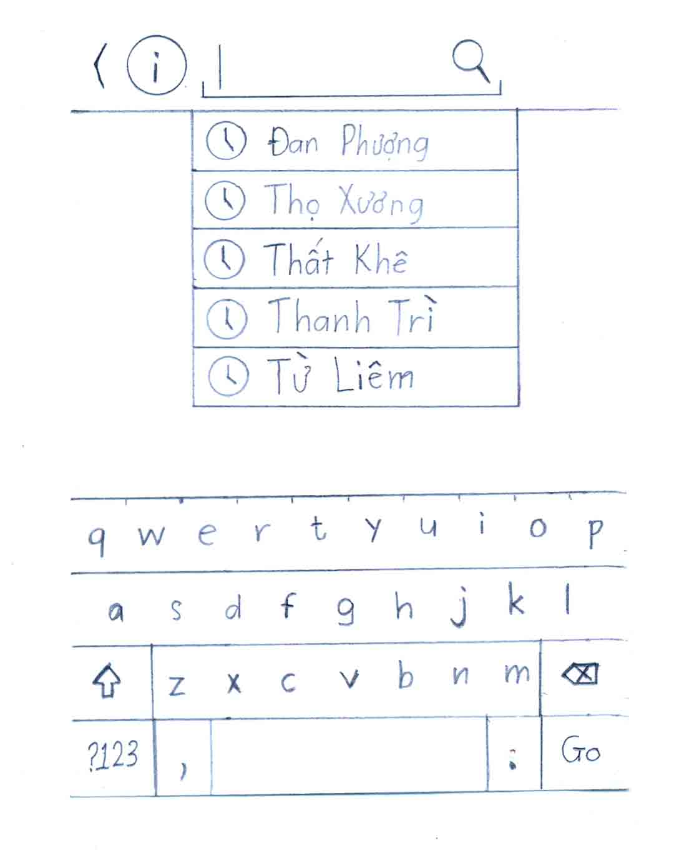
3.3 Screen prototypes

Slide 24
4. Software Design

Slide 25
Content
4.1 Architecture Design
4.2 Screen Design
4.3 Class Design
4.4 Database design
4.5 Technical solution

Slide 26
4.1 Architecture Design

Slide 27
4.2 Screen Design
4.2.1 Main Application

Slide 28
4.2 Screen Design
4.2.2 Database Administration Application

Slide 29
Example: Old district list screen
No. | Item | ID | Display type | I/O
1 | List View of District | list | ListView | O
2 | Image of District | image | ImageView | O
3 | Name of District | name | TextView | O
4 | Search button | action_search | Menu | O
5 | Navigation drawer | fullLayout | DrawerLayout | O
6 | Drawer Icon | drawerIcon | ImageView | O
7 | Drawer Title | drawerTitle | TextView | O

Slide 30
4.3 Class Design

Slide 31
Sequence diagram: Search Place by tag

Slide 32
4.4 Database design

Slide 33
4.5 Technical solution
4.5.1 Special text service
[hổ ngải*|con hổ bện bằng rơm, để trừ tà]
[Từ Liêm|D|OHNTL]

Slide 34
4.5 Technical solution
4.5.2 Solar/lunar calendar

Slide 35
5. Coding

Slide 36
Content
5.1 Development Environment
5.2 Deployment Environment
5.3 Coding Convention

Slide 37
5.1 Development Environment

Slide 38
5.2 Deployment Environment
Android 4.0 or higher
Computer with .NET framework 4.5

Slide 39
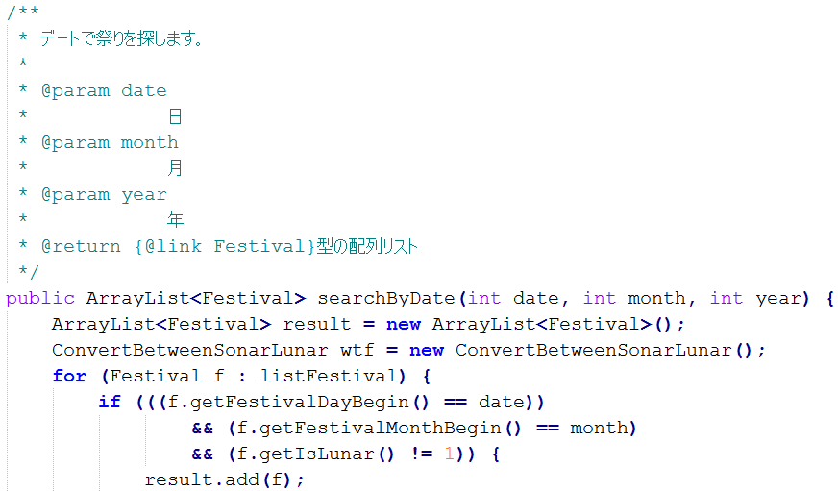
5.3 Coding Convention
Base on Oracle standard Java coding convention

Slide 40
6. Quality Control

Slide 41
Content
6.1 Review
6.2 Testing

Slide 42
6.1 Review
Project Plan
Software Requirement Specification
Design documents
Source code
Test plan and Test case

Slide 43
A sample of checklist
No. | Check Point | Yes/No
1 | FUNCTIONALITY
1.1 | LINKS
1.1.1 | Check that the link takes you to the page it said it would. | Yes
1.1.2 | Ensure to have no orphan pages (a page that has no links to it) | Yes
1.2 | FORMS
1.2.1 | Acceptance of invalid input | Yes
1.2.2 | Optional versus mandatory fields | Yes
1.2.3 | Input longer than field allows | Yes

Slide 44
6.2 Testing
6.2.1 Test model

Slide 45
6.2 Testing
6.2.2 Test case
ID | Test Case Description | Test Case Procedure | Expected Output | Inter-test case Dependence | Result | Test date
[Use Case-1] | 「Địa chí cận đại」画面を開けます | １－画面を見ます ２－以下からオプション を１つ選びます ２．１－“Địa chí cận đại” を触って、「Old province list」画面へ移動になります ２．２－記事名をさわって、「OldDistrict Detail」画面へ移動になります | １．「Địa chí cận đại」画面をロードします ２．「Địa chí cận đại」画面に以下の情報が表示されます： ー検索ボックス ―点画： Địa chí cận đại ー“Địa chí cận đại”部の中ランダム記事のタイトル。 ―背景は記事から取った写真です。 | アプリケーションが開始されました | パース | ２０１４年２０月１０日
[Use Case-2] | 「Old District Detail」画面を開けます | ユーザは「Địa chí cận đại」画面で記事名を触ります | １．「Old District Detail」画面をロードします 2.「Old District Detail」画面に以下の情報が表示されます：－検索ボックス ―記事のタイトル ―記事の写真 ―記事の情報 | 「Địa chí cận đại」画面が表示されました | パース | ２０１４年２０月１０日
[Use Case-3] | 「Old District Detai」画面から「Địa chí cận đại」画面に戻ります | ユーザはデバイスで「Back」ボタンを触ります | １．「Địa chí cận đại」画面をロードします ２．画面に以下の情報が表示されます： ―検索ボックス ―タイトル：Địa chí cận đại ー“Địa chí cận đại”部の中ランダム記事のタイトル。 ―背景は記事から取った写真です。 | 「Old District Detail」画面が表示されました | パース | ２０１４年２０月１０日

Slide 46
6.2 Testing
6.2.2 Test report
Module Code | Pass | Fail | Untested | Bug List (Round 1) | Bug List (Round 2) | Number of Test Cases
Total of Test Case | 569 | 0 | 0 | 140 | 0 | 569
Unit test | 59 | 0 | 0 | 0 | 0 | 59
Function | 344 | 0 | 0 | 50 | 0 | 344
Performance | 37 | 0 | 0 | 19 | 0 | 37
GUI | 21 | 0 | 0 | 21 | 0 | 21
Database Tool | 108 | 0 | 0 | 50 | 0 | 108

Slide 47
7. Summary

Slide 48
7.1 Future Develop
Expand to other platform: iOS, Window Phone,…
More data
Develop server to minimize needed storage

Slide 49
7.2 Lesson Learned
Technique
Teamwork
Process
Management
Knowledge

Slide 50
8. Demo

Slide 51
9. Q&A

