Slide 1
Capstone Project DocumenT
Team collaboration - HAKI
Nguyễn Văn Hiệp – SE01961
Nguyễn Hoàng Anh – SE02151
Đỗ Hữu Chiến – SE02258
Lê Mạnh Linh – SE02352
Nguyễn Văn Vũ – SE02130
Team Collaboration Application
HAKI

Slide 2
Contents
1. Introduction
2. Project Management Plan
7. Demo & Q&A
3. System Requirement Specifications
4. System Design Description
5. System Implementation & Test
6. Maintenance & Future developments

Slide 3
Part 1: Introduction

Slide 4
The People
Mr. Lương Trung Kiên
Instructor
Nguyễn Văn Hiệp
Nguyễn Hoàng Anh
Project Manager
Developer
Developer
Designer
Nguyễn Văn Vũ
Đỗ Hữu Chiến
Developer
Technical
Technical
Tester
Lê Mạnh Linh
Test leader

Slide 5
Background
sharing website
Many kinds of project:
Charity
Entertainment
Event management
Business
Scientific research
Personal
etc

Slide 6
Background
sharing website
Exchange information
Team work
Manage information
Manage people in team

Slide 7
Problems
sharing website
Many small tasks
Members are different role
Group members need to communicate
Share and exchange information
Information need to updated frequently
Need to know working progress
Assign works for members
Manage many groups

Slide 8
Our proposal
Our proposal to increase work's effective:
Brings better user experience.
Comfortable.
Professional to work.
Professional to manage group and project when users work like a team or user want to manage their plan.

Slide 9
Our proposal
sharing website
Haki is developed on Android and Web browser

Slide 10
Part 2: Project Management Plan
sharing website

Slide 11
The proposed system and scope
Development Technologies
Process
Project organization
Project Planning

Slide 12
The Proposed System & Scope
Proposed system
Create boards (as projects)
Create lists ( each list has many tasks)
Track activities of all members
Manage personal tasks
Manage project and member ( for PM)
Search group, project and user
Synchronize
Scope
Android application
Web application

Slide 13
Development Technologies
sharing website

Slide 14
Process model
Iterative Development Model

Slide 15
Project organization

Slide 16
Project Planning

Slide 17
Team management
sharing website
Work 5hs/day
and 5 days/week
Buffer: about 1 week
Meeting: from Monday
to Friday
Online meeting

Slide 18
Risk Management
Risk Description | Avoidance plan | Contingency plan
Team member’s illness | Define the suitable schedule to ensure the health of members | Other members try to share and complete work to meet the deadline.
Conflicts between team members | Organize team buildings frequently to improve members spirit | Team members should make concession to each other. All of the members should analyze and find the way to become reconciled.
Changing requirement | Hold meeting frequently to define and discuss all features of project | Meet supervisor to determine whether features should be implemented or not. Project manager creates implementation plan and push progress quickly.

Slide 19
Quality Control
Desired value
Main features are completed
Use coding convention
User interface is good, friendly
Functions are implemented quickly
Synchronization is exactly, quickly and integrity
Easy to maintain
Good performance
High security

Slide 20
Part 3: System Requirement Specifications

Slide 21
System Requirement Specifications
Functional requirement
Non-Functional requirement

Slide 22
Functional Requirement
Guest user
Member user
Master user
Owner user

Slide 23
Functional requirement

Slide 24
Functional Requirement
Member user
Sign in
Sign out
Change password
Forgot password
View activity
Group activity
Project activity

Slide 25
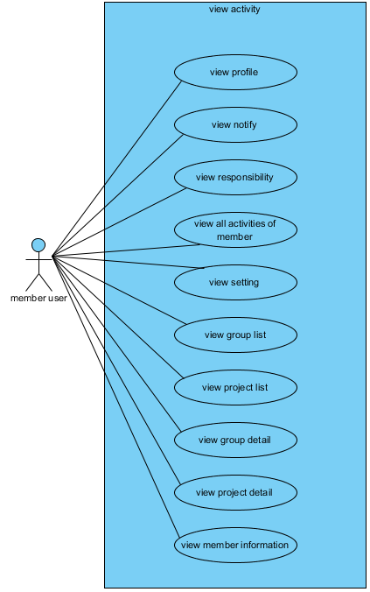
Functional requirement

Slide 26
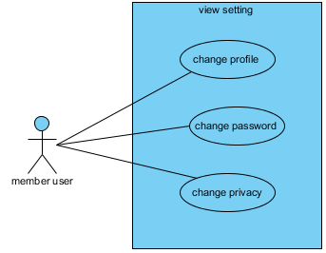
Functional requirement

Slide 27
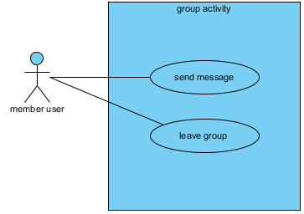
Functional requirement

Slide 28
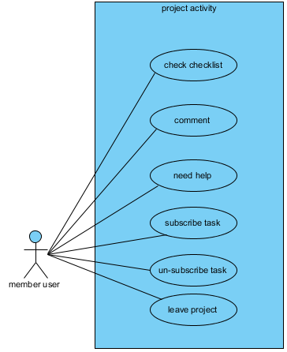
Functional requirement

Slide 29
Functional Requirement
Master user
Mange group by master
Add member to group
Remove member of group
Update information of group
Manage project by master

Slide 30
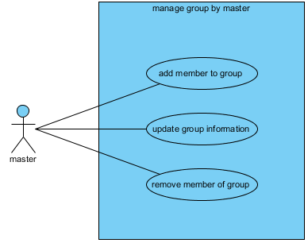
Functional requirement

Slide 31
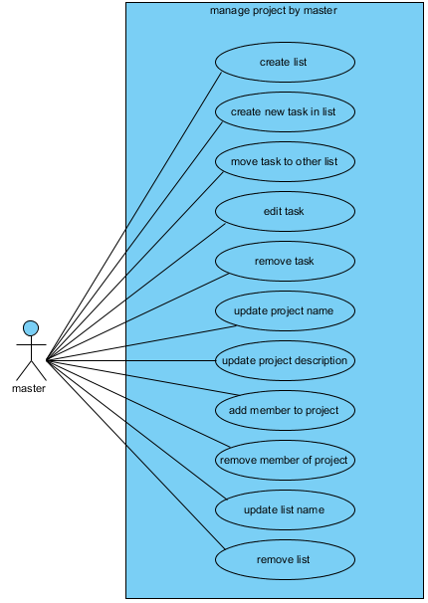
Functional requirement

Slide 32
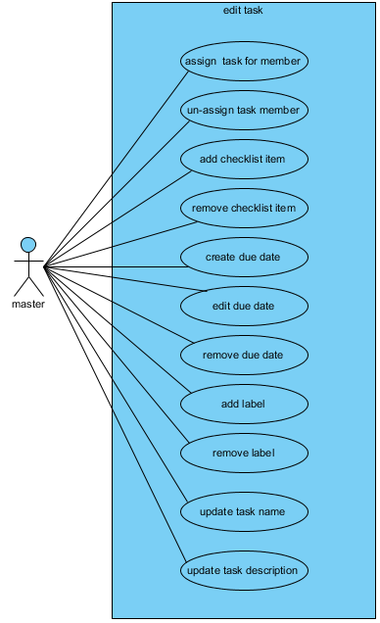
Functional requirement

Slide 33
Functional Requirement
Owner user
Manage group by owner
Create group
Change permission in group
Remove group
Manage project by owner
Create project
Change permission in project
Remove project

Slide 34
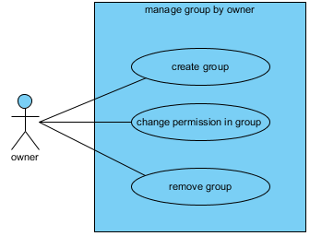
Functional requirement

Slide 35
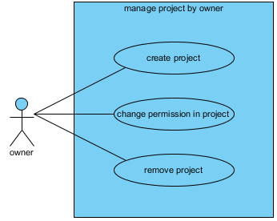
Functional requirement

Slide 36
Use case specification

Slide 37
System Requirement Specifications
sharing website
Non-Function requirement
Usability
Availability
Reliability
Security
Security
Performance
Maintainability

Slide 38
Non-Functional requirement
Usability
Front-end language: English
Easy to use
Clear and convenient user interface
Availability
Run 24/24
Reliability
Database and files: backed up regularly
Easily to upgrade to expanded
Security
Implement secure session token for authentication.
Validate form’s data input from user.
Use token to prevent CSRF attack.
Sanitizing user’s input to prevent XSS attack.
Use Reliable and safety configuration for server.

Slide 39
Non-Functional requirement
Maintainability
Source code must be commented clearly for maintenance and expansion in future.
Errors must be logged, easy to maintenance and fixing.
Apply coding standards and naming conventions.
When project completed, documents related to standards and conventions must be included.
Portability
User can access to the system from anywhere with Internet connection.
Installation package size must be small enough to be suitable for Android phone.
Haki is developed on Android and web application.
Performance
The system and server are able to serve for the numbers of concurrent connection to be 200 users. We will consider upgrading if necessary.
The access numbers per day is about 1000 accesses, concentrate on from 9:00 to 11:00 and from 14:00 to 16:00.
Screen transition is less than 5 seconds.

Slide 40
Part 4: System Design Description

Slide 41
System Logical Architecture

Slide 42
System Physical Architecture
Client-server

Slide 43
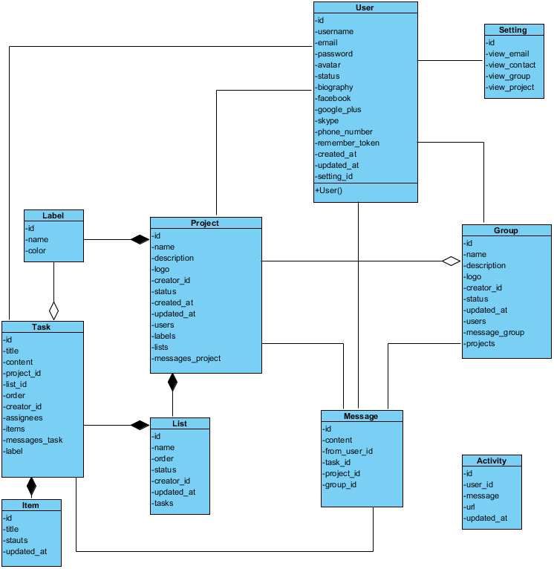
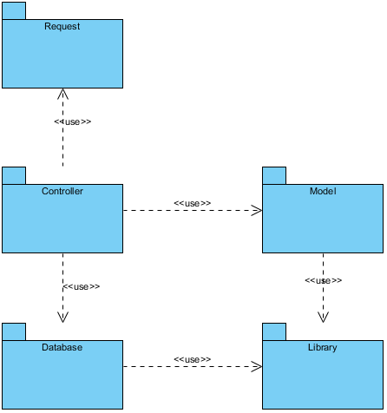
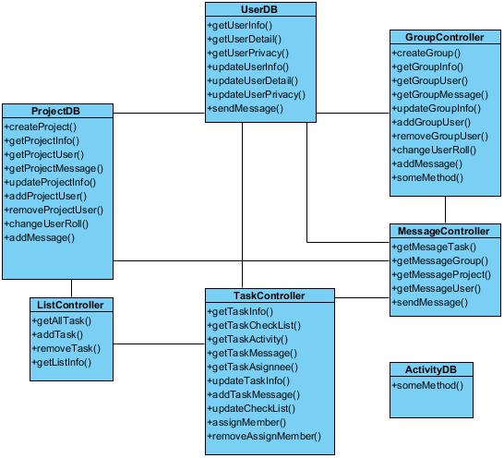
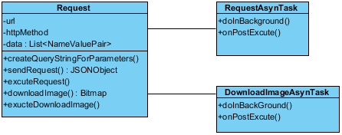
Class diagram
Package
Model
Controller
Library
Request
Database

Slide 44
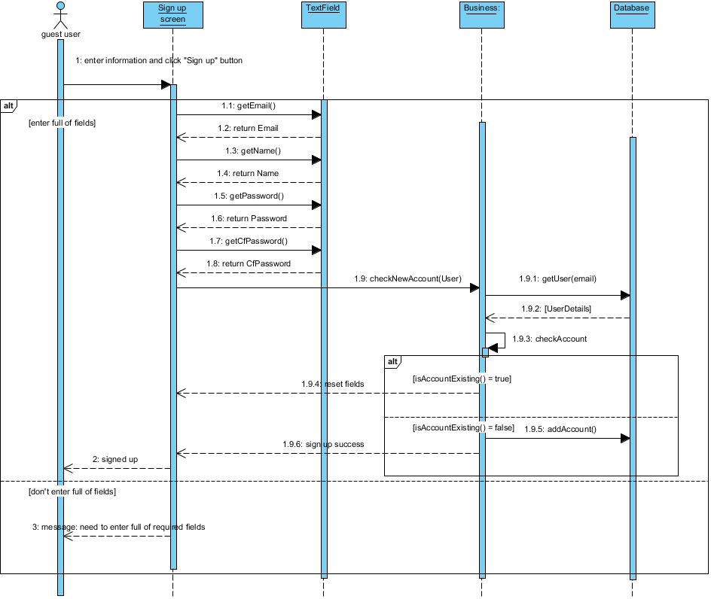
Sequence diagram

Slide 45
Database

Slide 46
Part 5: System Implementation & Test

Slide 47
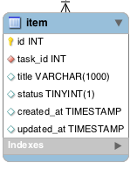
System Implementation
Coding convention

Slide 48
Sequence diagram
Sequence diagram
Sign in

Slide 49
Source code

Slide 50
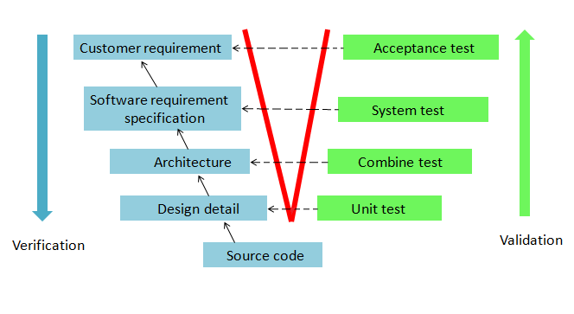
Test
Testing model
Verification & Validation Model

Slide 51
Test
sharing website
The efficiency of V&V model:
Can detect defects, resolve defects and find the cause of defects in early stage of life cycle.
Reduce risks of project.
Improve quality and reliability of application.
Reduce the affect to costs and schedule

Slide 52
Testing environment
Chrome 36
IE 9
Firefox 31
Android 4.1

Slide 53
Testing tools
sharing website
Robolectric
Junit

Slide 54
Test cases

Slide 55
Testing results v1
File | Number of test case | Passed | Failed | Skip | Coverage (%)
Android-app | 125 | 90 | 35 | 0 | 72%
Web-app | 125 | 100 | 25 | 0 | 80%
Server | 100 | 83 | 17 | 0 | 83%
Integration test | 10 | 10 | 0 | 0 | 100%
GUI | 144 | 94 | 50 | 0 | 65%
TOTAL | 504 | 377 | 127 | 0 | 74.8%

Slide 56
Testing results v2
File | Number of test case | Passed | Failed | Skip | Coverage (%)
Android-app | 125 | 125 | 0 | 0 | 100%
Web-app | 125 | 125 | 0 | 0 | 100%
Server | 100 | 100 | 0 | 0 | 100%
Integration test | 10 | 10 | 0 | 0 | 100%
GUI | 144 | 144 | 0 | 0 | 100%
TOTAL | 504 | 504 | 0 | 0 | 100%
Test successful coverage: 100%

Slide 57
Part 6: Maintenance & Future developments

Slide 58
Maintenance
Review code
Running the test, debug and fix errors
Update the missing functions.

Slide 59
Approach to development
Develop app on iOS
Development full function for our application
Improve the function of convenience, flexibility and easier for users on android application.
Development chat function become real-time
Development real-time notification
Development to integrate with google drive & dropbox for attachment feature and file sharing

Slide 60
Lesson learned
sharing website
Team work:
Working in group
Communication
Resolve conflicts
Technologies
Software development processes
Management skill
Organize
Negotiate
Planning

Slide 61
sharing website

Slide 62
sharing website

Slide 63
Thanks for attending!

