Slide 1
Railway Ticket Reservation Site
Supervisors : Mr. Bùi Đình Chiến
RTRS member :
Nguyễn Hùng Đức (02137) Trần Bửu Huy (02277) Lê Anh Huy (02225) Nguyễn Đức Phương(01820) Lê Bảo Thắng (01163)

Slide 2
CONTENT
Introduction
Project Management Plan
Requirement Specification
Software Design
Testing
Lesson Learned
Demo
Q&A

Slide 3
Introduction
Project Background
Existing system
Proposal
Expected system

Slide 4
Project Background
Acting an important role in transportation
Booking ticket methods are still old-fashioned
Overloading occurs frequently
Notes:
Mặt tiện lợi của đi tàu hỏa

Slide 5
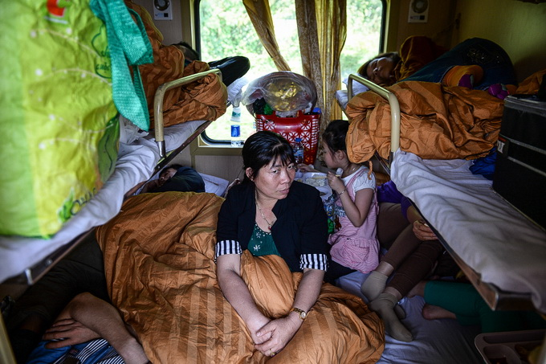
Project Background
Notes:
Mặt đang còn bất cập trong đi tàu hỏa (lơi lỏng trong việc bán vé tàu hỏa)

Slide 6
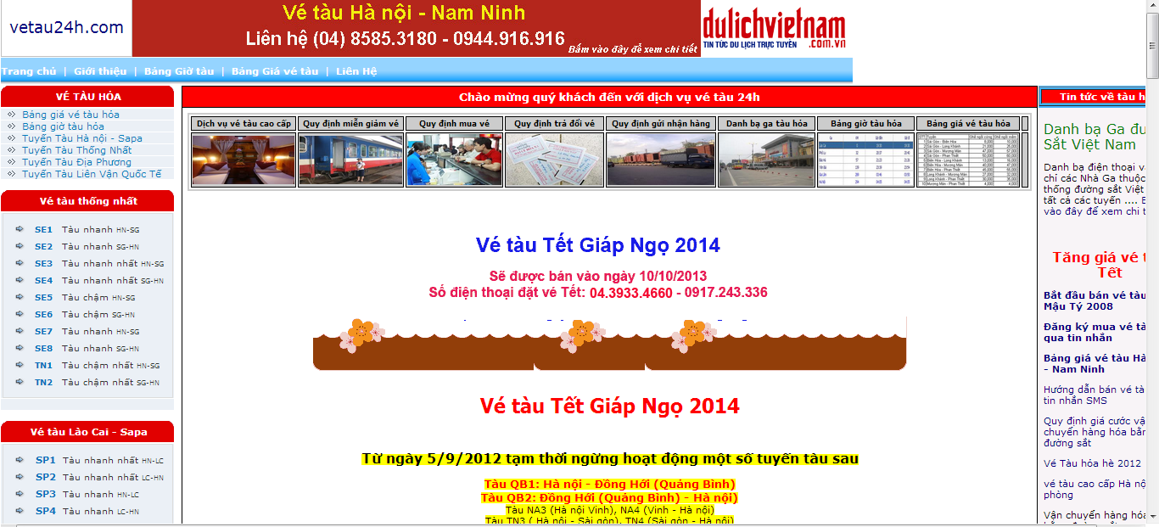
Existing System
Vetau24h.com
Notes:
(?)Không nên để Pros và cons trong slide

Slide 7
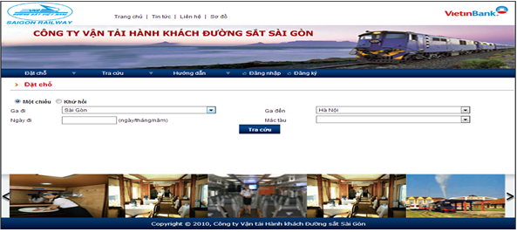
Existing System
Vetau.com.vn
Cons:
GUI isn’t designed well.
Limitations in payment methods.
Small server, can’t serve well when having a large number of connections.
Only allowed to buy ticket in specific times of year and only for passenger and agency in South side.
Notes:
(?)Không nên để Pros và cons trong slide

Slide 8
Existing System
Vetau24h.com
Updating continuously
Old-fashioned designed
Vetau.com.vn
Old-fashioned designed
Small server
Only allowed to buy ticket in specific times

Slide 9
Proposal
Fully functionals
Improving in desgin

Slide 10
Expected system

Slide 11
Project Management Plan
Software Process Model
WBS
Tool & Technologies
Risk Management Plan

Slide 12
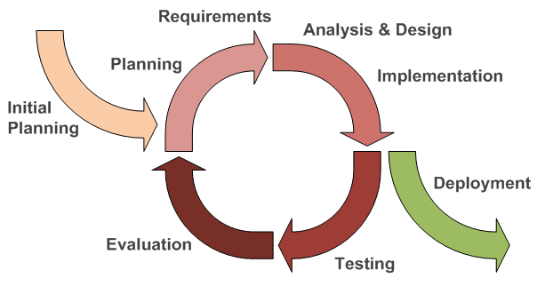
Software Process Model
Flexible to change requirements.
Easy for team members who do not have much experience.
Earlier defects detection and less costly to fix.

Slide 13
WBS
WBS | Task Name | Duration | Start | Finish
1 | Initiating | 11 days | Mon 1/6/14 | Mon 1/20/14
2 | Planning | 7 days | Mon 1/13/14 | Tue 1/21/14
3 | Executing | 54 days | Mon 1/20/14 | Thu 4/17/14
3.1 | Phase 1 | 31 days | Mon 1/20/14 | Mon 3/17/14
3.1.1 | Requirement | 11 days | Mon 1/20/14 | Mon 2/17/14
3.1.2 | Design | 12 days | Tue 2/18/14 | Wed 3/5/14
3.1.3 | Implementation | 10 days | Mon 3/3/14 | Fri 3/14/14
3.1.4 | Testing | 21 days | Sun 2/16/14 | Fri 3/14/14
3.1.5 | Documentation | 3 days | Wed 3/12/14 | Fri 3/14/14
3.2 | Phase 2 | 20 days | Mon 3/17/14 | Fri 4/11/14
3.2.1 | Requirement | 3 days | Mon 3/17/14 | Wed 3/19/14
3.2.2 | Design | 5 days | Thu 3/20/14 | Wed 3/26/14
3.2.3 | Implementation | 11 days | Thu 3/27/14 | Thu 4/10/14
3.2.4 | Testing | 19 days | Tue 3/18/14 | Fri 4/11/14
3.2.5 | Documentation | 2 days | Thu 4/10/14 | Fri 4/11/14
3.3 | Phase 3 | 4 days | Mon 4/14/14 | Thu 4/17/14
3.3.1 | Random test and fix bug | 3 days | Tue 4/15/14 | Thu 4/17/14
3.3.2 | Finalize source code | 1 day | Thu 4/17/14 | Thu 4/17/14
4 | Monitoring and Controlling | 80 days | Mon 1/6/14 | Fri 4/25/14
4.1 | Deliver Plan | 80 days | Mon 1/6/14 | Fri 4/25/14
4.2 | Weekly Meeting with Supervisor | 71 days | Tue 1/7/14 | Tue 4/15/14
4.3 | Progress Report Submitted | 76 days | Mon 1/6/14 | Mon 4/21/14
5 | Closing | 10 days | Sat 4/19/14 | Thu 5/1/14

Slide 14
Tool & Technologies
Language: Java, HTML, JavaScript.
Front‐end technologies: Struts2 and Hibernate3, jQuery, AJAX.
Architecture and design patterns: MVC.
Database: SQL Server.
Development tools: Eclipse Juno, Microsoft SQL Server 2008.
Unit testing tool: JUnit 4.
Design tools: Astah community, Pencil Project.
Communication tools: Facebook, Skype, Google mail, ALO ALO.
Document tools: Microsoft Office 2010, Microsoft Project 2010.
Web browser: Google Chrome

Slide 15
Risk Management Plan
ID | Description | Avoidance plan | Contingency plan | Status
1 | Overestimate or underestimate time of project | - Define detail plan in each working phase. - Major functions must be in high priority. - Ask supervisor for advices. | - Implement tasks concurrently. - Work overtime.
2 | Poor Productivity | - Create detailed plan and deadline. - Estimate reasonable time for tasks. - Create rules that all members must follow. | - Analyze problems together and make suitable solutions. - Contact supervisor for advices.
3 | Conflicts between team members | - Regularly organize team buildings to improve members’ spirit. | - Team members should make concession to each other. - All team should analyze and find a way to become reconciled.
4 | Requirement changing | - Carefully brainstorm among team members. - Regularly hold meetings to define and discuss all features in project. | -Team meetings with supervisor to determine whether features should be implemented or not. - Project manager creates implementation plan for implemented features and push progress quickly.
5 | Member is sick | - Define a suitable schedule to guarantee member’s health. | - Share work to other members to meet work deadline.
6 | Hardware unavailability | - Define a schedule to backup project’s data. | - Restore project’s data.

Slide 16
Requirement Specification
Functional requirements
Non-functional requirements

Slide 17
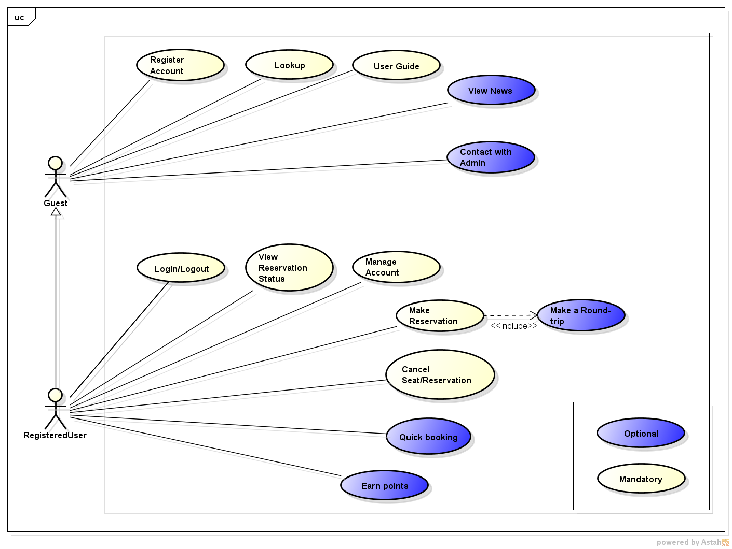
Function requirements

Slide 18
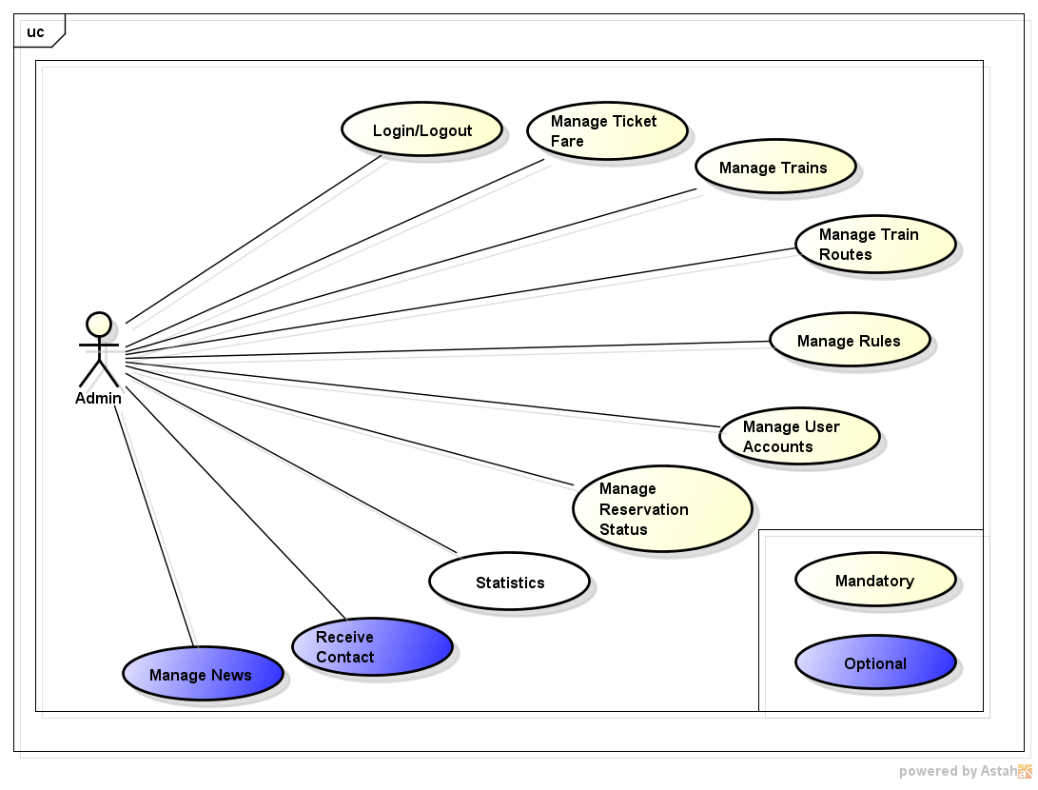
Functional Requirements

Slide 19
Guest
Register
Contact
Lookup
User guide
View news

Slide 20
User
Login/logout
Manage Account
Make Reservation
View reservation status
Cancel Reservation
Earn Point

Slide 21
Admin
Login/logout
Manage Account User
Manage Train
Manage Rules
Manage TicketFare
Statistic

Slide 22
Non-Functional Requirements
Reliability
Maintainability
Data must be collected carefully and correctly
Code comments and naming convention.
The database should be recovered.
Automatic error logging
Usability
Security
Easy-to-use user interface.
Password: MD5 algorithm
Custom error message.

Slide 23
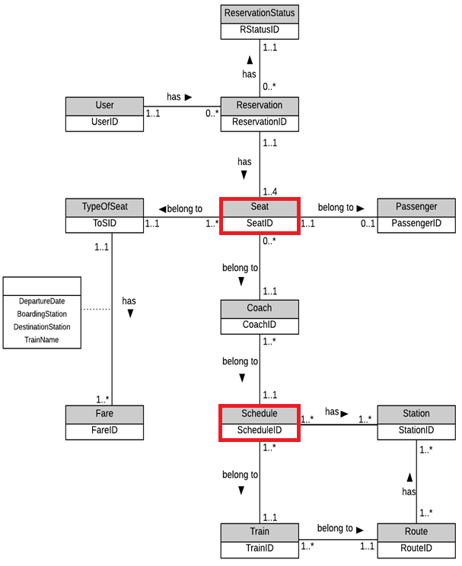
Entity-Relationship Diagram

Slide 24
Software Design
SAD
Component Diagram
Detailed Design
Database Design

Slide 25
SAD
Overall System Architecture

Slide 26
SAD
Logical view

Slide 27
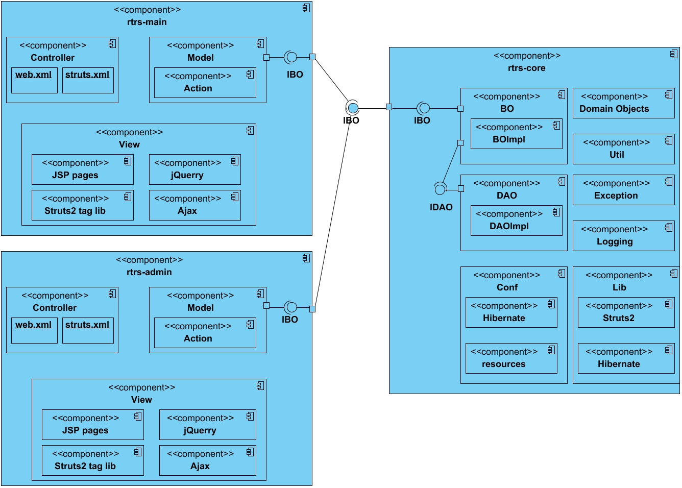
Component Diagram

Slide 28
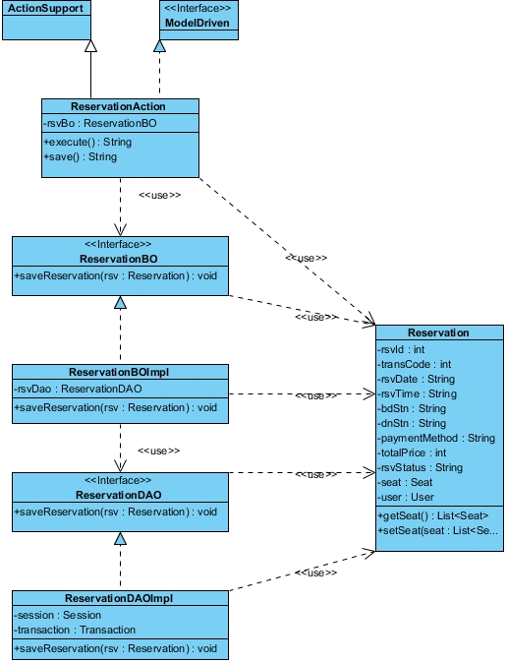
Detailed Design
Class Diagram

Slide 29
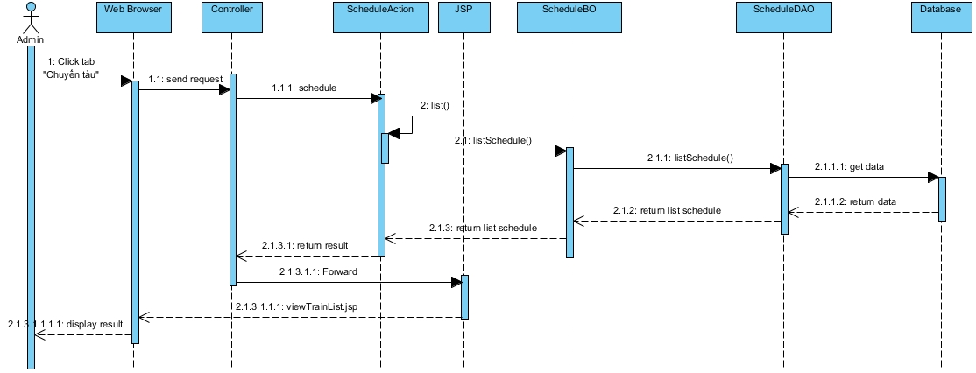
Detailed Design
Sequence diagram

Slide 30
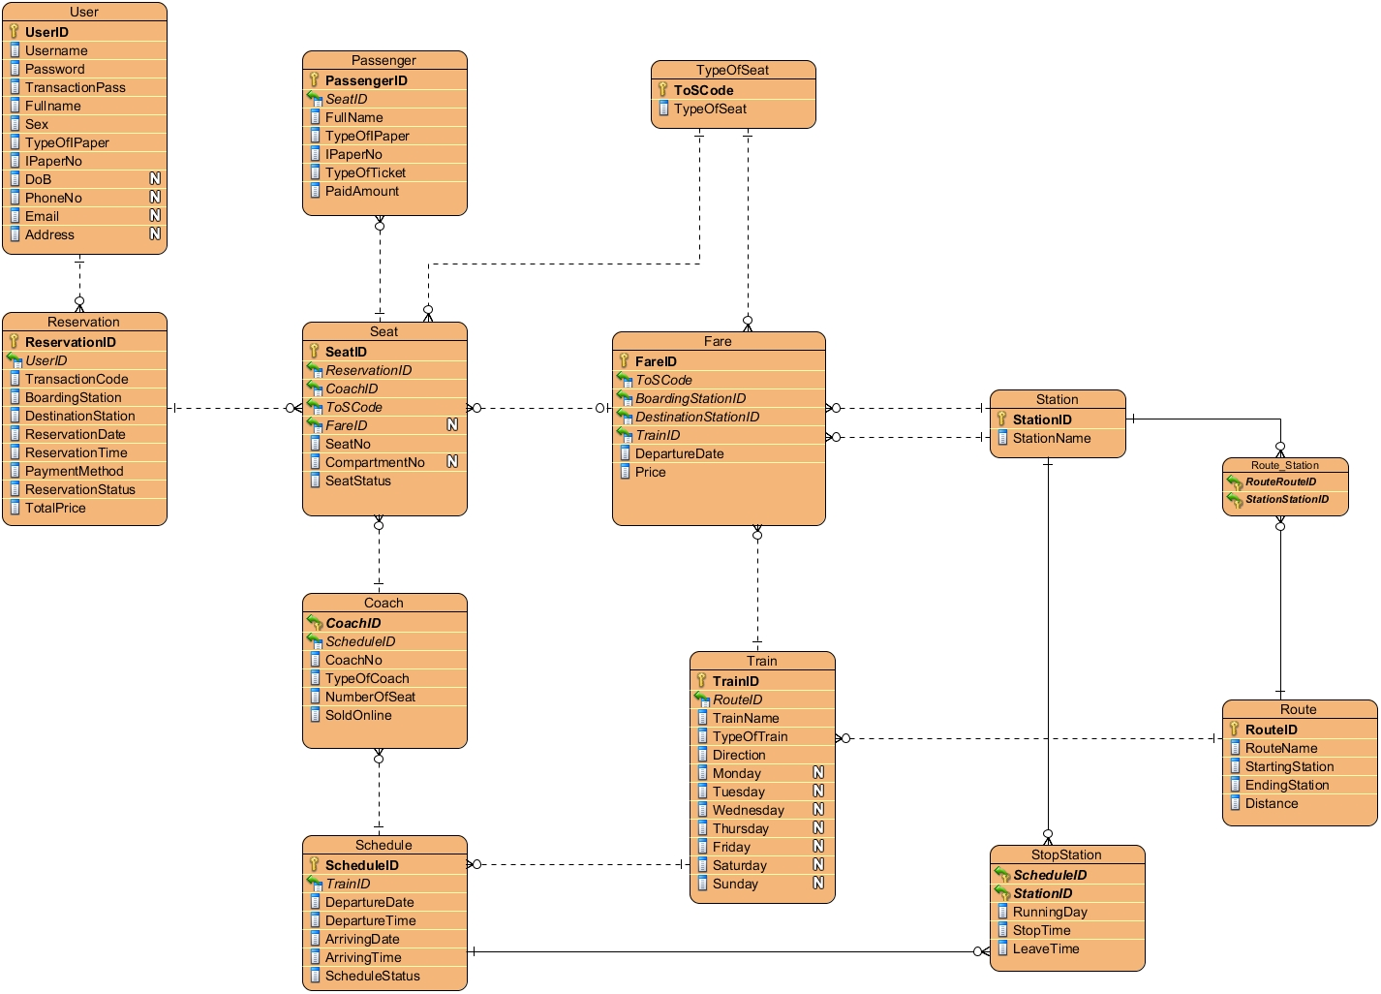
Database Design
Table Diagram

Slide 31
Testing
Testing model
Testing Process
Test stage
Testing Environment
Test Plan
Test case
Test result

Slide 32
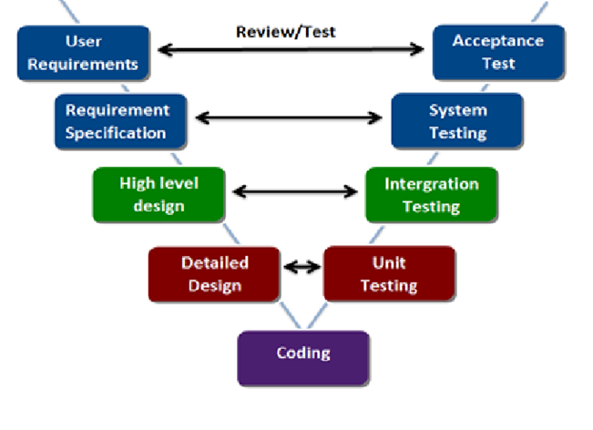
Testing model
1234

Slide 33
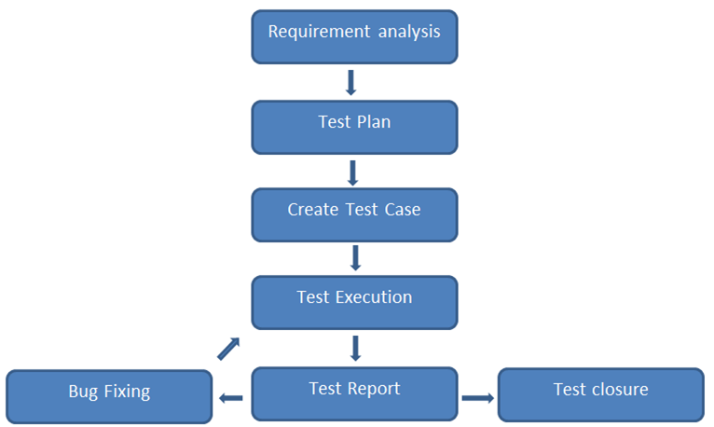
Testing Process

Slide 34
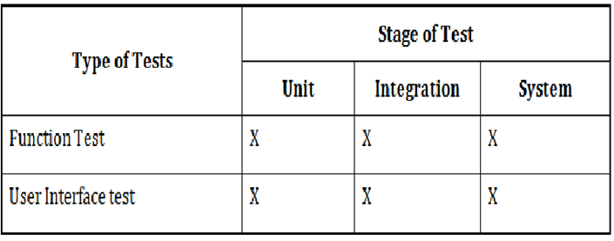
Test stage

Slide 35
Testing Environment
Chrome 34.0.1847.116 m
RAM 2GB | CPU Xeon | HDD 160 GB

Slide 36
Test Plan

Slide 37
Test case

Slide 38
Test result

Slide 39
Lesson Learned
WIG:
Teamwork
Communication
Resolve conflict
Management skill:
Organize
Negotiate
Planning
Motivate team
Technologies:
Java
Framework: Struts 2, Hibernate
Subversive SVN, Code Google
Bootstrap, JQuery, ...

Slide 40
Demo

Slide 41
Q&A

Slide 42
Thank You!

