Slide 1
DELICIOUS HUNTER
Supervisor: Nguyen van sang
Members | Tran Quang Tuan | SE60604
 | Dang Quang Minh | SE60691
 | Hoang Viet Thang | 01515
 | Dang Giang Nam | 00462
 | Vu Duy Khanh | 00437

Slide 2
Delicious Hunter
Project Management
Software Specification
Software Design
Testing
Project Overview
Project Result
Demo

Slide 3
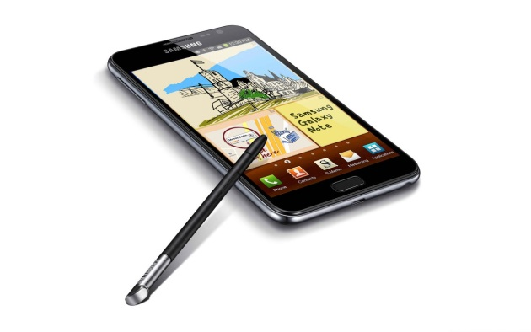
Delicious Hunter
Problem Definition
Are you cooking? You want to note the recipes that you make?
You want to mark the places you have lunch?
You want to make the cookbook to share with your friends?
Want to take picture and edit picture and add to your cookbook
Want to use Samsung S pen function but apps don’t support

Slide 4
Delicious Hunter
Problem Definition
Currently, Android have a lot of app for cooking but
They don’t focus on making cookbook
Doesn’t support touch pen
Housewife and cooker can’t make their recipes and save them to their device

Slide 5
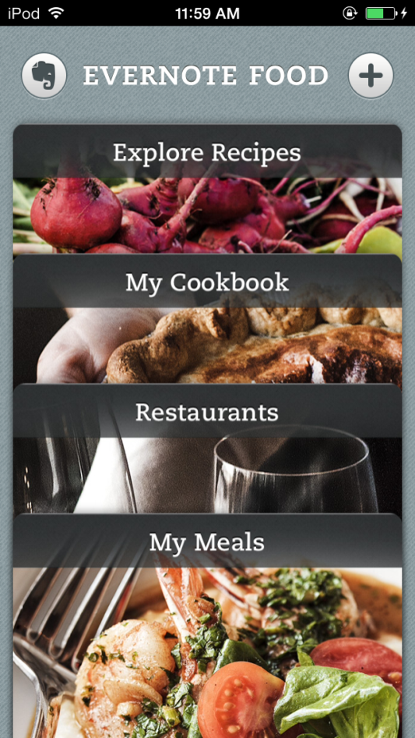
Delicious Hunter
Current Application
Evernote Food
Tracking and Logs your meal
Have maps API to logging meals
But
The recipes show in web browser so it hard to see on phone
Do not focus a lot on recipes and food

Slide 6
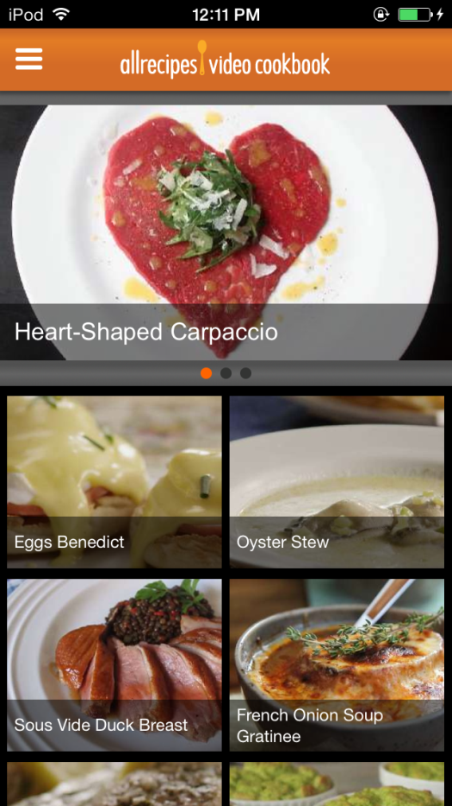
Delicious Hunter
Current Application
All recipes Video Cookbook
Easy to use
Watch and write review about food
But
Could not using offline mode
Using high speed internet connection
Could not making user recipes

Slide 7
Delicious Hunter
The Idea
DH team will make:
Making cook book with photo and step by step
Help housewife and cooker to make their material storage to reuse
Using touch pen SDK to use Signature authentication and making cook book

Slide 8
Delicious Hunter
The Idea
Personalize Cooking to make user can cook what they want
Have Socials Network to share what they want
A better software, easier, and convenient for user, first is

Slide 9
Delicious Hunter
Objective
To meet requirements from FPT University. Completing projects is necessary conditional for us to graduate.
Learning new technologies: Touch pen, Android Development, Image Processing,…
Learning control and manage project
development process

Slide 10
Delicious Hunter
Objective
Getting more experience to working in group, improve skill
Making a software by our own
Expand in the future

Slide 11
Project Management
Organization Structure
Deliverables
Tools & Environment
Project Model

Slide 12
Delicious Hunter
Project Model
Figure1-1. Rational Unified Process Model Overview

Slide 13
Delicious Hunter
Project Model
Why we chose the RUP Model?
Develop iteratively
Supports an iterative approach to development that addresses the highest risk items at every stage in the lifecycle, significantly reducing a project’s risk.
Very important for inexperienced team in controlling issues like us.

Slide 14
Delicious Hunter
Project Model
Why we chose the RUP Model?
Manage requirements
Managing requirements during the whole development process ensures project team develops the right system with right requirements

Slide 15
Delicious Hunter
Project Model
Why we chose the RUP Model?
Verify software quality
Testing process is implemented in all the cycles of application development time
Reduce risks

Slide 16
Study business case and feasibility study of project
Inception
Complete draft screen prototypes
Complete draft requirements
Determine project scopes
Complete project management plan

Slide 17
Complete user requirement specification
Complete Software requirement specification
Elaboration
Complete Database model
Complete architecture design

Slide 18
Complete coding and unit test
Construction
Complete functional and regression test
Complete user manual
Deploy application
Transition
Deliver source code
Complete all reports and documents

Slide 19
Delicious Hunter
Organization Structure

Slide 20
Delicious Hunter
Objectives
Metrics | Unit | Committed | Actual | Deviation
Start Date | dd-mm-yyyy | 06-01-2014 | 06-01-2014 | 0 days
End Date | dd-mm-yyyy | 25-04-2014 | 25-04-2014 | 0 days
Duration | Elapsed days | 80 days | 80 days | 0 days
Maximum Team Size | Person | 5 | 4 | 0

Slide 21
Delicious Hunter
Deliverables
No | Stage | Deliverable/ Milestone | Delivery Date | Delivery Location
1 | Inception | Deliver Report No.1 | 06-01-2014 | Supervisor
2 | Inception | Deliver Report No.2 | 24-01-2014 | Supervisor
3 | Elaboration | Deliver Report No.3 | 12-02-2014 | Supervisor
4 | Elaboration | Deliver Report No.4 | 05-03-2014 | Supervisor
5 | Construction | Complete Coding | 28-03-2014 | Supervisor
6 | Construction | Deliver Report No.5 | 19-03-2014 | Supervisor
7 | Construction | Deliver Report No.6 | 02-04-2014 | Supervisor
8 | Transition | The last Document and CD source code | 04-04-2014 | FU
9 | Transition | Project completed | 08-04-2014 | FU

Slide 22
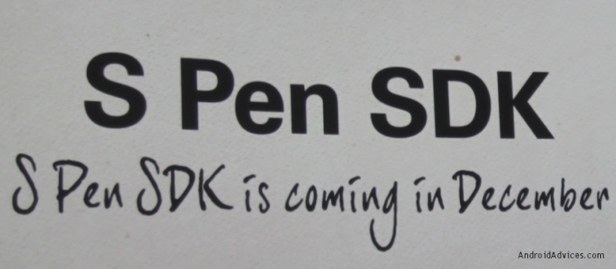
Delicious Hunter
Software

Slide 23
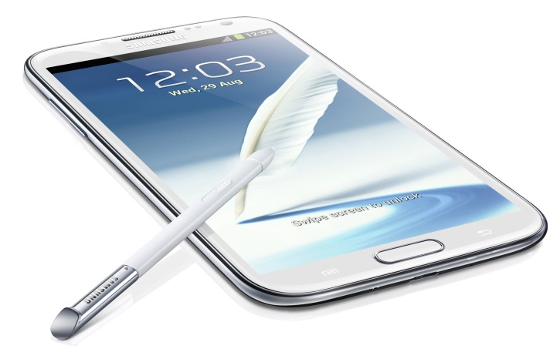
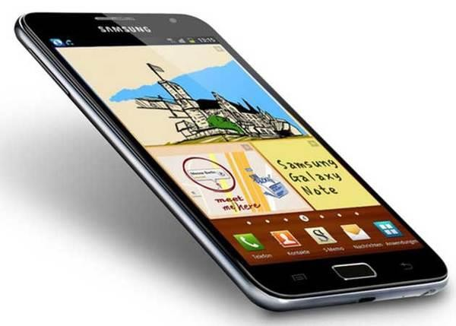
Delicious Hunter
Hardware

Slide 24
Software Specification
Functional Requirement
Non Functional Requirement
System Overview

Slide 25
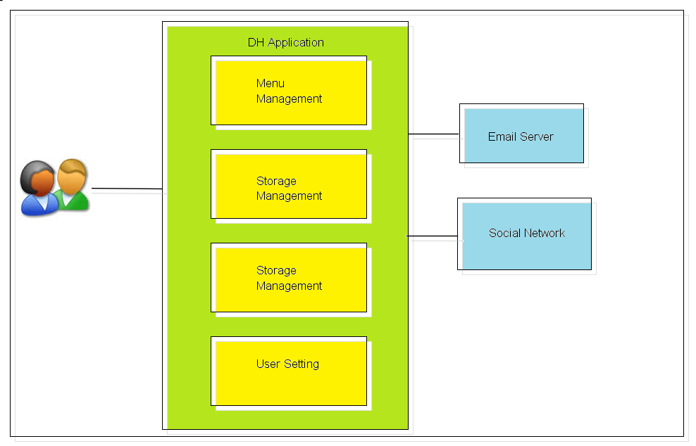
Delicious Hunter
System Overview

Slide 26
Delicious Hunter
Functional Requirement
When the delicious hunter system turn on, the system have 4 option for user:
User setting
Storage Management
Library management
Menu Management

Slide 27
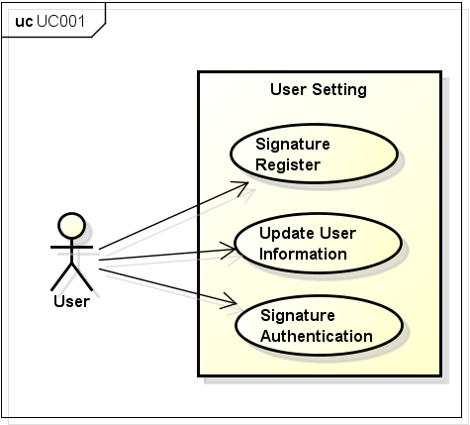
Delicious Hunter
Functional Requirement

Slide 28
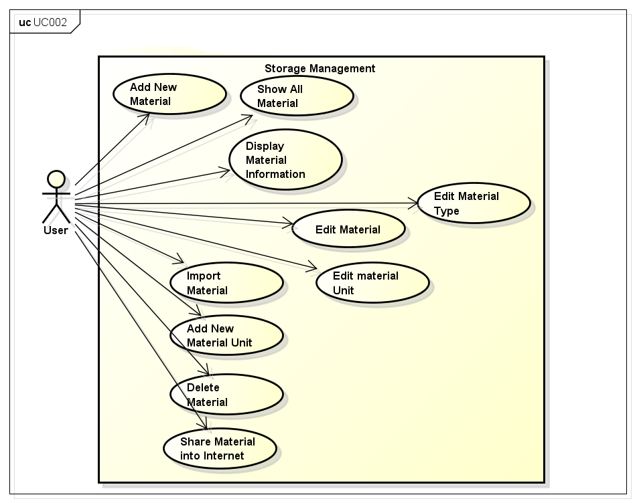
Delicious Hunter
Functional Requirement

Slide 29
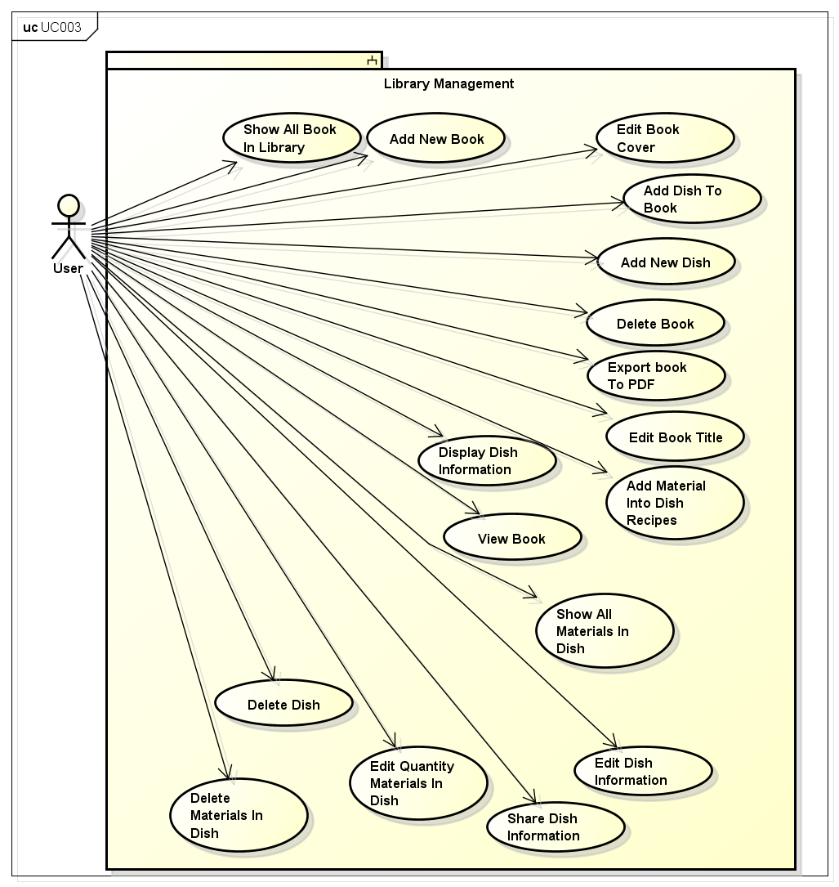
Delicious Hunter
Functional Requirement

Slide 30
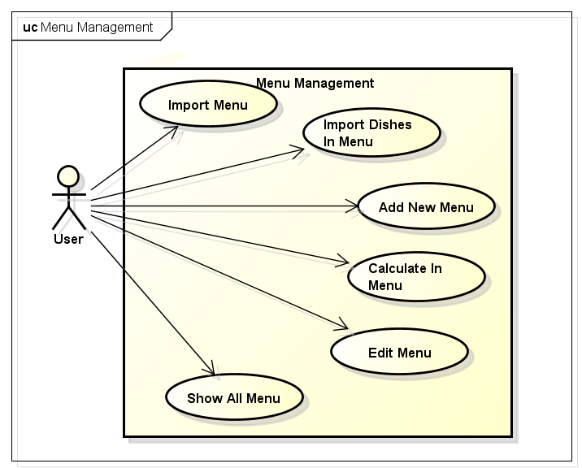
Delicious Hunter
Functional Requirement

Slide 31
Delicious Hunter
Non-Functional Requirements
Performance:
Time to response < 3s
Time of processing 2~ 5s
Availability:
Available 95% of time

Slide 32
Delicious Hunter
Non-Functional Requirements
Maintainability:
architectural standards
coding standards.
Usability:
Complete each function in 10 action

Slide 33
Software Design
Package Design
Entity Relationship
Architecture Presentation

Slide 34
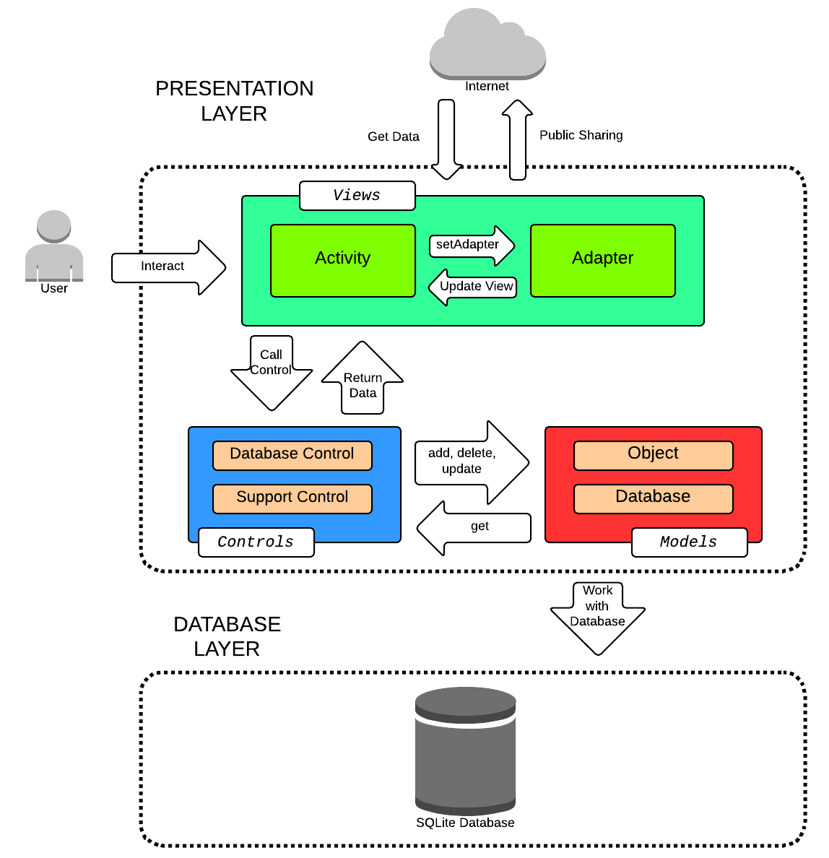
Delicious Hunter
Architecture Presentation

Slide 35
Delicious Hunter
Architecture Presentation
Why We chose MVC?
- Many objects in these applications tend to be more reusable, and their interfaces tend to be better defined.
- Easy to update and maintenance

Slide 36
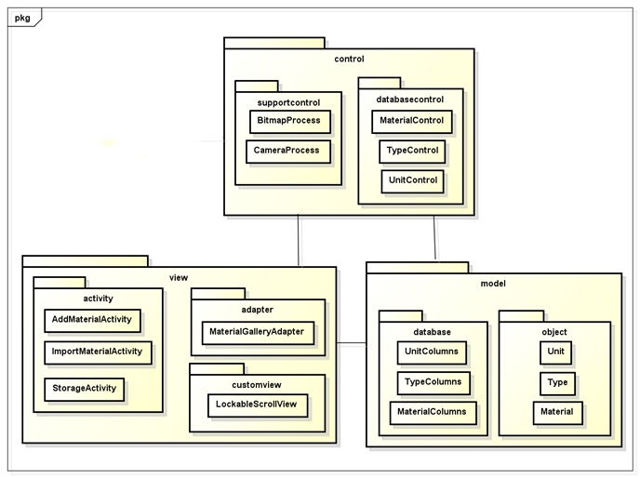
Delicious Hunter
Package Design

Slide 37
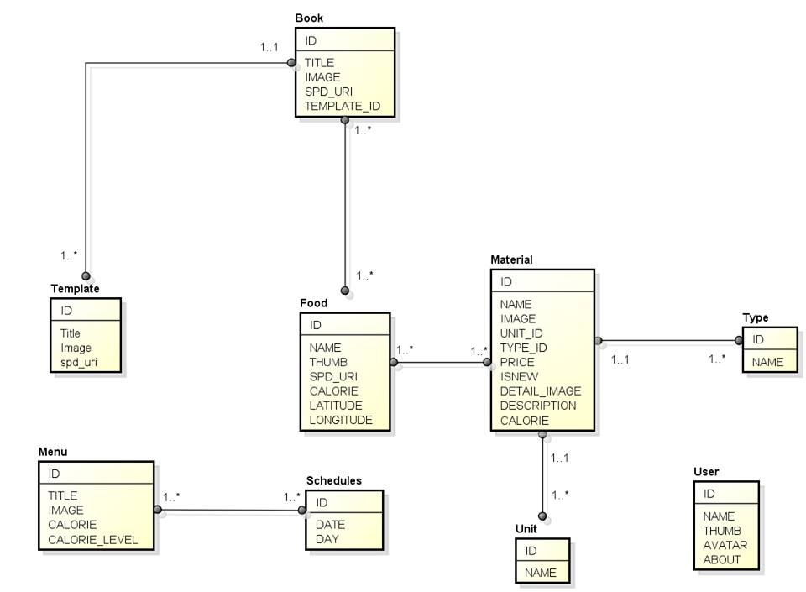
Delicious Hunter
Entity Relationship

Slide 38
Testing
Test Process
Test Result
Test Model

Slide 39
Delicious Hunter
Test Model
Customer requirement
validate
Acceptance test
Product specifications
verify/validate
System test
verify
High-level design
Integration test
other V&V activities
Low-level design
verify
Component test
Coding & unit test

Slide 40
Delicious Hunter
Test Model
Why We chose V Model?
Simple and easy to use
Avoid the downward flow of the defects
Work well for small projects where requirements are easily understood
Testers control and follow the actual workflows

Slide 41
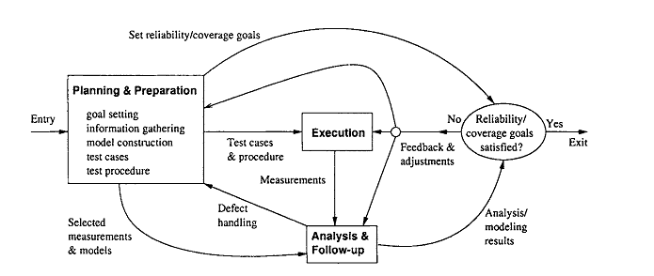
Delicious Hunter
Test Process

Slide 42
Delicious Hunter
Test Process
Goal setting: test stages, test items etc.
Planning
&
Preparation
Test cases preparation
Test procedure preparation
Executing test
Execution
Related activities: retest, report etc.
Checking result
Analysis
&
Follow up
Analysis result
Initiating & monitoring

Slide 43
Delicious Hunter
Test Process
Doer : developer
Unit test
Time : 17/03 – 01/04
Integration test
Doer : test team
Time : 19/03 – 25/03
Doer : test team
System test
Time : 26/03 – 02/04

Slide 44
Delicious Hunter
Environments and Resource
Environments
Name | Purpose | Detail
Samsung Galaxy Note 2 | Real Device test | Ram: 2GB Memory Storage: 8GB Android OS 4.3
Samsung Galaxy Note 8.0 | Real Device test | Ram: 2GB Memory Storage: 16GB Android OS 4.2

Slide 45
Delicious Hunter
Environments and Resource
Resource
Member | Position | Responsibilities
Đặng Quang Minh | Test Leader | Create test plan Review test cases Review test report
Hoàng Việt Thắng | Tester | Create test cases Execute test Create test report

Slide 46
Delicious Hunter
Test Result
No | Module code | Pass | Fail | Untested | N/A | Number of test cases
1 | Home Screen | 3 | 0 | 0 | 0 | 3
2 | UC001- User Setting Control | 9 | 0 | 0 | 0 | 9
3 | UC002 - Storage Management | 30 |  | 1 |  | 50
4 | UC003-Library Management | 42 |  | 1 |  | 42
4 | UC004- Menu Management | 20 |  | 0 |  | 20
 | Sub total | 104 | 0 | 2 | 0 | 106
Test coverage |  | 98.11 | %
Test successful coverage |  | 98.11 | %

Slide 47
Project Result
Comparison Result
Lessons Learned
Project Result

Slide 48
Had more experiences and skills in time management, team work, risk management etc.
Project Result
Complete basic functions that proposed at the beginning

Slide 49
Delicious Hunter
Main objectives | Develop an Android application that helps users to create, manage and work with their Cook Book
Purpose | Provide a tools to help housewives and cooker to make cooking easier
Items | Plan | Actual
Releases date | 17/04/2014 | 17/04/2014
Releases version | 1.0 | 1.0
Days | 100 | 100
Test cases |  | 106
Defects |  | 7
Document pages | 200 | Approximately 250
Lines of code
Comparison Result

Slide 50
Delicious Hunter
Limitation & Expectation
Still not upload application to Google Play
Limitation
Some functions in editor screen are not smooth as expected
Some GUI are still upgrading

Slide 51
Delicious Hunter
Limitation & Expectation
Increase Database to make user cook easier
Expectation
Support Multi Language
Develop Google Map function to note food

Slide 52
Delicious Hunter
Lesson Learned
Situation | Problem | Lessons learned
Conflict in team | Members are stress Cannot make decision | Talk and listen to each other Analysis situation Make right decisions
Technical difficulties | Take lots of time to solve Miss the deadline | Search in Google or some IT forums Ask group’s supervisor or teachers for some advices

