Slide 1

Travel Experience Website
Capstone Project
Hanoi, Apr 24th, 2014

Slide 2
Project Team
Supervisor
Bùi Ngọc Anh
Team member
01141 – Nguyễn Trường Sơn
01413 – Hoàng Trường Đại
00918 – Nguyễn Việt Thắng
00862 – Vũ Anh Tuấn
00877 – Đỗ Hữu Thiện

Slide 3
Content
1
Introduction
2
Project Management Plan
3
Requirement Specifications
4
5
6
7
8
Design Description
Testing
Summary
Demonstration
Q & A

Slide 4


Introduction

Slide 5
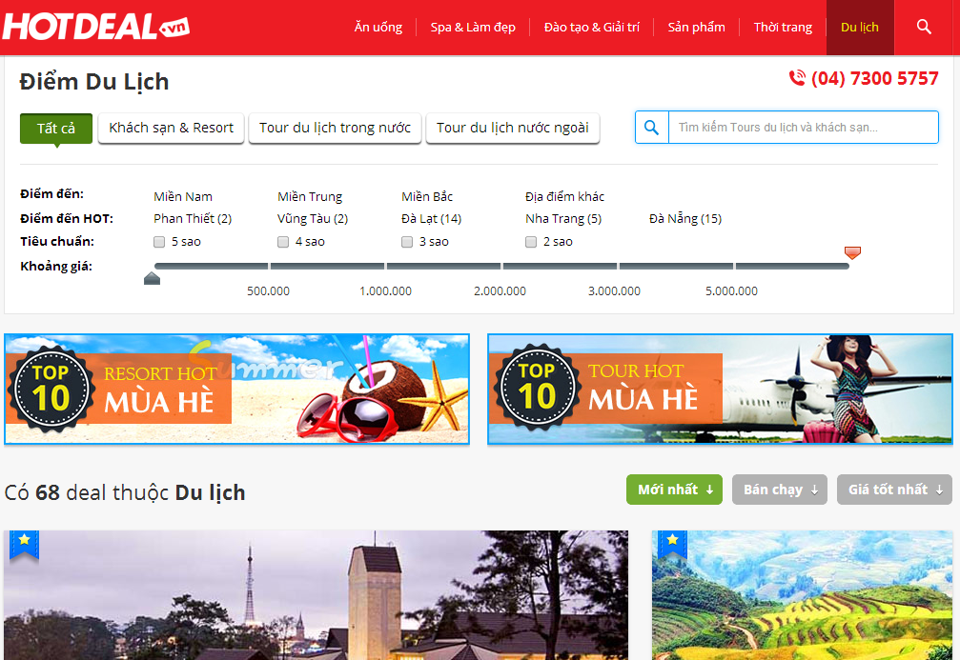
Existing Solution

Slide 6
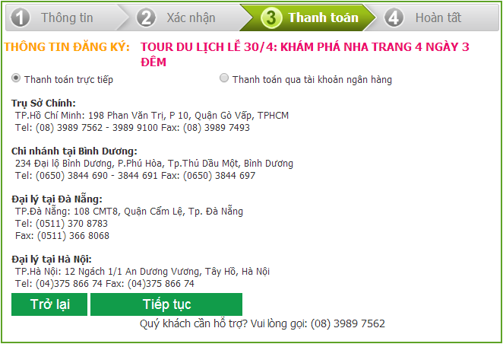
Existing Solution

Slide 7

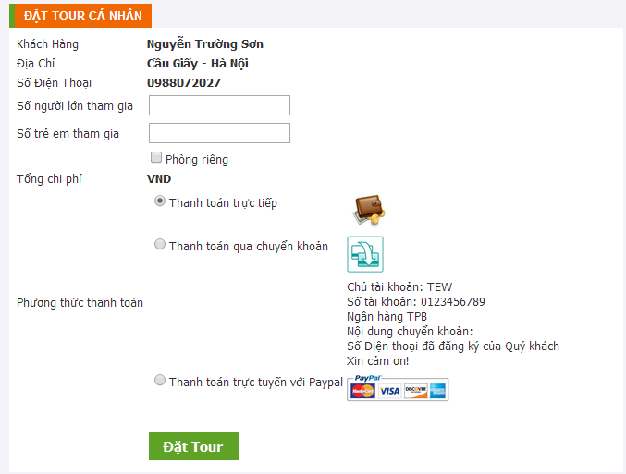
Travel Experience Website

Slide 8

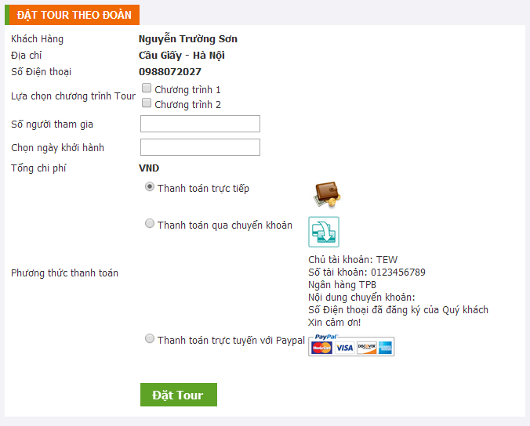
Travel Experience Website

Slide 9



Proposal
Order Tour
Individual / Collective options
Select Tour Programs
Online Payment with PayPal

Slide 10
Scope
Scope of work
This website only provide tours and services in Vietnam for Vietnamese.
Register validation with SMS just to apply Vietnam phone number.
Manage customers with Identity card, do not support Passport.
Not yet support domestic online payment (E.g: Bao Kim, Ngan Luong).

Slide 11
Project Management Plan
Hardware Requirement
  CPU : Dual Core 2.1 GHz or higher
  RAM : 2 GB or higher
Software Requirement
No. | Item | Value
1 | Operating Systems | Windows 7, Windows 8
2 | Development Kit | JDK 1.6 or higher
3 | Web Server | Apache Tomcat 7.0
4 | Database Management System (DBMS) | MySQL 5.6
5 | Development Frameworks | Hibernate 3.0

Slide 12

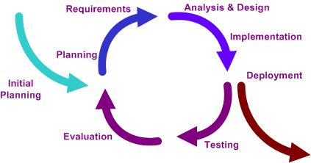
Software Development Model
Iterative and incremental development
Easy to break project into phases
Easy to change requirement & design
Suitable for inexperience team

Slide 13





Tools

Slide 14





Technologies

Slide 15
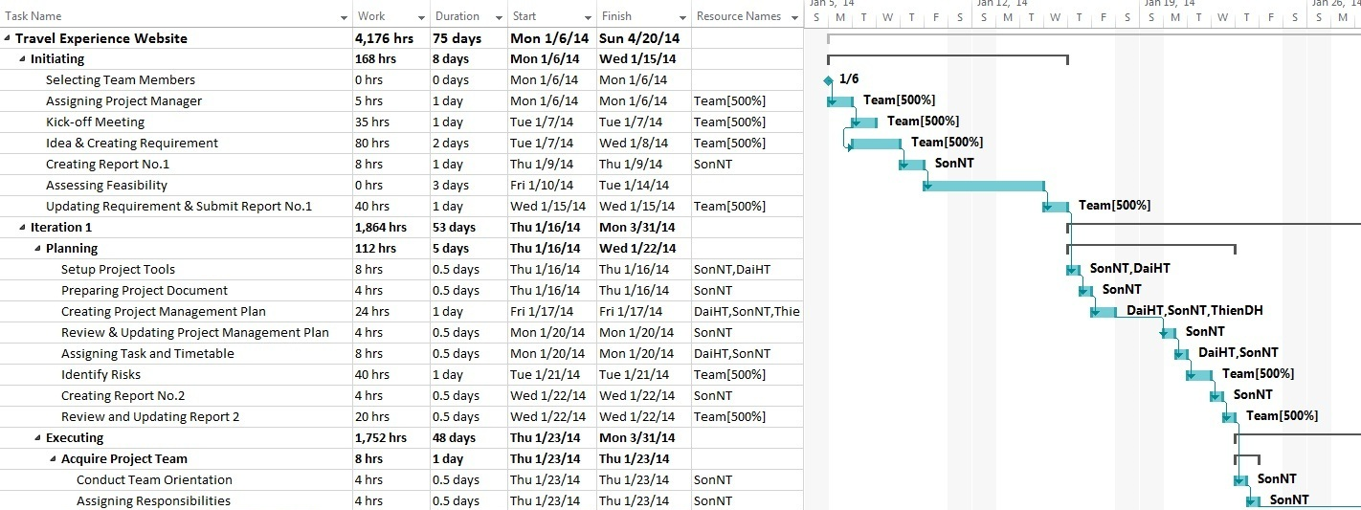
Detailed Plan

Slide 16
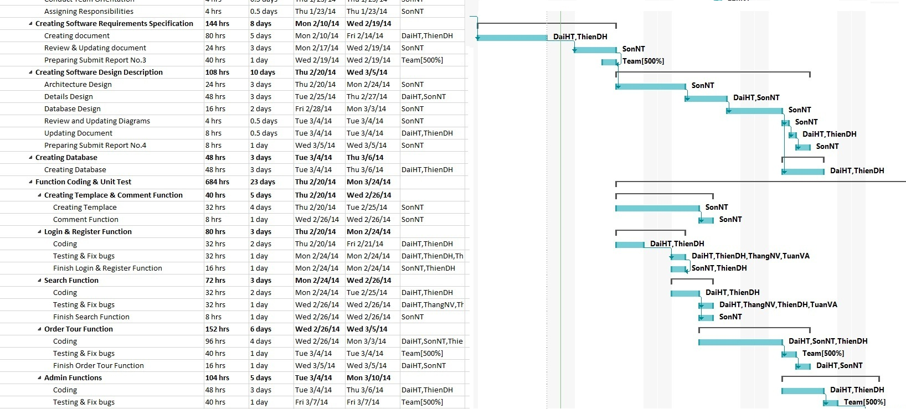
Detailed Plan

Slide 17
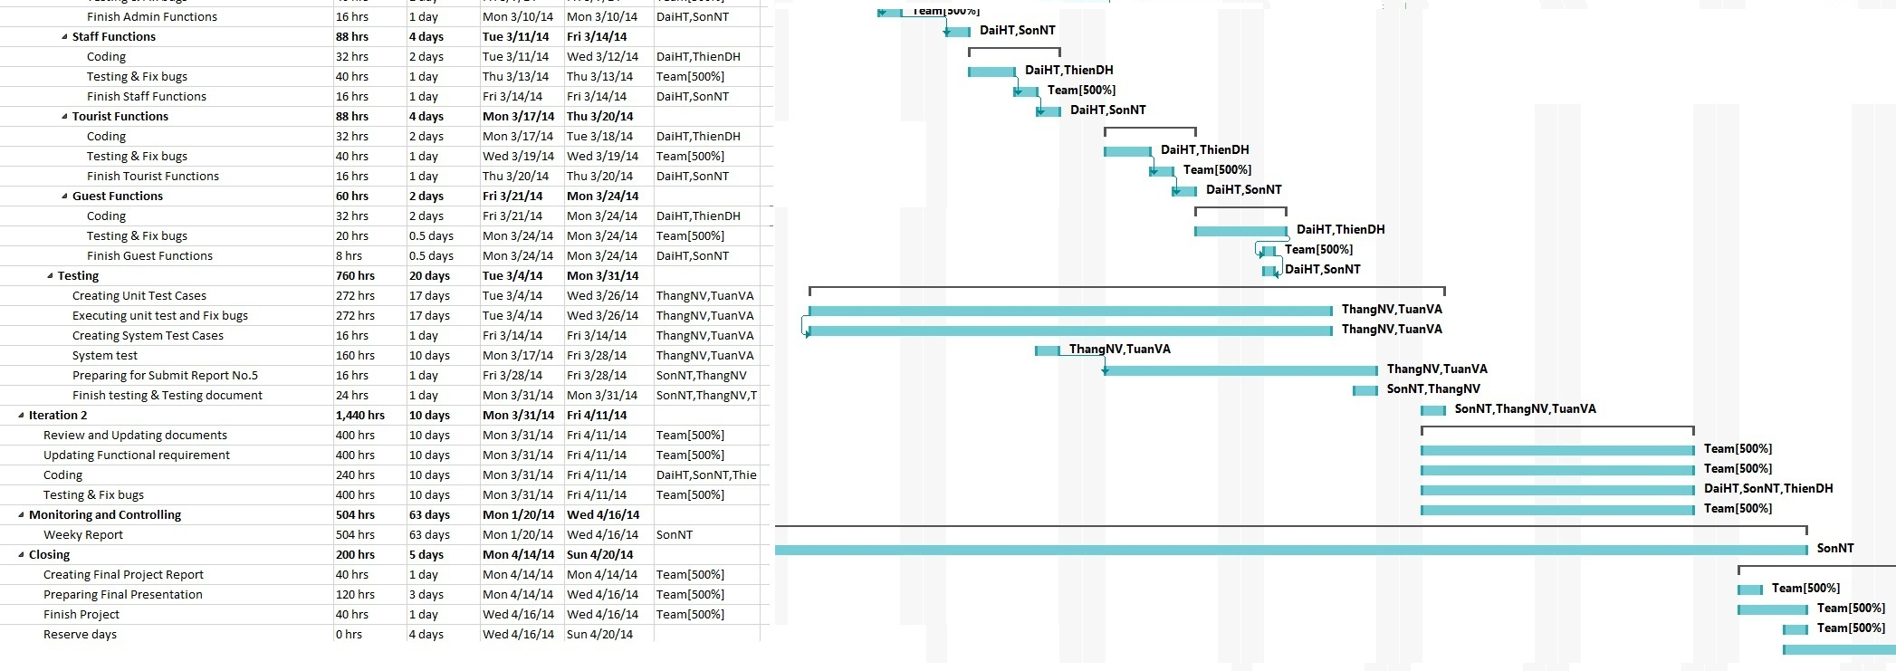
Detailed Plan

Slide 18

Teamwork
Meeting 2 hours/day and 3 days/week
Locations: School, Home
Communication: Skype, Phone

Slide 19

Difficulties
Conflicts between team members
Unable to follow standard software development process
Confusion in building
business process system

Slide 20
Software Requirement Specifications
Functional Requirement
Non-functional Requirement

Slide 21
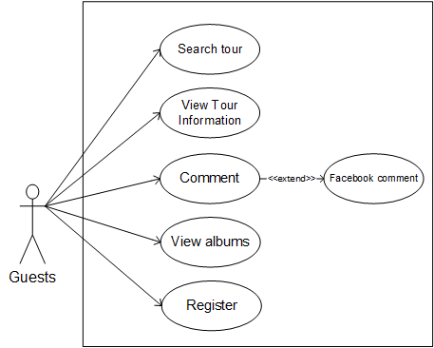
Functional Requirements
Guest

Slide 22
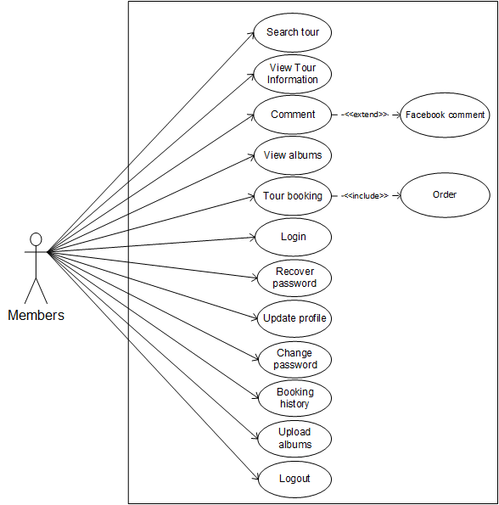
Functional Requirements
Customer

Slide 23
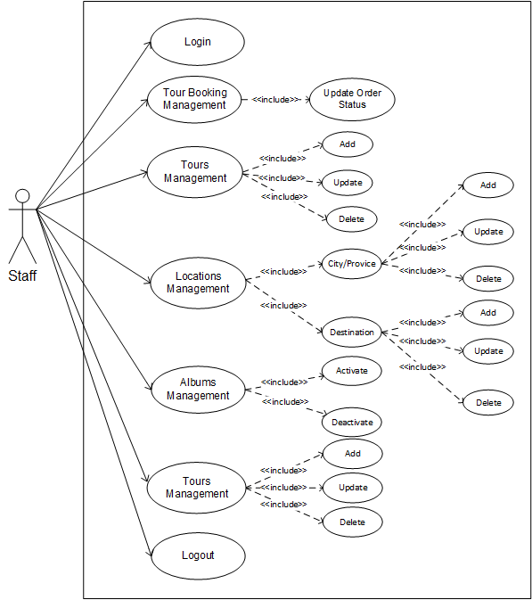
Functional Requirements
Staff

Slide 24
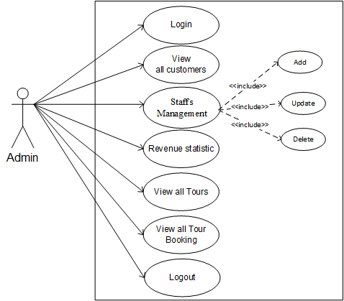
Functional Requirements
Admin

Slide 25


Non-functional Requirements
1. Portability
  Website can be used by any
  people with a browser and
  an Internet connection
2. Security
  Password is encrypted
  in MD5 method

Slide 26

Software Design Description
Architecture design
Detail design
Database design

Slide 27
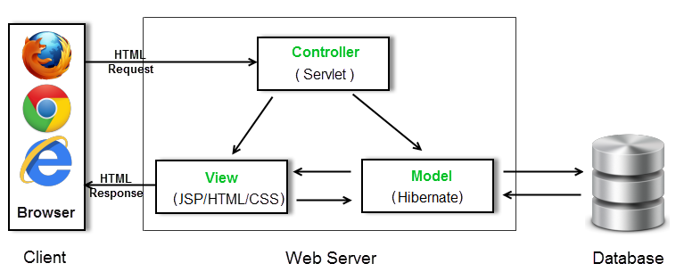
System Architecture

Slide 28

Detailed Design
Class Diagram
Sequence Diagram

Slide 29
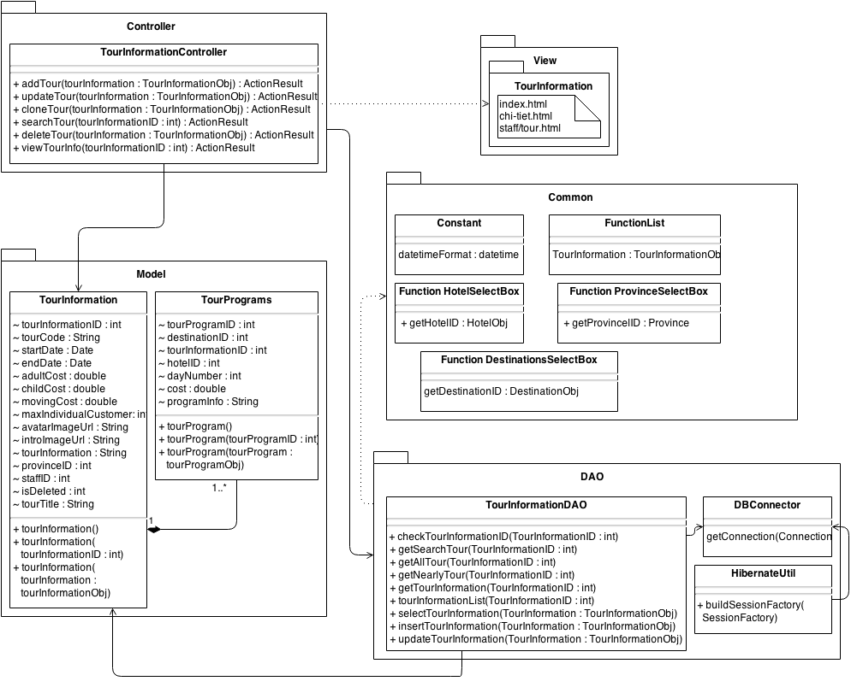
Class diagram for Tours group

Slide 30
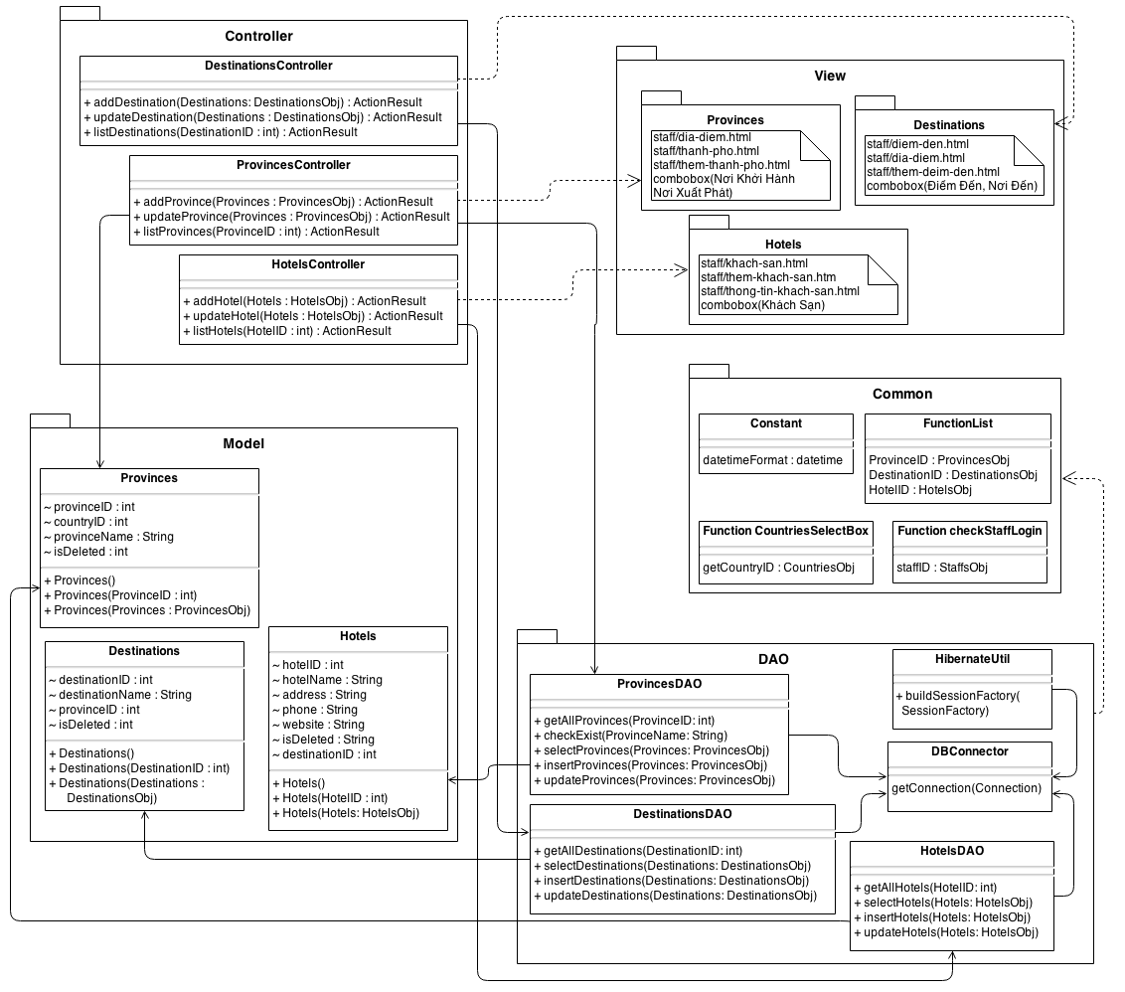
Class diagram
for Locations
group

Slide 31
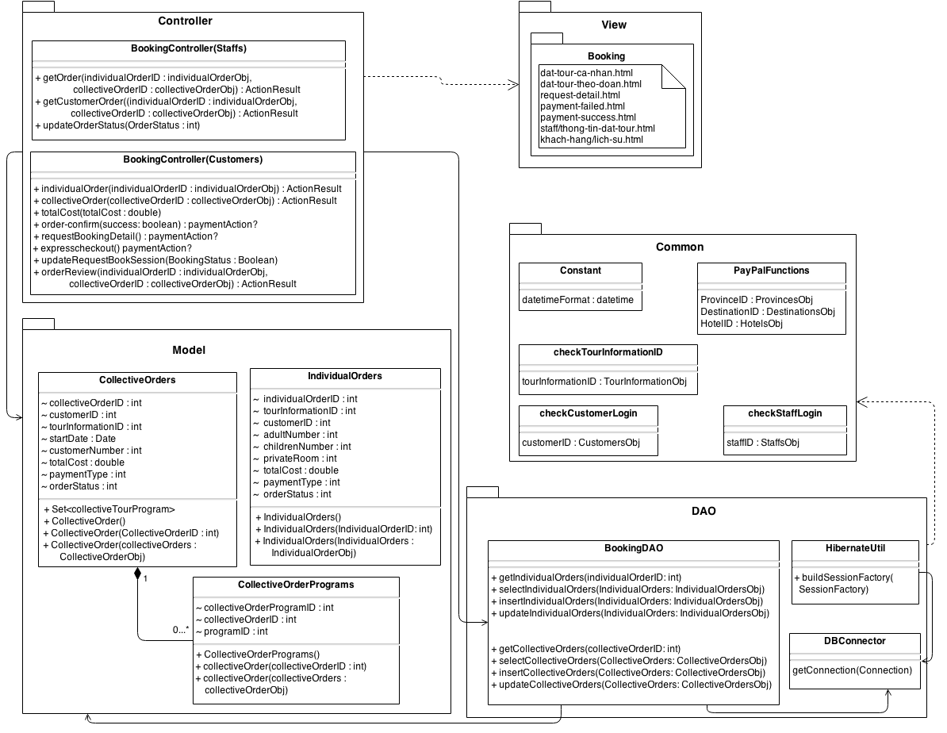
Class diagram
for Booking
group

Slide 32
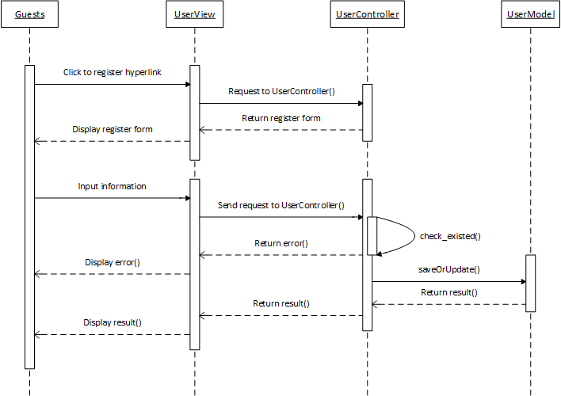
Sequence diagram
Register

Slide 33

Sequence diagram
Add new tour

Slide 34
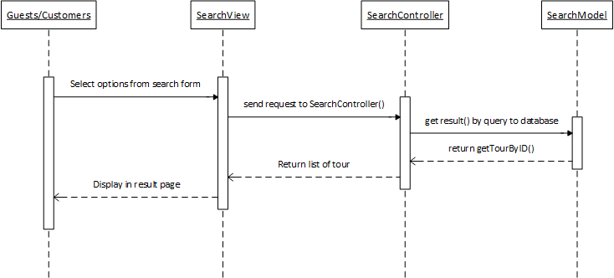
Sequence diagram
Search tour

Slide 35
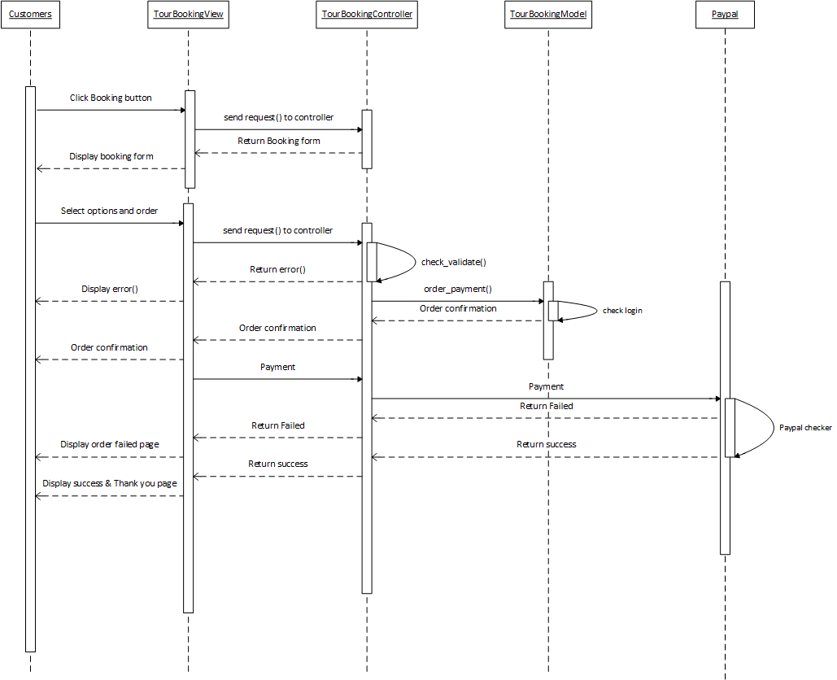
Tour booking

Slide 36


Tour Booking
Individual
Collective

Slide 37
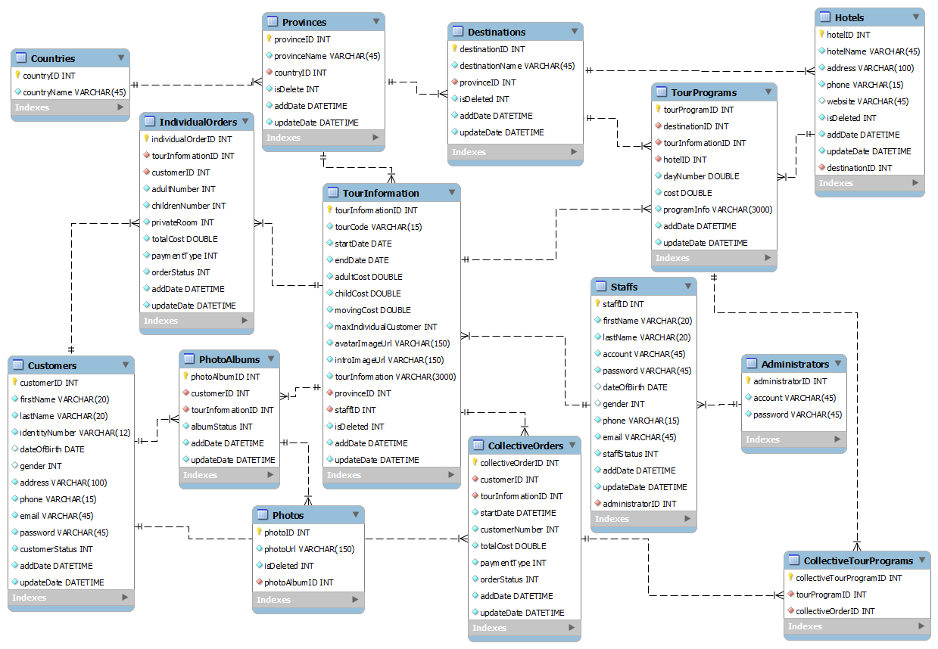
Database Tables Design

Slide 38
Testing
Testing Process
Testing
Test Report

Slide 39
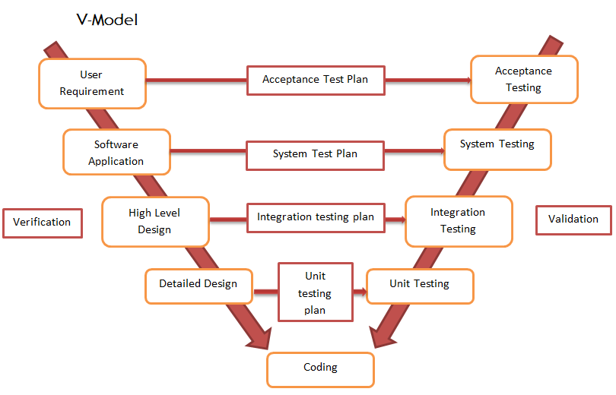
Testing Process

Slide 40
Test Report
No. | Module | Passed | Failed | Untested | No. of Test Cases
1 | Unit Testing | 282 | 0 | 0 | 282
2 | Intergration Testing | 51 | 0 | 0 | 51
3 | System Testing | 97 | 0 | 0 | 97
 | Total | 430 | 0 | 0 | 430

Slide 41
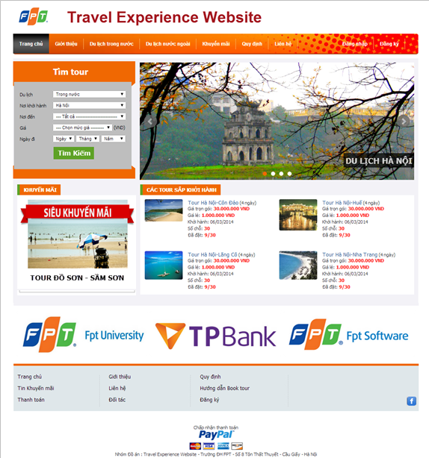
Summary

Slide 42



Summary
Project Management Skills
  Plan Creating
  Activity Organization
  Time management
Working In Groups
  Communication Skills
  Conflict Resolutions
Technologies
  Java (Hibernate….)
  Jquery, Ajax, HTML, CSS
  MySQL

Slide 43



Future Development
Domestic Online payment
Foreign Tour Booking

Slide 44

Demo

Slide 45

Q&A

Slide 46
Thank you for listening !

