Slide 1
Budgetary Management Subsystem
Capstone Project Presentation
卒業論文プレゼンテーション

Slide 2
About Us
TRAN BINH DUONG
Supervisor
指導教員
Nguyen Van Vung
Nguyen Ba Tu
Pham Xuan Hung
Do Quang Quy
Phan Huy Hung
Team leader
チームリーダー
Team member
チームメンバー
Team member
チームメンバー
Team member
チームメンバー
Team member
チームメンバー

Slide 3
OUTLINES
Overview
概要
Project Management
プロジェクト管理
Requirement Specification
要求仕様
Software Design
ソフトウェア設計
Coding
コディング
Quality Control
品質管理
Summary
サマリー
Demo
デモ

Slide 4
1
Overview
概要

Slide 5
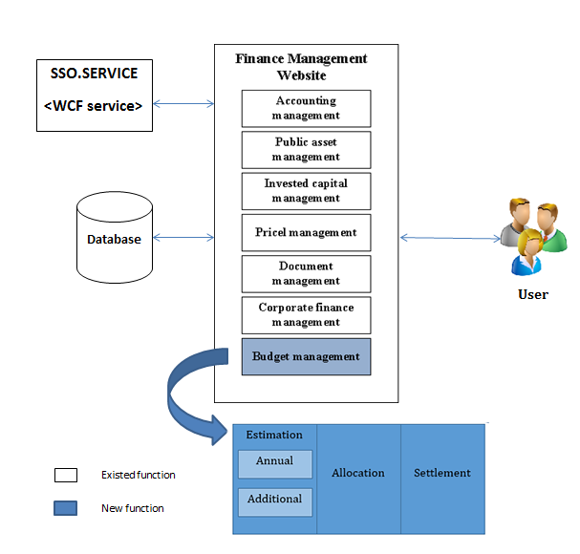
Overview-概要
System overview

Slide 6
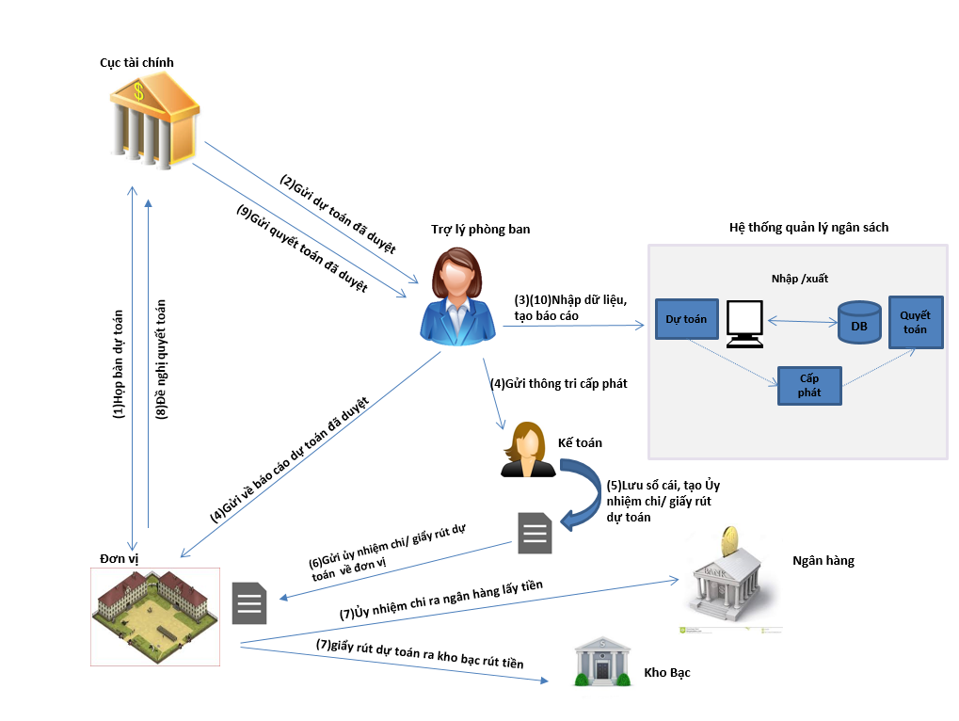
Overview-概要
Rich Picture

Slide 7
2
Project Management
プロジェクト管理

Slide 8
Project Management-プロジェクト管理
Content -内容
Project Organization
(プロジェクト組織)
Content -内容
Software Process Model
(ソフトウェアの過程模型)
Task Plan
(タスク計画)
Equipment and Tools
(機器やツール)
Communication Management
(コミュニケーション 管理)
Risk Management
(リスク管理)
Quality Management
(品質管理)

Slide 9
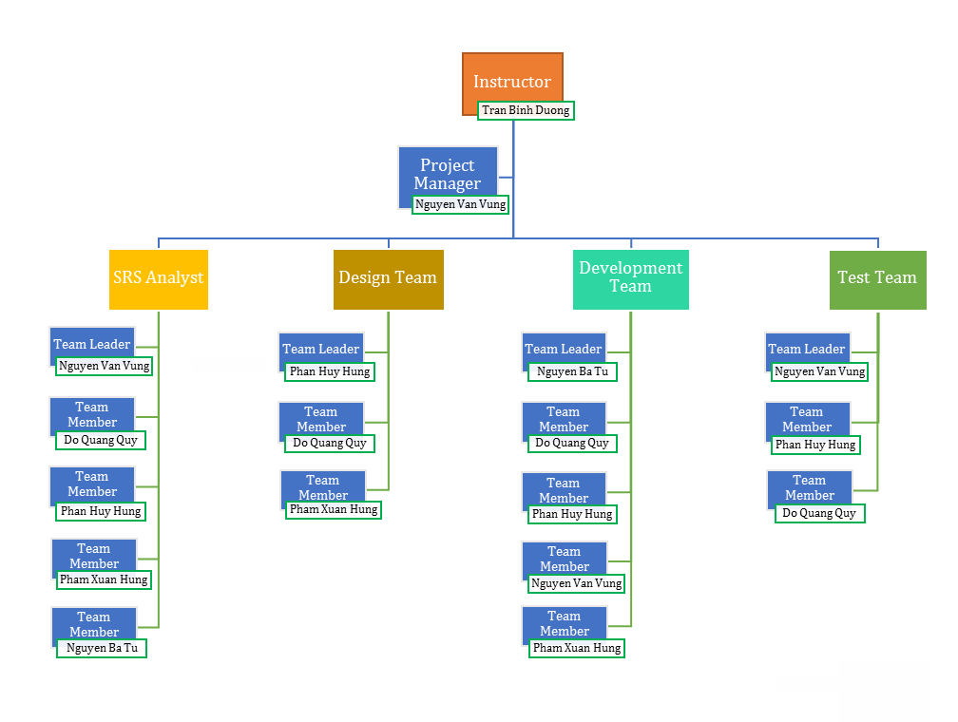
Project Organization - (プロジェクト組織)

Slide 10
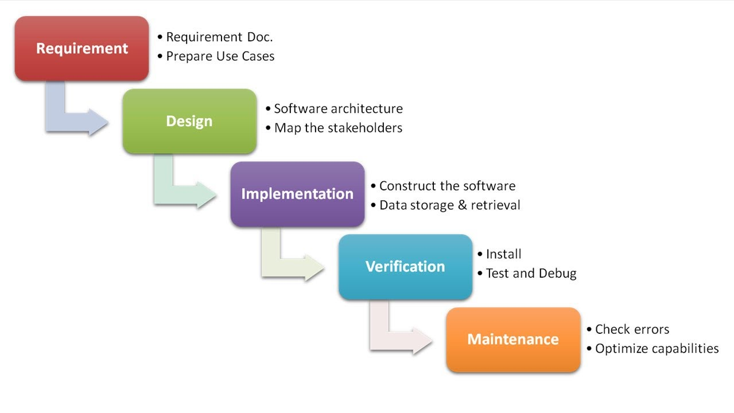
Software Process Model - (ソフトウェアの過程模型)

Slide 11
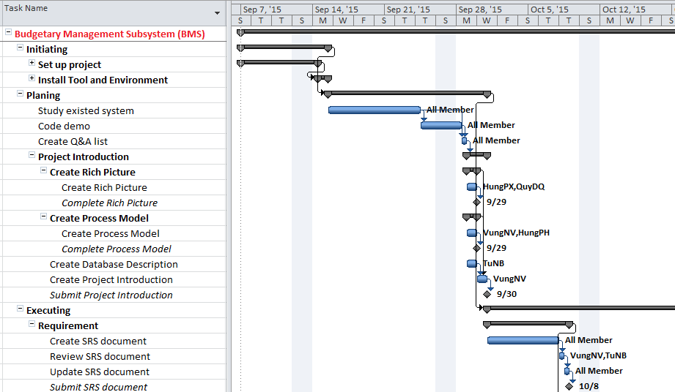
Task Plan - (タスク計画)

Slide 12
Equipment and Tools - (機器やツール)
Office tools
Design tool
Management tool

Slide 13
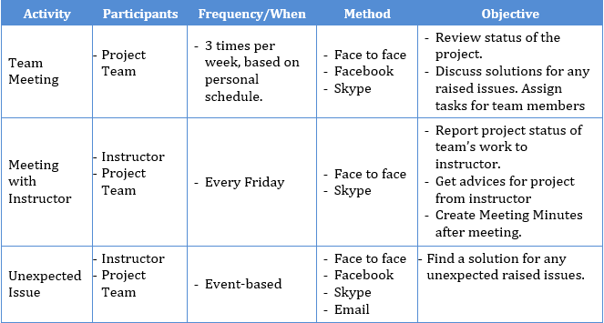
Communication Management-(コミュニケーション 管理)

Slide 14
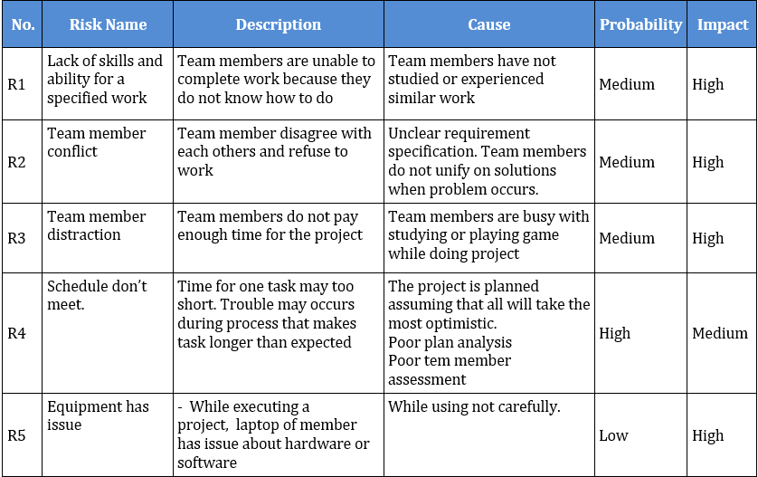
Risk Management-(リスク管理)

Slide 15
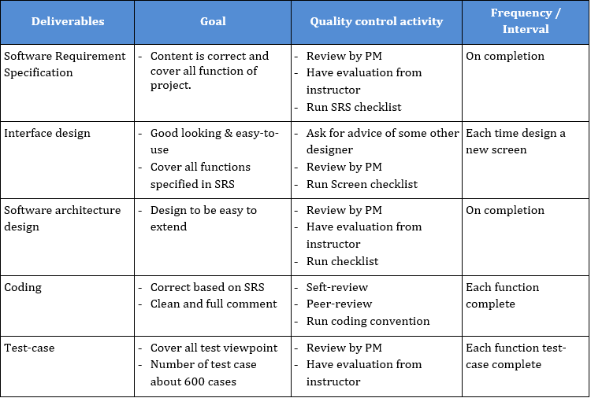
Quality Management-(品質管理)

Slide 16
3
Requirement Specification
要求仕様

Slide 17
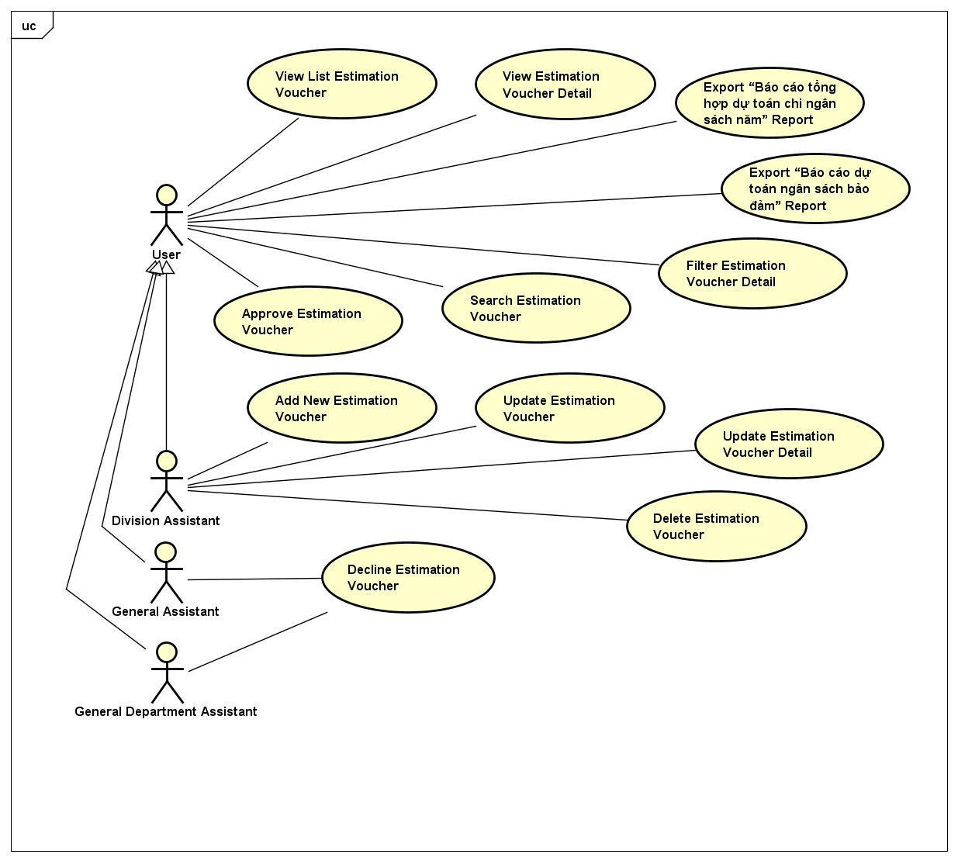
Functional Requirement-機能仕様
Budget estimation use case

Slide 18
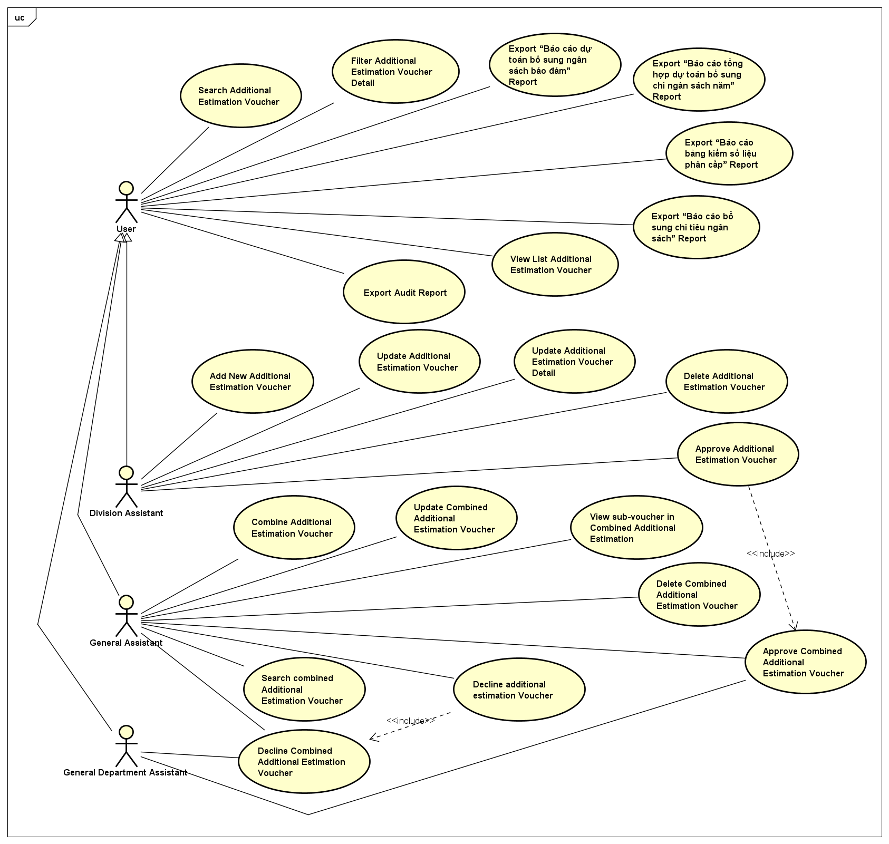
Functional Requirement-機能仕様
Additional budget estimation use case

Slide 19
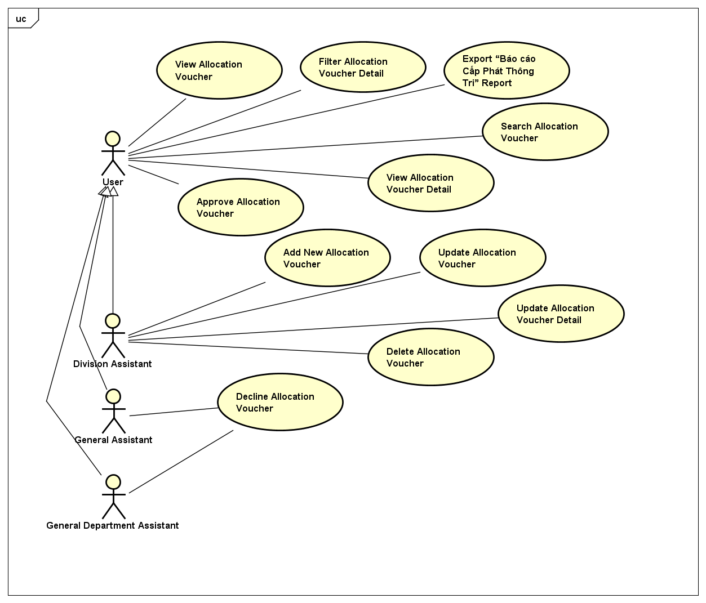
Functional Requirement-機能仕様
Budget allocation use case

Slide 20
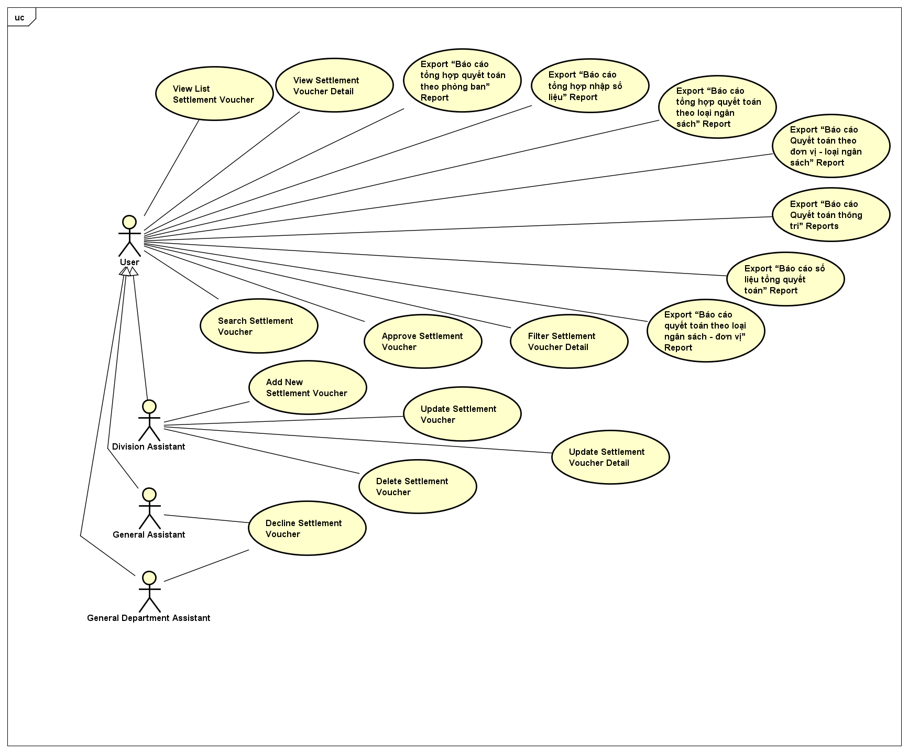
Functional Requirement-機能仕様
Budget settlement use case

Slide 21
Non-functional Requirement-非機能仕様
Reliability
Maintainability
Mean time between failures: about 6 month
The maximum bugs per function are 2 bugs/a function when user uses software within 2 months. The average number of bugs in the software during system testing is about to be around 3 bugs/KLOC.
Coding standards and naming conventions: Output of the project must include coding standards and naming conventions documentations. Implementation code must be easy to maintain. All code must be clearly commented, including class, method documentations.
Mean time to repair: Immediately when Administrator finds out problems. Average 0.5 day.
Usability
Security
Usability Requirements support the following from the perspective of its primary users:
Efficiency of use: User can complete each function is lesser than 10 actions.
Help facilities: User will be trained a week about all the functions of system .Beside, user will be provided user guide to support
In order to avoid unwanted access by strangers, the security implemented in various ways:
User authorize: Functions will be show after users login dependencies user’s role and permission of each user. At early stage, User can use function cross each other in some actions.
Availability
Performance
Percentage of availability time is about 24 per 7
In term of response time, waiting time of processing will be 0.5 to 1 seconds; waiting time to process normal functions will not exceed 2 seconds and process loading or combining data will not exceed 3 seconds.

Slide 22
4
Software Design
ソフトウェア設計

Slide 23
Content -内容
Overall System Architecture
(全体的なシステムアーキテクチャ設計)
Application Architecture Design
(アーキテクチャ設計)
Data Design
(データ設計)
Screen Design
(画面設計)

Slide 24
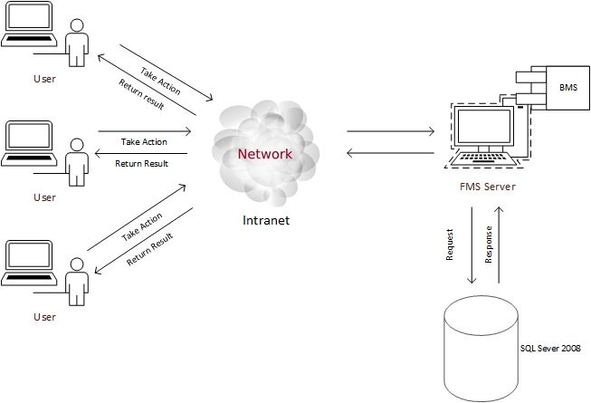
Overrall System Architecture Design - 全体的なシステムアーキテクチャ設計
Overall FMS architecture

Slide 25
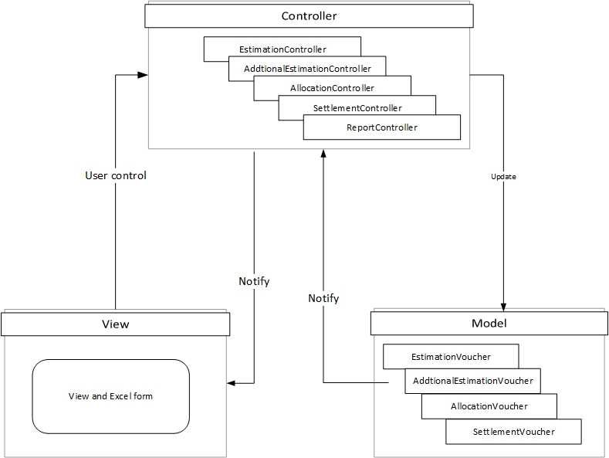
Application Architecture Design-アプリケーションアーキテクチャ設計
BMS web application architecture

Slide 26
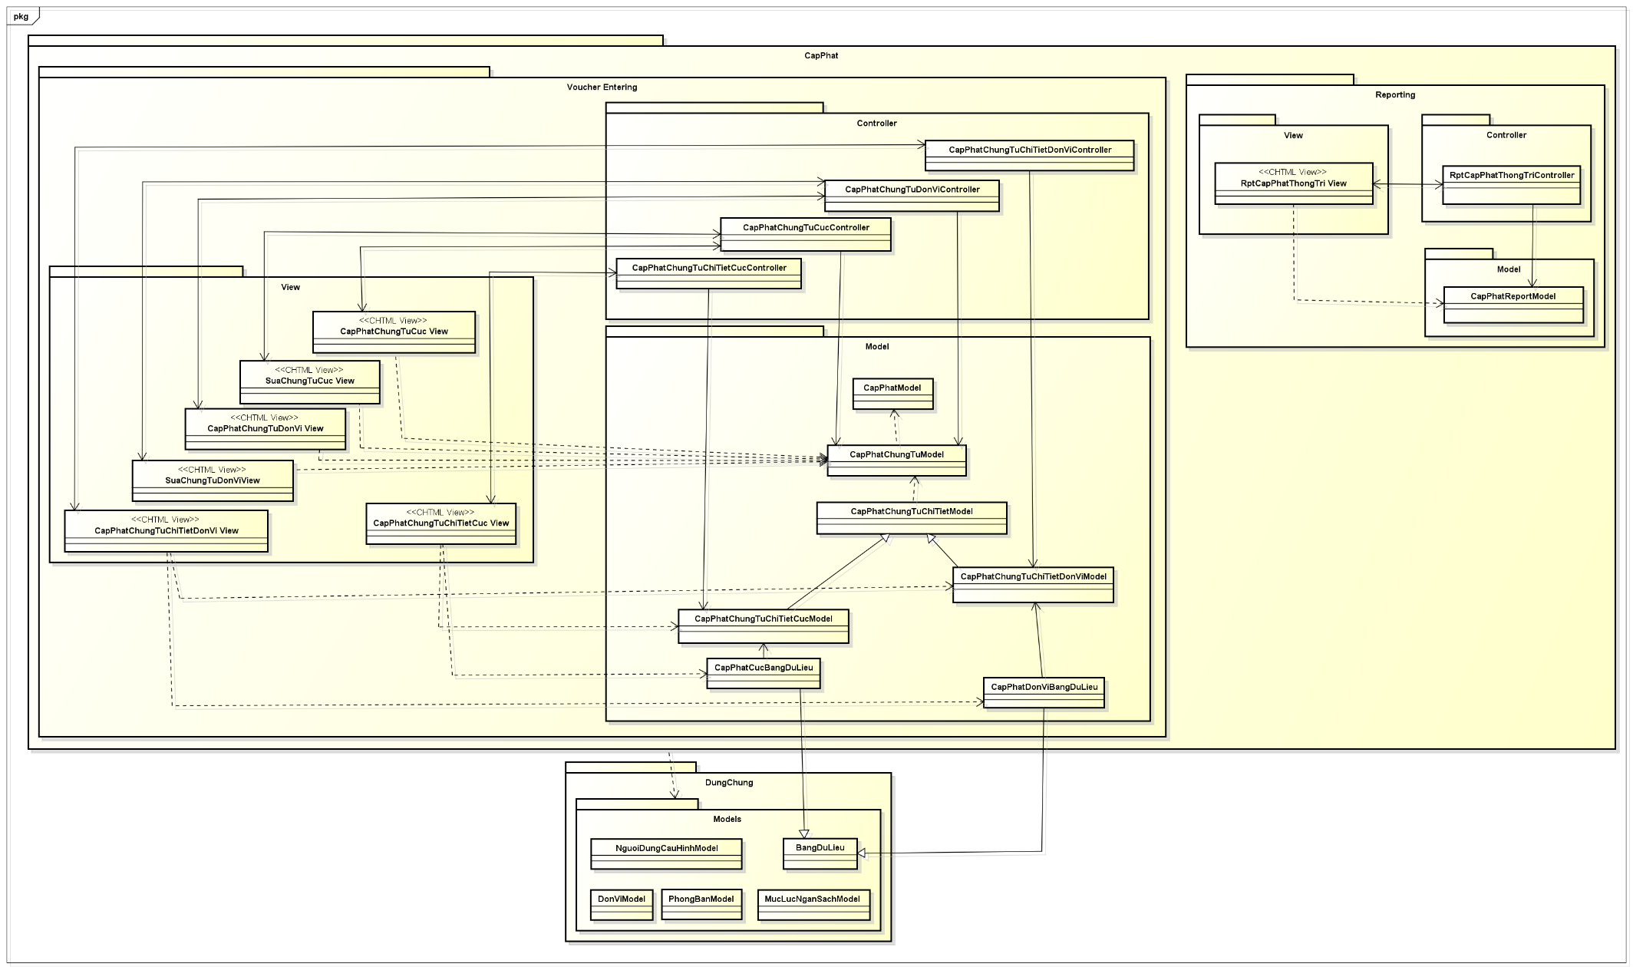
Application Architecture Design-アプリケーションアーキテクチャ設計
Class diagram

Slide 27
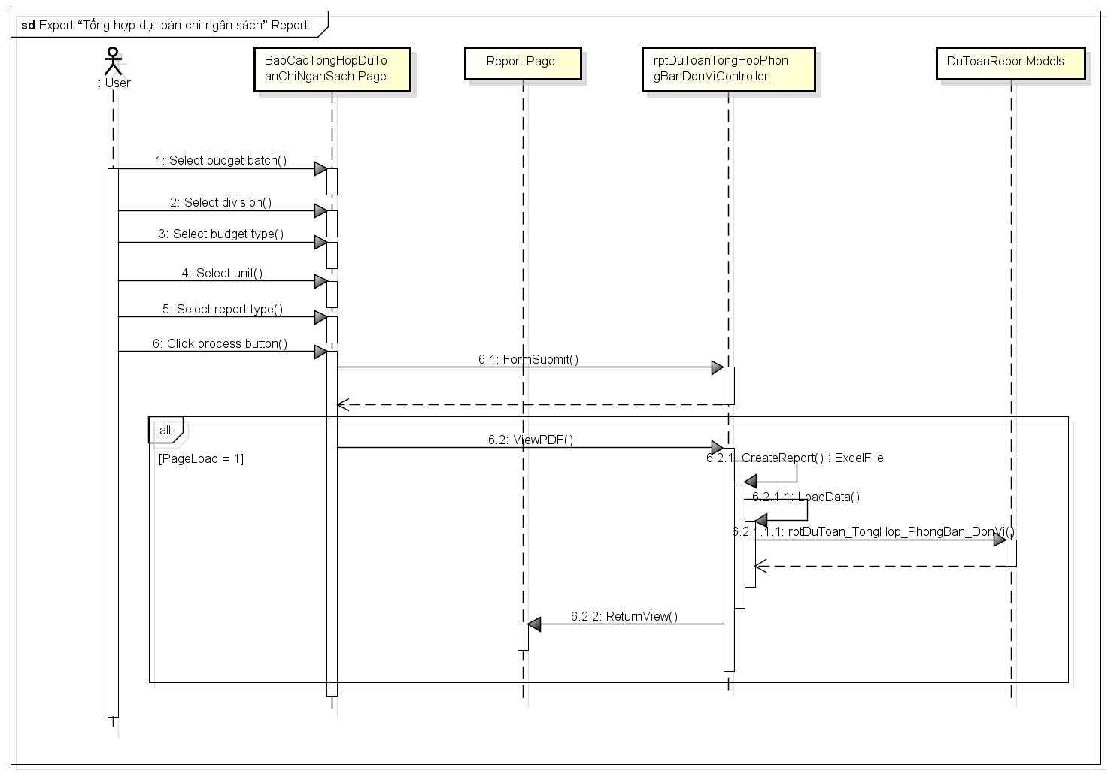
Application Architecture Design-アプリケーションアーキテクチャ設計

Slide 28
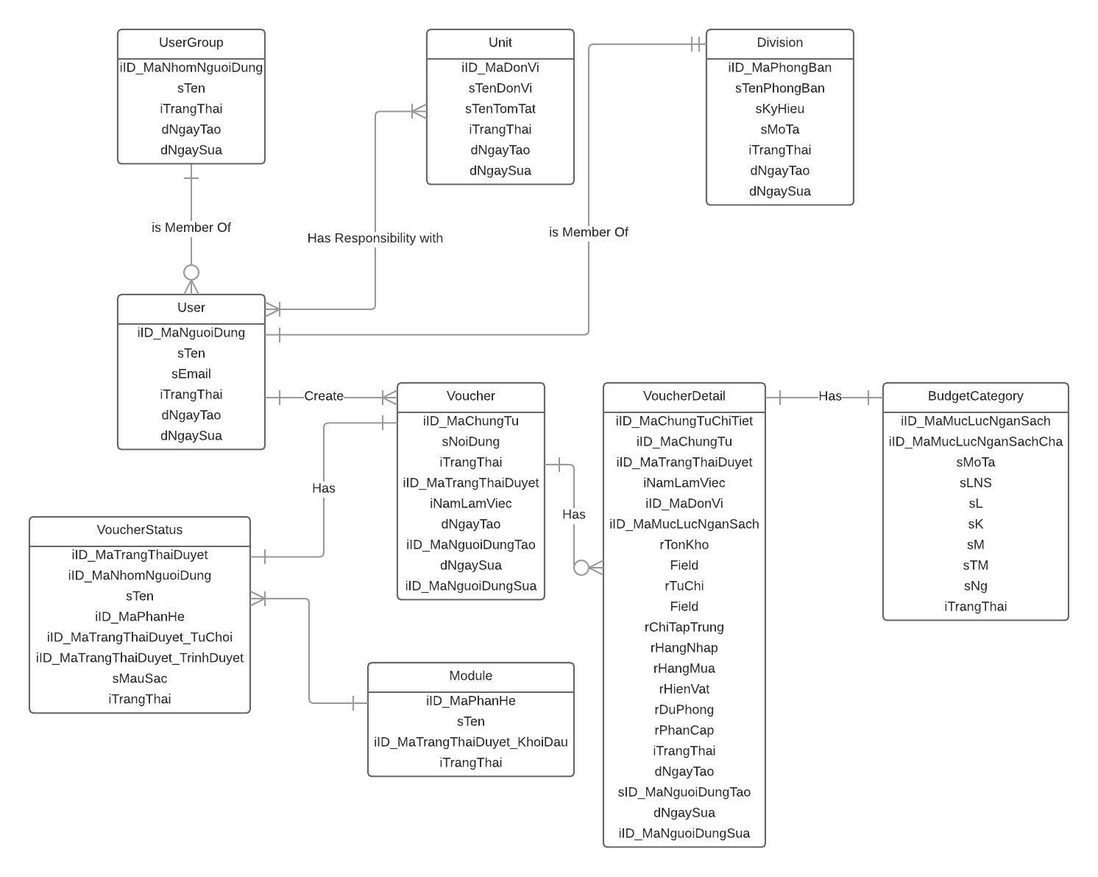
Data Design-(データ設計)
Entity relationship diagram

Slide 29
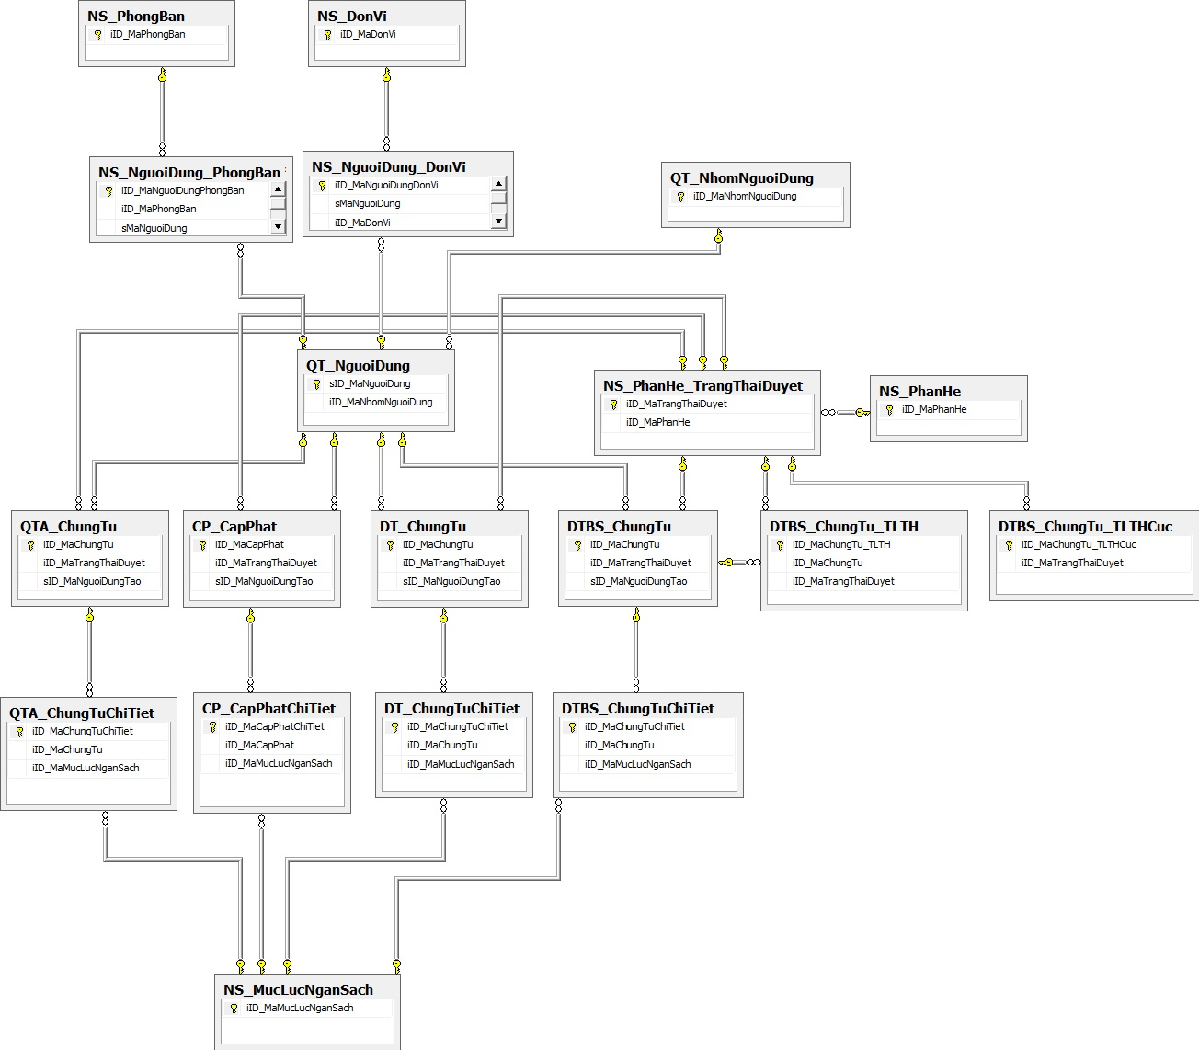
Data Design-(データ設計)
Table list

Slide 30
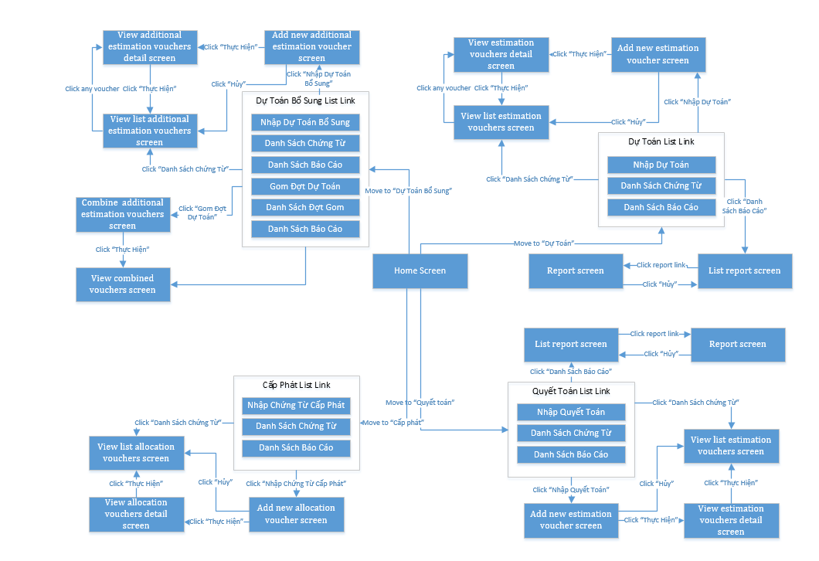
Screen Design - 画面設計
Screen flow

Slide 31
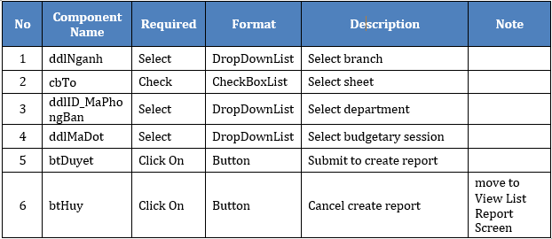
Screen Design - 画面設計

Slide 32
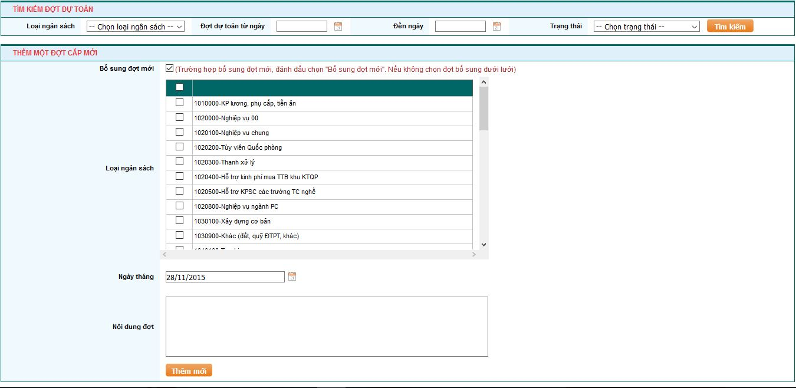
Screen Design - 画面設計
Add new estimation voucher screen

Slide 33
5
Coding
コディング

Slide 34
Development Environment-開発環境

Slide 35
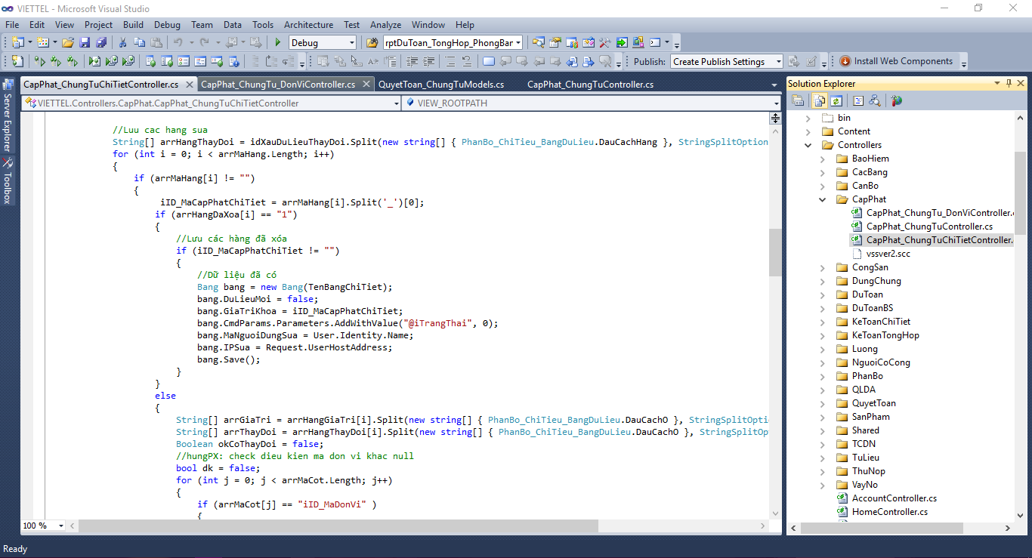
Coding Convention-コーディング規約

Slide 36
Source code Review-ソースコード レビュー

Slide 37
6
Quality Control
品質管理

Slide 38
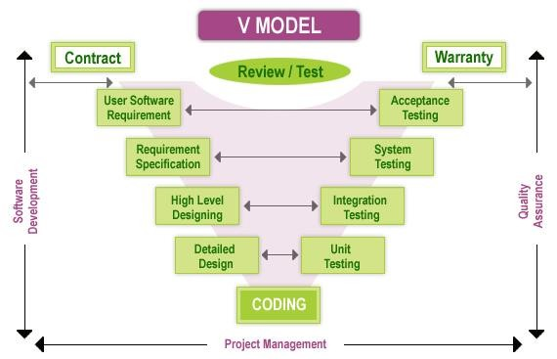
Testing・Test Model-テスティング

Slide 39
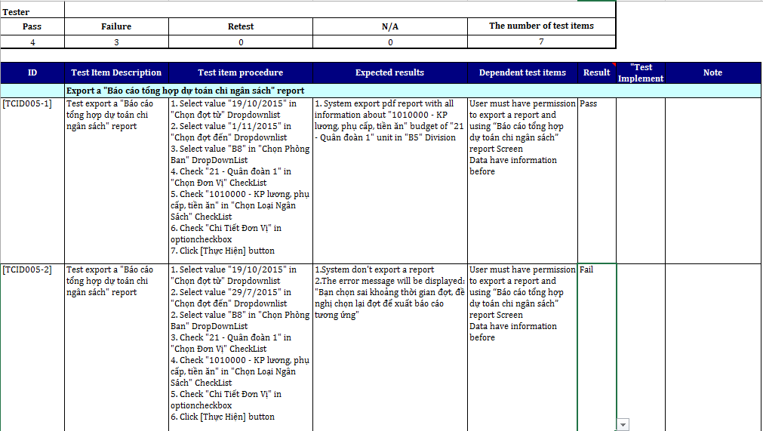
Test case-テストケース

Slide 40
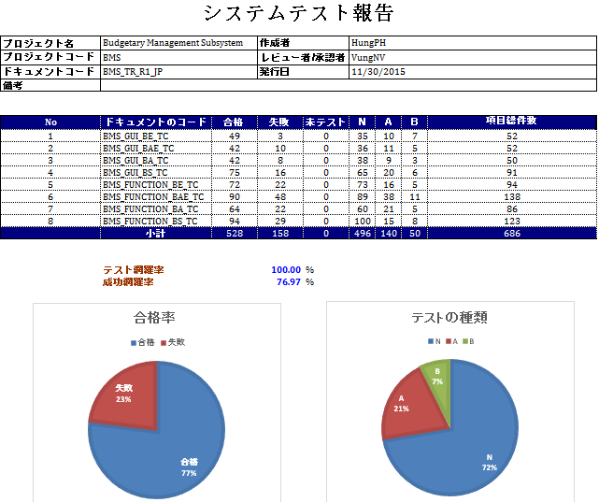
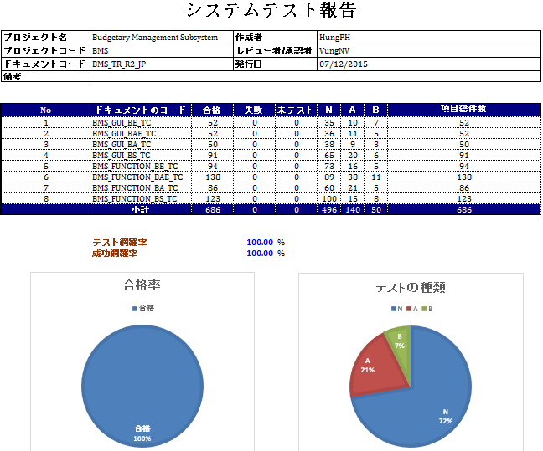
Test Report-テスト実行報告
Test round 1 report
Test round 2 report

Slide 41
7
Summary
サマリー

Slide 42
Future Development-拡張機能
We plan to improve the performance of BMS and develop missing phase that cannot implement in this development phase.
There’re also some function that the customer even don’t know what the truly need. The team will work together to help them identify those function.

Slide 43
Lesson Learned-学んだ
Working in professional environment
Improving technique
Teamwork

Slide 44
8
Demo
(デモ)

