Slide 1
CAPSTONE PROJECT
OBJECT FOLLOWING ROBOT
Summer 2014

Slide 2
Supervisor:
Phan Dung Hung
Authors:
Trinh Van Quang
Nguyen Hoang Viet
Luong Manh Cuong
Nguyen Binh Duong

Slide 3
Content
Introduction
Project Management Plan
Project requirements specification
Non Functional
Functional
Tools
Design
Mechanical Design
Hardware Design
Firmware Design
Software Design
Implement
Testing
Conclusion and perspectives.

Slide 4
I. Introduction
Idea
Existing product
Scope of project

Slide 5
1. Idea
Analysis object behavior
Getting started with Robot

Slide 6
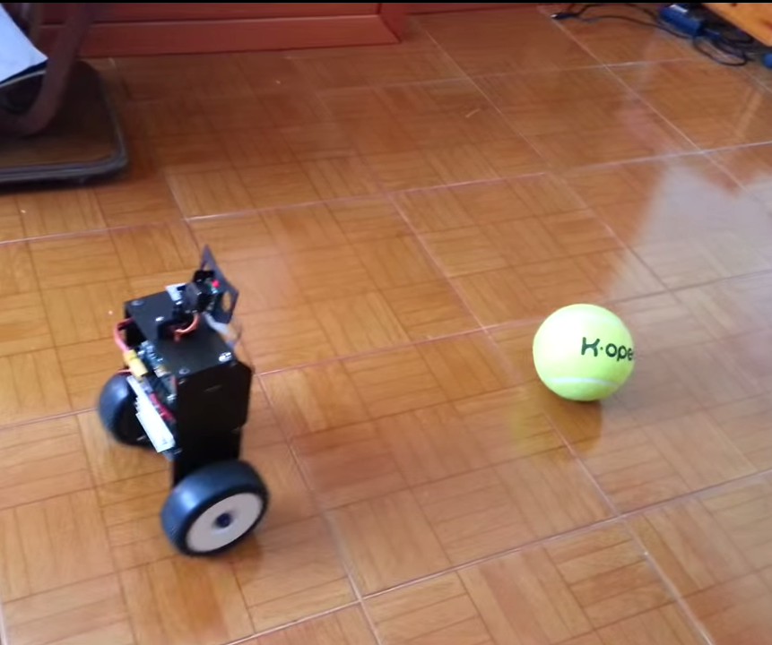
2. Existing product
RS4 Robot in Website: http://roboticssamy.blogspot.pt Author: Samuel Matos

Slide 7
3. Scope of project
Detect the tennis ball.
Tracking the tennis ball.
Follow the tennis ball.

Slide 8
II. Project Management Plan
Project process model.
Role and Responsibilities.
Work breakdown structure (Time plan).

Slide 9
1. Project process model

Slide 10
2. Role and Responsibilities
Supervisor
(Mr.HungPD)
Project Manager (QuangTV)
QuangTV
QuangTV
VietNH
CuongLM
VietNH
VietNH
QuangTV
DuongNB
CuongLM
CuongLM
DuongNB
Analyst Team Design Team Develop Team Test & QA Team

Slide 11
Work breakdown structure (Time plan)

Slide 12
III. Project requirements specification
Non Functional
Functional
Tools

Slide 13
1. Non Functional
Performance:
Plug and play
Battery is enough for 2-3 hours
Use rechargeable
Maintainability:
Easy to repair
Easy to configure

Slide 14
Non Functional
Reliability:
Stable software
Safety:
Components are covered.

Slide 15
2. Functional

Slide 16
3. Tools
Hardware:
Raspberry Pi model B rev 2
Webcam or Raspberry Pi camera module
Arduino Pro Mini
L298N Module
LM2596HVS Module
SRF04
R4WD Mobile Platform
Tower Pro SG90 Servo
Tiger Power 11.1V 2200mah 25C

Slide 17
Mechanical devices:
Knife
Screwdrivers
Glue
Solder machine
…

Slide 18
Software tools & enviroment
Arduino IDE, Notepad ++, Geany, Visual Studio.
Raspbian OS, Windows OS, Ubuntu OS.
Microsoft office.
Cmake, V4l2, OpenCV …
Putty, Xming, WinSCP, Terminal Software
…

Slide 19
IV. DESIGN
Mechanical Design
Hardware Design
Firmware Design
Software Design

Slide 20
1. Mechanical design
Control Wheel
Control Camera

Slide 21
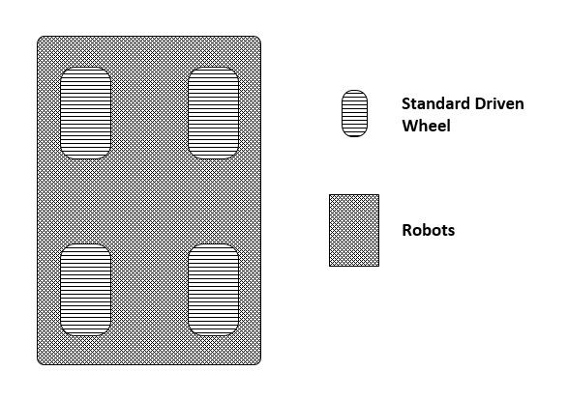
The Standard Driven Wheel

Slide 22
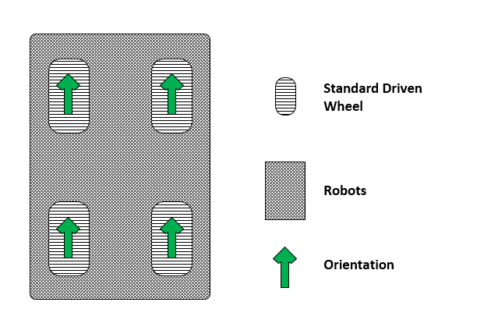
Forward

Slide 23
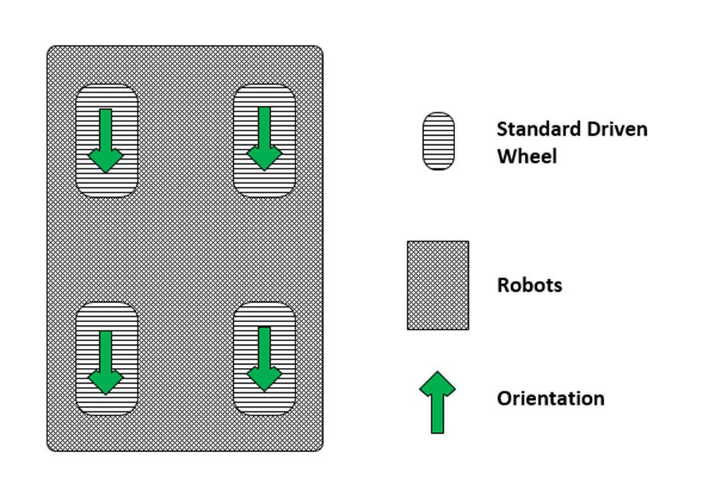
Back

Slide 24
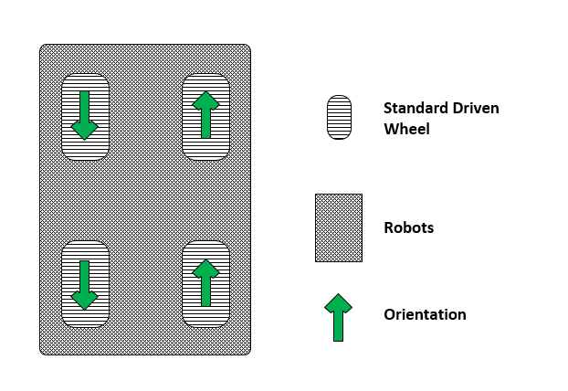
Turn Left

Slide 25
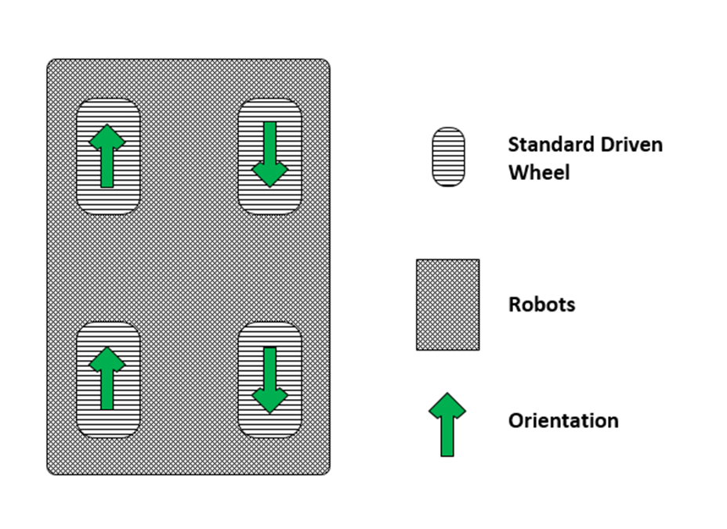
Turn Right

Slide 26
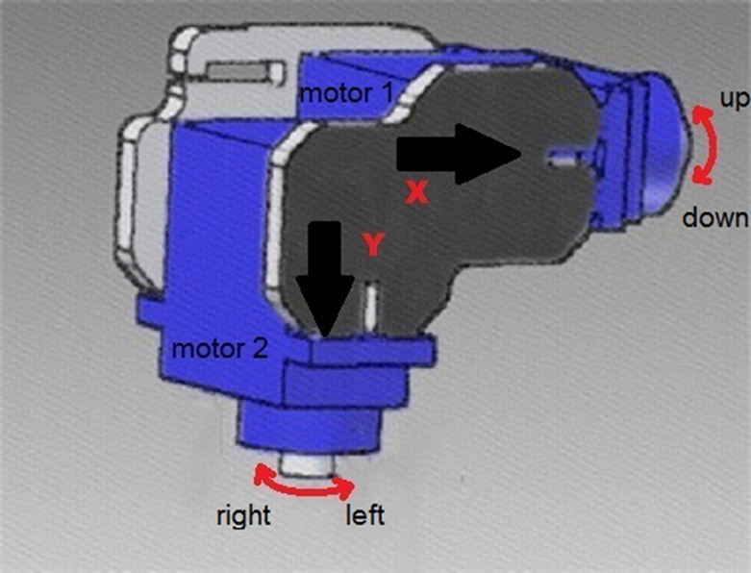
Control Camera

Slide 27
2. Hardware design
Power System
Motor System
SRF04
Servo Motor
Raspberry Pi and Arduino
Raspberry Pi and RasPi Camera

Slide 28
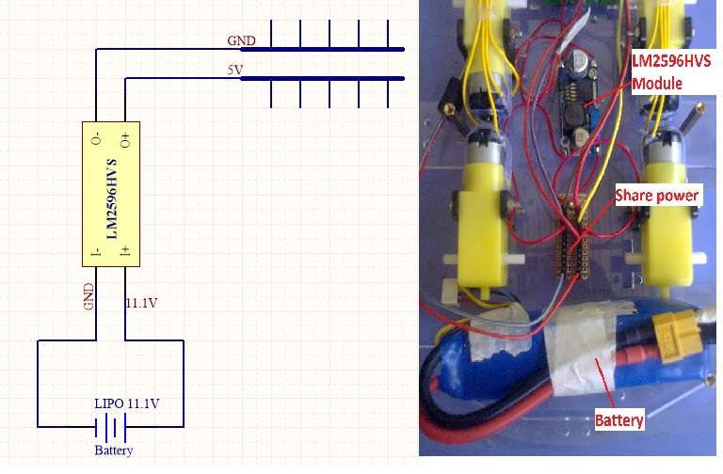
Power System

Slide 29
Motor System

Slide 30
SRF04

Slide 31
Servo Motor

Slide 32
Raspberry Pi and Arduino

Slide 33
Raspberry Pi and Raspberry pi Camera

Slide 34
3. Firmware design
Firmware dataflow diagram

Slide 35
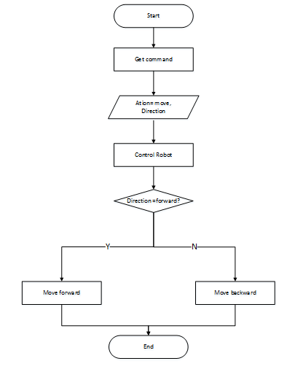
3. Firmware design
Move robot flowchart

Slide 36
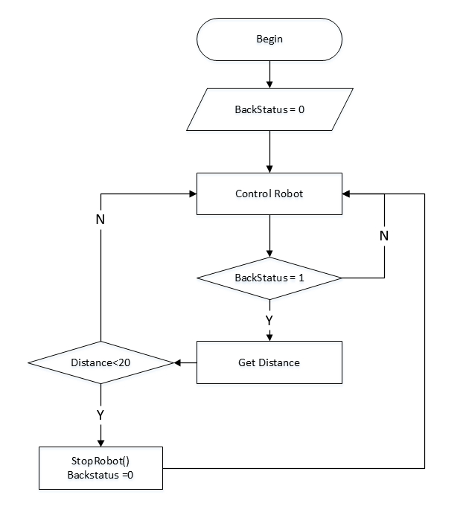
3. Firmware design
Detect obstacle flowchart

Slide 37
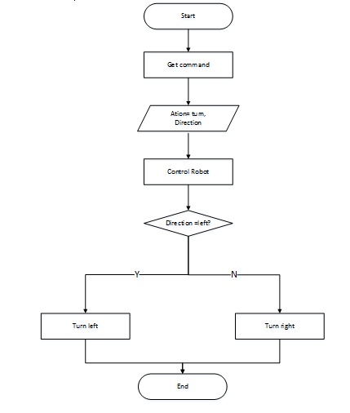
3. Firmware design
Turn robot flowchart

Slide 38
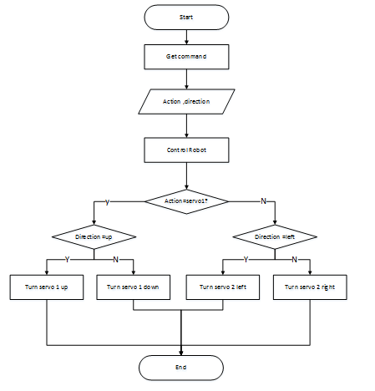
3. Firmware design
Turn servo flowchart

Slide 39
4. SOFTWARE DESIGN
Software dataflow diagram

Slide 40
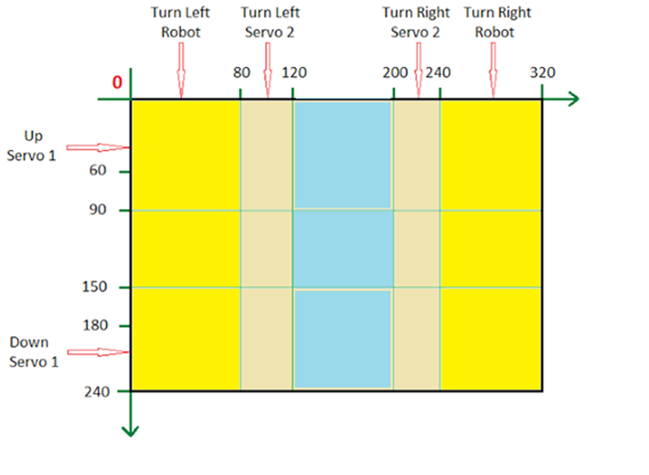
SOFTWARE DESIGN
ROI overview

Slide 41
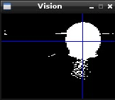
V. Implement
Programing image process with Pi Eye vision
Pros:
simple source code to capture object
Easy to set up and use
Cons:
usually don’t catch right target
depend too much on color
hard to calculate area, because of easy to affect by noise

Slide 42
Programing image process with OpenCV:
Pros:
Reliable
Stable
Easier to calculate area of object
Can be consider as almost completed component
Cons:
Hard to install on RasPi (take 12 hours and easy to get bugged while installing)
Have to configure a lot to catch object
Depend on color too

Slide 43
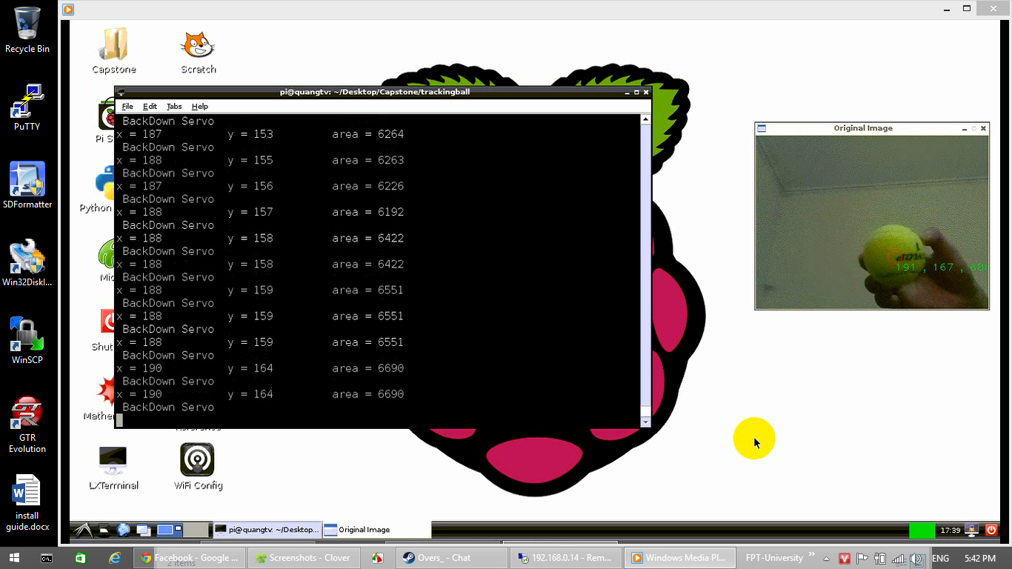
Programing image process with OpenCV:

Slide 44
Programing movement control with Arduino IDE :
The process is work good we complete earlier then expect, the Arduino IDE supported everything we need

Slide 45
VI. Testing
Test Plan
Execute Test
Report

Slide 46
1. Test plan

Slide 47
2. Execute Test
Test Case ID | Steps | Expected Results | Actual Result | Pass /Fail | Remarks
CRobot1 | Connect Raspberry Pi, Camera and R4WD Running code Place ball in center of camera Moving ball Up slowly | Servo1 will turn up | Good | Pass
CRobot2 | Connect Raspberry Pi, Camera and R4WD Running code Place ball in center of camera Moving ball Down slowly | Servo1 will turn down | Good | Pass

Slide 48
3. Report
No. | Module code | Pass | Fail | Untested | N/A | Number of test case
1 | R4WD, SRF04, Servo | 7 | 0 | 0 | 0 | 7
2 | Tracking Ball | 2 | 0 | 0 | 0 | 2
3 | Control Robot | 4 | 0 | 0 | 0 | 4

Slide 49
VII. Conclusion and perspectives
Conclusion
Product:
Robot running well.
Components are covered.
Working in group
Not good.
Perspectives:

